Slide 1

Information security is everyone’s responsibility
Information security training for DCJ’s contracted service providers.
This is a general guidance only. You should review your data and security risks regularly. You are responsible for protecting the data you hold and for complying with applicable laws and policies.

Slide 2
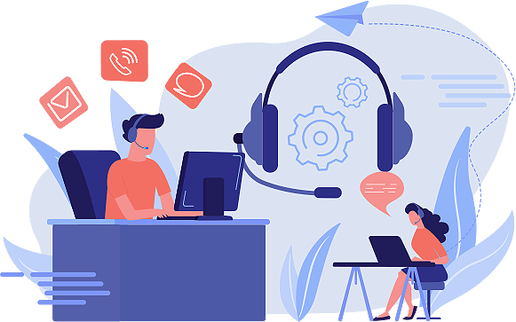
Welcome
This training module outlines your responsibilities as a Department of Communities and Justice (DCJ) contracted service provider, along with a number of practical things you can do to achieve and maintain a strong information security culture across your organisation.

Slide 3


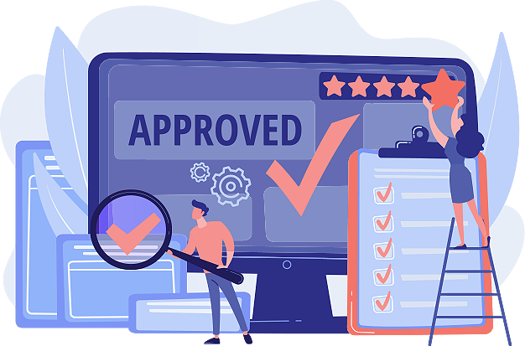
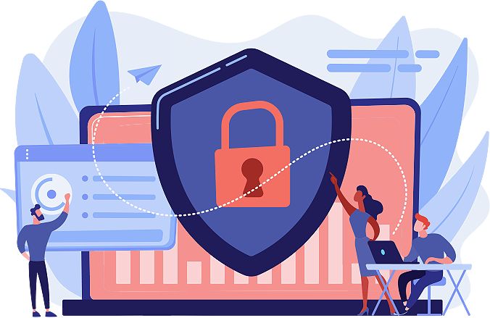
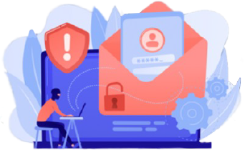

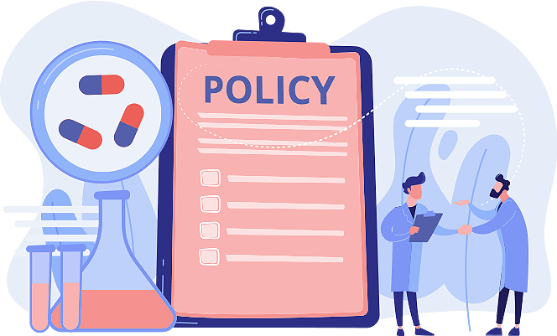
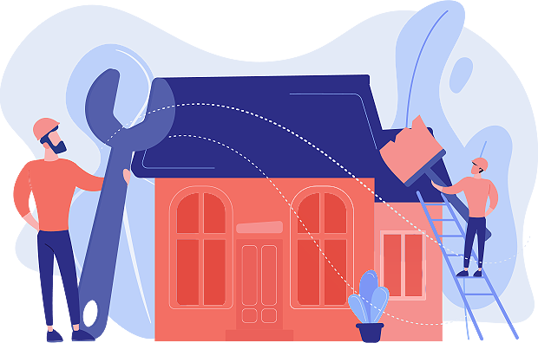
This information security training outlines the following topics:
Obligations and responsibilities of DCJ contracted service providers
Password management
Cyber threats
Situational awareness
Steps to take if there is a security incident
Tools and resources to help you and your organisation

Slide 4
What is information security training?
Information security training helps you gain the knowledge necessary to perform your job in a safe and efficient manner, and ensures you uphold your responsibilities and obligations as a DCJ contracted service provider.
This helps you:
be more informed about security threats
be more sceptical about what you receive in emails
consider the risks before engaging with potential dangers. For example, clicking on an email with malicious links

Slide 5
Your obligations for maintaining secure information
DCJ’s contracted service providers have responsibilities and obligations to maintain secure information, and notify us when an actual or suspected information security incident is detected. This policy applies to all electronic and physical data storage.
Your organisation holds private information about DCJ, and clients and families who access the services you deliver on our behalf.
You’re required to comply with the requirements of relevant legislation and policy, as well as the provisions of your contract with us, in relation to privacy, information management and your information and communications technology (ICT) systems.

Slide 6
What do we expect from you?
We expect your organisation to establish, maintain, enforce and continually improve policies, procedures and safeguards to protect the personal and confidential data held in your electronic and physical files against unauthorised access, use, disclosure, destruction, loss and alteration.
If your organisation detects an actual or suspected information security incident, you’re required to notify DCJ and keep us informed of progress until its resolution.
You can find out more about the information security obligations and responsibilities of DCJ contracted service providers on the DCJ website.

Slide 7


Now that you know your responsibilities and obligations, let’s take a moment to talk about password management.

Slide 8
Password management
This section provides information on the importance of passwords, creating secure passwords, and common mistakes to avoid when creating passwords.

Slide 9
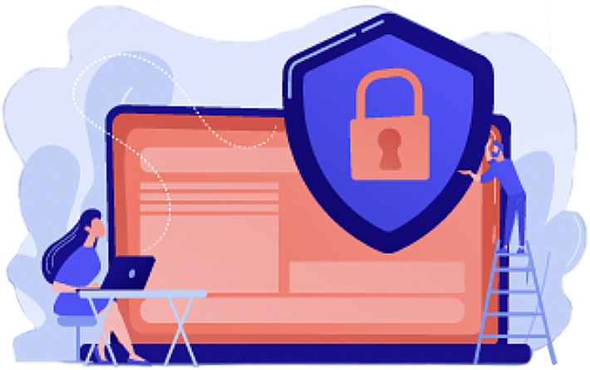
Why are your passwords important?
Your security card at work doesn’t allow you access to your home or gym, only your work. So, if someone were to have access to your card, they would only be able to get into one place, unless your card was reported lost or stolen beforehand.
Your online account password is like an access card. You have to take all measures to prevent your account from being misused by someone else for malicious activities.

Slide 10

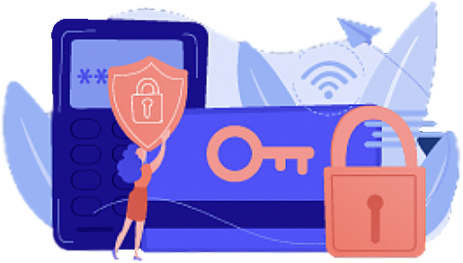
How can you ensure your password is secure?
Use 10 characters or more in length
Use a combination of uppercase and lowercase letters, numbers, and special characters
Change passwords every 60 days
Use different passwords for each of your accounts when required
Implement two-factor authentication in addition to your passwords, for an extra layer of security
Don’t incorporate common words like days of the week, greetings like ‘hello’ and names into your passwords
Don’t use recycled elements like ‘Monday1’ and ‘Monday2’
Don’t keep passwords on post-it notes, or in Excel, emails or Word documents
Don’t use your work email and password to sign up to non-work related activities

Slide 11

A secure password has at least 10 characters, and a combination of text, numbers, and special characters.
For example, u8e^7e,@!v

Slide 12
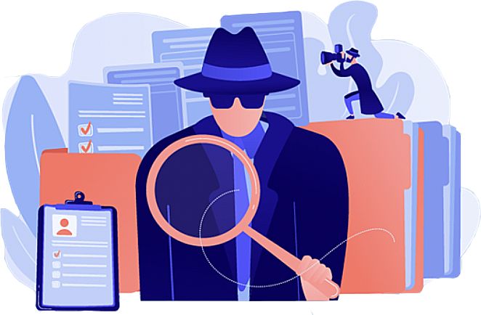
Cyber threats
This section explains some of the most common types of cyber threats you might come across so that you can be prepared, informed and alert.

Slide 13
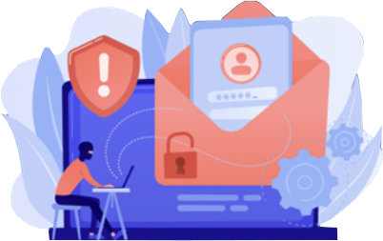
What is phishing? And how does it happen?
‘Phishing’ refers to dodgy emails, calls or messages that are devised to gain access to personal information, sensitive data and money from recipients.
Online scams are also known as phishing. Once a victim has 'taken the bait',
the attacker could then use the victim's identity to conduct illegal activities or access sensitive information that could compromise an organisation's security information.
Phishing is a form of deception. Attackers contact their targets while posing as a legitimate, reputable business, organisation or individual you think you know and can trust.

Slide 14
Where do phishing scams happen?
Phishing doesn’t just happen in emails. It can also be by telephone, text message or social media.
Look out for unexpected attachments, requests to provide login credentials, requests for money or changes to bank accounts.

Slide 15
Anyone can be a target of phishing
Attackers can target one specific person or send out phishing scams to thousands of people.
However, phishing tactics designed to trick staff members commonly include:
claims of being someone senior in the organisation
offers of something in short supply or promises of good deals
a sense of urgency, that there is limited time to act
references to current events or news stories

Slide 16
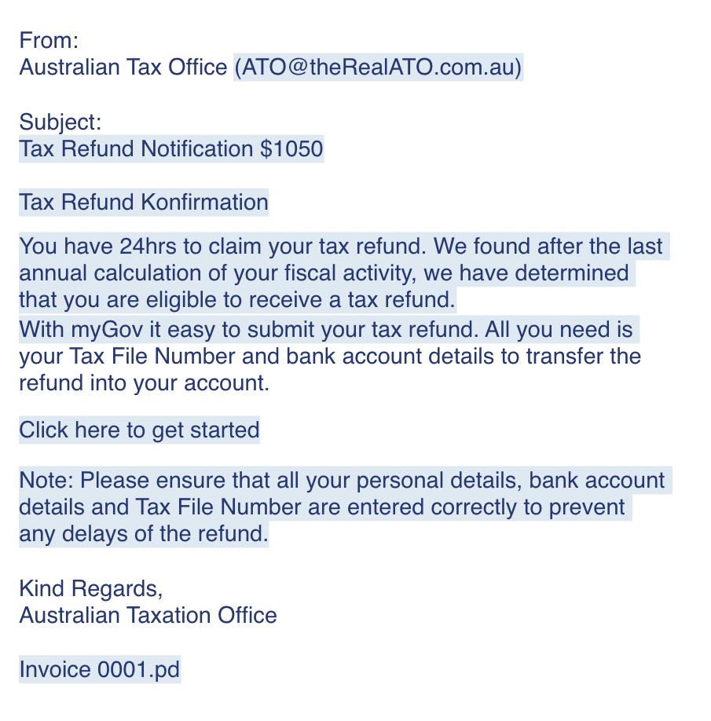
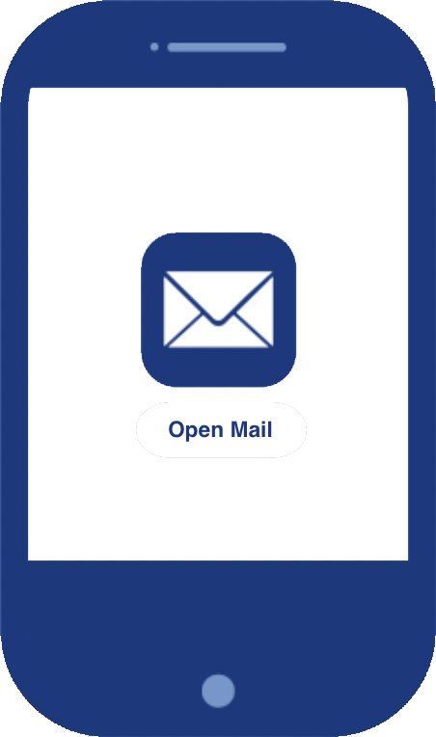
Let’s take a look at a phishing email
A phishing email usually has the following characteristics:
an unfamiliar email address, which differs slightly from the legitimate address
promises of free goods or services in the subject line
poor spelling and grammar with limited to no context
clickable links to unfamiliar web or email addresses
attachments with generic naming conventions

Slide 17
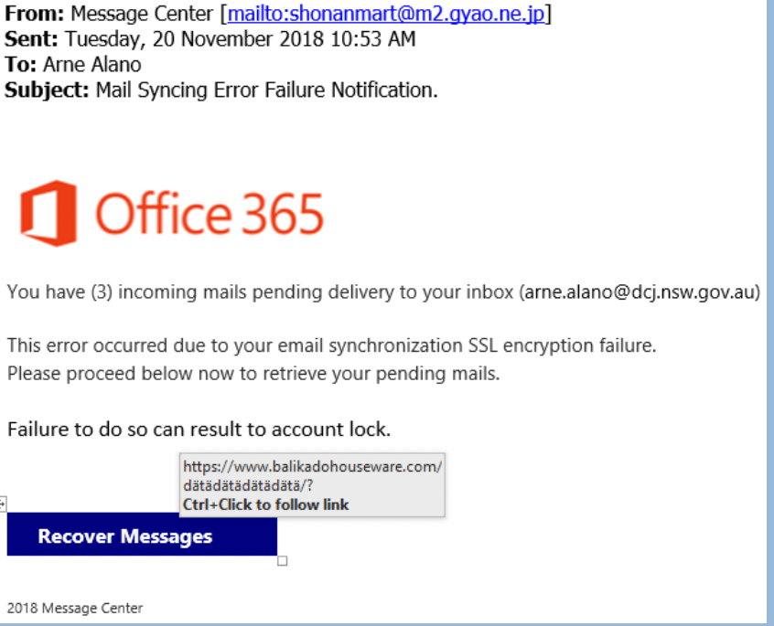
Looks like we caught another one
How do we know this is a phishing email?
There is no personalised greeting
The email is poorly written; for example, ‘you have (3) incoming mails’
There is a clickable link that does not match the domain of the company the attacker is impersonating

Slide 18
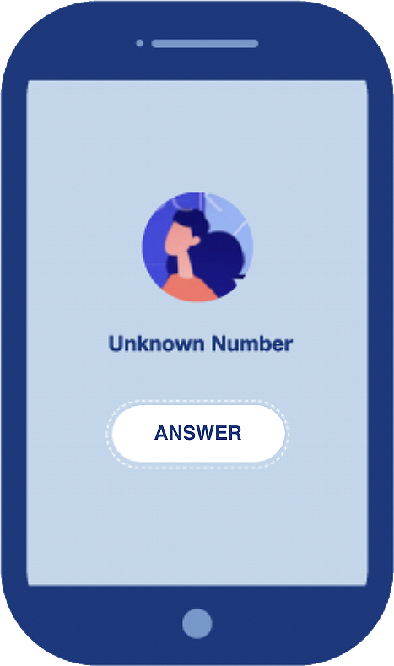


Now, let’s answer this phone call
Hello. My name is Alicia. I am from your IT department. During an audit this morning, I identified your personal banking details have been compromised.
To protect you from scammers, I need you to log in to a website and enter your banking credentials.
Can you provide the required details?
This is an attacker masquerading as a department leader phishing for personal information.

Slide 19
Don’t take the bait
If you’re unsure if a call, email or text message is actually from a trusted organisation, search for the official website or call their listed phone number.
Don’t use contact details provided over the phone or in messages as these may be fraudulent.

Slide 20
What is malicious software (malware) and who creates it?
Malware is a type of software that is designed to damage and disrupt a computer or server, or gain unauthorised access to information. It includes viruses, Trojans, spyware and worms.
Anybody can create malware. Cyber criminals can be anywhere in the world, and can target anyone in the world.

Slide 21
Why is malware used?
Criminals use malware to find out important information such as bank or credit card details or passwords. They can also use it to gain control of or spy on a victim’s computer. Malware attacks put victims at risk of:
fraud
identity theft
sabotage and disruption of business
data and intellectual property theft

Slide 22
How can you prevent a malware attack?
Malware attacks can occur at any time, so it is important you take protective measures including:
don’t open suspicious attachments or click on suspicious links
keep your devices updated and turn on automatic updates
apply access controls by limiting administrator privileges, and controlling user access on your devices
regularly backup your data, so you can recover any information you lose if you experience a malware attack

Slide 23
What is ransomware and why does it occur?
Ransomware is a type of malware that works by locking up or encrypting your files so that you can no longer use or access them, and can even stop your devices from working. Usually, an attacker will then demand a ransom to restore the victim’s access or prevent the publication of data.

Slide 24
How does ransomware work and who is targeted?
Ransomware can affect your devices through opening suspicious emails, links or attachments, visiting unsafe websites, and having inadequate security on devices and network servers.
All kinds of organisations can be targeted, but small businesses are particularly vulnerable. Many small businesses are often less security conscious, are less likely to implement cyber security measures, and spend less on cyber security measures, that could help prevent and recover from ransomware.

Slide 25
Never pay a ransom
Paying a ransom will not guarantee your files will be restored and will not prevent any stolen data being published or used in other crimes.
You may also increase the likelihood of being targeted again.

Slide 26
Situational awareness
This section provides information on:
remote work practices
human error
tailgating

Slide 27
Working remotely
As an employee of your organisation, you may be able to work remotely.
When working remotely, you must take appropriate measures to ensure you are connected to a trusted network and you protect the confidentiality of information you are using.
For example, be cognisant of the people around you so that they can’t see your screen or see you entering sensitive information.

Slide 28
How can you work safely while working remotely?
Do not connect to untrusted networks
Be aware of people next to you
Avoid entering personal information and passwords onto to any site
Limit file sharing, including Bluetooth
Only log in to sites if they are secure, as they are more likely to protect the integrity and confidentiality of data. You can tell a site is secure when the address starts with ‘https’, or your browser displays a padlock icon beside the address
Use your smart phone as a private hotspot if you are required to work in a public space

Slide 29
Everyone is human, and so are errors
While cyber criminals pose a significant threat to the information security of organisations, simple mistakes can have big consequences, and can lead to information falling into the wrong hands.
Data breaches caused by human error are on the rise, and it is everyone’s responsibility to take extra care when handling private information, to make sure it stays private.

Slide 30
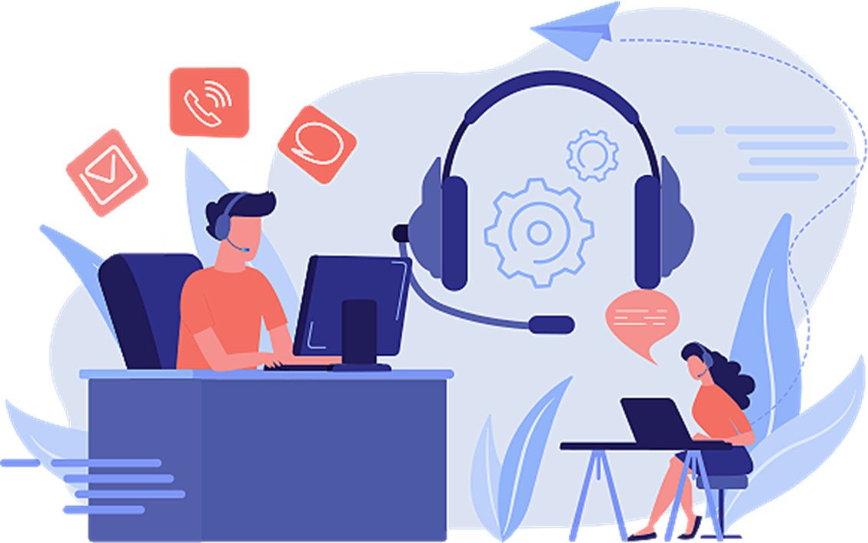
How can you avoid human error?
Don’t send sensitive information unless it is absolutely necessary
If you do need to send sensitive information to someone else, always check the email addresses of recipients to confirm you are sending the information to the right person
Watch out for accidentally clicking ‘reply all’ to emails
When forwarding emails to new recipients, consider the contents of the email chain and remove anything that doesn’t need to be shared
Check email attachments for confidential information before sending
Send emails using ‘bcc’ where necessary to keep recipients and their email addresses confidential

Slide 31
Tailgating
Information security attacks do not only occur online. Physical security breaches can affect businesses and often go undetected.

Slide 32
What is tailgating and how does it happen?
Tailgating is a physical form of security breach that occurs when an unauthorised person seeks to gain access to a restricted area.
A tailgater may walk through a secure passage behind an employee, ask an employee to hold the door open for them, pretend to be delivering a package, or lie and say they forgot their own pass.

Slide 33
Who tailgates and why do they do it?
Gaining physical access to a site is a technique fraudsters use to implement further actions aimed at attacking an organisation.
Tailgaters can include:
disgruntled former employees
people with personal issues with certain employees, or the company
individuals trying to gain access to a company’s computer systems in order to do damage, or for other corrupt purposes
individuals who work for an organisation, in order to compromise, steal, change or destroy information of other organisations, companies or individuals

Slide 34

Let’s take a look at how this tailgater gained access to a restricted office building
Steve walked into a corporate office wearing a suit, to blend into the environment.
He was able to use an elevator to reach the level he wanted, but he needed to swipe a pass to get in. So, Steve knocked on the door.
Sarah saw Steve and assumed he was an employee because of the way he was dressed so she opened the door and let him in.

Slide 35
How can you close the door on tailgaters?
Ensure doors to secured areas are closed immediately
If someone asks to borrow your access card to get into the office, do not give it to them.
If you see a suspicious or unfamiliar person loitering around an access control point, or following you or someone else through an access control point without visible identification, challenge them if you feel that it is safe to do so. Otherwise, immediately report them to your supervisor, a security officer, or anyone else on site that you feel might be able to assist you in this circumstance.

Slide 36
So, when do I need to involve DCJ?
Our interest is in incidents that involve information about DCJ and its staff, personal information about clients and their families, and related program data that is held by your organisation for the services you’re contracted to provide for DCJ.

Slide 37
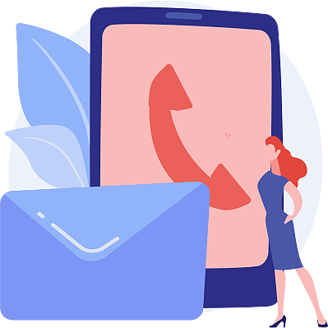

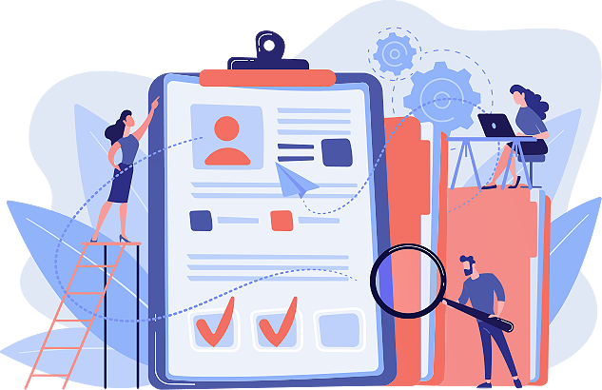
What do I do if I detect an actual or suspected information security incident?
1.
Notify DCJ of an actual or suspected security incident
2.
Investigate the information security incident and notify DCJ of early findings

Slide 38
1. Notify DCJ of an actual or suspected security incident
It is important that your organisation does not delay in providing advice of an information security breach that involves DCJ data, client or program information and that this advice is made as soon as it is detected.
This allows DCJ to assess the impact on systems and client information, and to provide support to you or identify where action needs to be taken by DCJ.

Slide 39
2. Investigate the information security incident and notify DCJ of early findings
Within 48 hours of notifying DCJ, you’re required to undertake an early investigation of the information security incident and notify your lead DCJ contract manager of the findings, in writing.
Your report of the early investigation and its findings must include:
a description of the incident and its potential consequences
details of lost or potentially compromised client information/data
actions you have taken or planned to manage or remedy the information lost or compromised
any actions required to ensure any disruption to ongoing service delivery is minimised.

Slide 40
What happens next?
What you need to do, and the actions we take, will depend on the nature and seriousness of the incident, as well as any requirements specified in your contract with us.

Slide 41
What DCJ does after you notify us of an incident
If the incident is serious and involves a cyber-attack or breach of your organisation’s ICT systems, we may have to temporarily restrict your organisation’s access to DCJ’s electronic systems.
DCJ may actively work with you to manage the incident, and if other DCJ stakeholders need to contact you to obtain further information and/or to provide assistance to you, it will be done in consultation with your lead DCJ contract manager.
If client data is involved, your lead DCJ contract manager will work with your organisation to decide on the appropriate action to be taken to inform the clients affected, and inform you of what other responses we’ve commenced.

Slide 42
Additional actions may be required
Depending on the nature of the incident, we may ask you to undertake an information security assessment. If necessary, we’ll work with you to determine the most appropriate steps to take to ensure program data and client information are protected.
For serious incidents, we may document the remedial actions required in a formal improvement plan, which we’d work with you to develop.
In less serious cases, we may agree to an informal plan of improvements to your information security, and monitor your progress at regular contract meetings.

Slide 43
Thank you
Congratulations. You have completed DCJ’s information security training for contracted service providers.
Make sure to download and print our top 10 take-aways for Information Security here.

Slide 44

Resources to assist you
These resources will assist you to understand NSW and Commonwealth privacy laws, your obligations and responsibilities as a DCJ contracted service provider, and give you more information security tactics to protect your organisation.
Legislation
NSW Privacy and Personal Information Protection Act 1998
NSW Government Information (Public Access) Act 2009
NSW Health Records and Information Privacy Act 2002
Privacy Act 1988 (Cth)
Our website
Maintaining secure information and notifying us of information security incidents
Think you can catch a phish?
Put your knowledge to the test by taking the ACSC quiz.
Australian Government Australian Cyber Security Centre (ACSC)
Small Business Cyber Security Guide
First Nations Resources

