Slide 1
Family and Community Services (FACS)
Sharryn Wheeler, Director Community Services Western NSW
16 August 2016

Slide 2
FACS Western NSW District – overview
Western NSW District covers 55% of the land mass of NSW with approximately 280,000 people
Large geographical areas with high levels of socio-economic disadvantage
1271 children and young people living in out of home care (OOHC) placements
780 children and young people case managed by FACS
Approx. 60% of these children and young people in OOHC are Aboriginal
To date, approx. 45% of children and young people have been transferred to the non-government sector
Western NSW is supported by 2 Directors ( Central West & Western NSW). 6 geographic Groupings with 14 Community Service Centres. Realigning with Murrumbidgee and Far West.
Notes:
SHARRYN
Large geographical area to cover
High levels of disadvantage
Note the 60% transferred to NGOs includes a proportion where FACS still retains case management responsibility

Slide 3
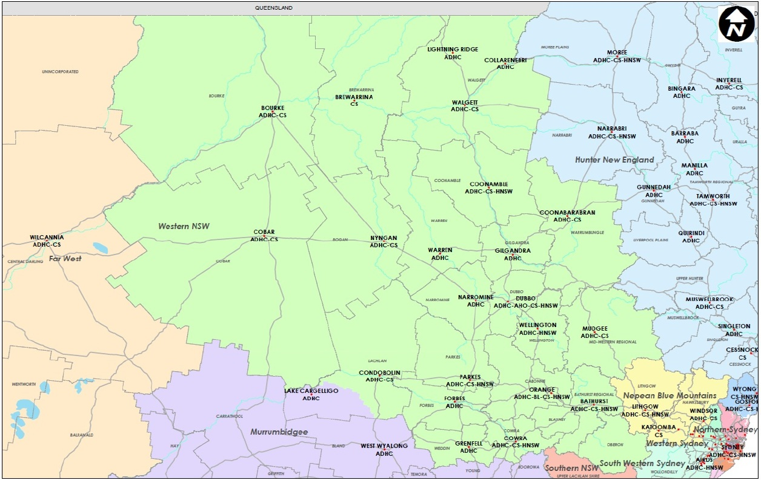
FACS Western NSW District
The Department of Family and Community Services (FACS) delivers services to some of the most disadvantaged individuals, families and communities in NSW – OOHC distribution
24 CYP
92%
24 CYP
96%
24 CYP
92%
WMCPU
27 CYP
96%
19 CYP
100%
71 CYP
79%
19 CYP
100%
15 CYP
93%
162 CYP
86%
62 CYP
59%
25 CYP
85 %
32 CYP
68%
58 CYP
60%
51 CYP
59%
105 CYP
56%
Notes:
These figures are from MAY Baseline data- however they show the distribution of CYPO in OOHC
What does OOHC look like in Western NSW??
Of the 749 CYP in OOHC - breakdown is as attached
Dubbo CSC has highest number of CYP in OOHC, followed by Bathurst and Orange
Aboriginal CYP – not sole focus but we need to be mindful and think about our high OOHC population as its critical in delivering OOHC services to Aboriginal people and maintaining positive relationships .
7 CSC’s within WD are at above 80% – or at 100% Aboriginal OOHC population ( CSC’s include Bourke 92% , Brewarrina 96% , Coonabarabran 86% , Coonamble100% , Cobar 100% and Nyngan 93% )

Slide 4
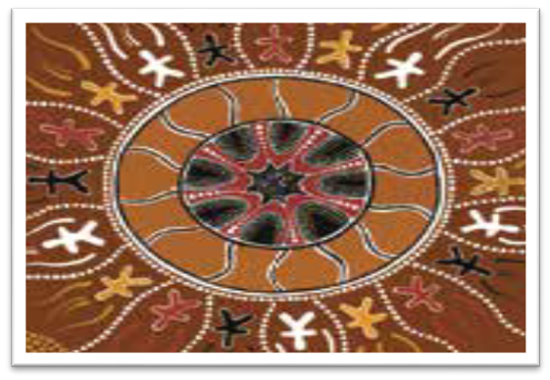
FACS Western NSW District – our challenges
Workforce:
Geography and travel needed to see families
FTE 142 Casework staff - Sept 2013 24% vacancy, July 2016 decreased to 2% vacancy rate
Recruitment and supporting a sustainable workforce
NGO Sector:
Slow OOHC NGO sector growth
1 Aboriginal OOHC provider (Ngurambang/
Uniting in Dubbo)
Entries into care
Entry into care trending UPWARDS (since March 2015, 294 CYP)
Limited OOHC placement availability, particularly kinship carers
Notes:
Western NSW has a fragile service sector – only 1 Aboriginal OOHC Provider ( Dennis will discuss further)
We have high volume – complex communities and large distances to travel to service our communities.

Slide 5
FACS Western NSW District- our focus areas
Guardianship :
Focus on permanency planning for CYP. 118 YP under Guardianship.
Project Officer dedicated to this work. 3 Guardianship Final Orders made since project commencement, with 7 to be finalised.
Leaving Care After Care:
116 YP who are 15+. Planning needs to occur earlier
Joint planning with Disability Services for YP with disabilities and complex needs
NGO transfers:
Ongoing process. Most NGO contracts are at capacity with limited growth options.
Full transition not anticipated to occur for another 5-10 years.
Notes:
Guardianship
11 external carer assessments (which included the assessment of 28 children);
12 x S90’s currently submitted and underway at Court (re Guardianship); ongoing investigation (with carers, children, parents); obtaining and reviewing Ch16A information; obtaining and reviewing medical clearances/information; travel
• Intent/benefits of Guardianship - For carers who are assessed against suitability criteria to be able to meet the needs of children in their care without the ongoing support of FACS. It enables them to be able to move forward with everyday and long term requirements for children without the intrusion/intervention of FACS; to provide greater stability for children and families; to take away the stigma of foster care/OOHC
• Eligibility - Carers who had been parenting without the assistance of FACS for (in some cases, many years); carers who had stable and communicative relationships with parents (thus ensuring ongoing contact and appropriate relationship building); carers who are able to maintain healthy and safe boundaries between the parents and children in care; relative or kin; no current concerns for children/families; parents who have readily conceded to orders and future plans for the children. Important to note that Guardianship will also be considered for carers who been receiving a regular service from FACS as well
- G’Ship - 118 YP ( western 71 of those)
- LCAC - HIGH NUMBERS OF YP AGING OUT ( 116 YP ARE 15+ IN OOHC ACROSS DISTRICT)
- Transfers ( interstate & districts) TOTAL 224 ( WESTERN 138 / CENTRAL WEST 86)

Slide 6
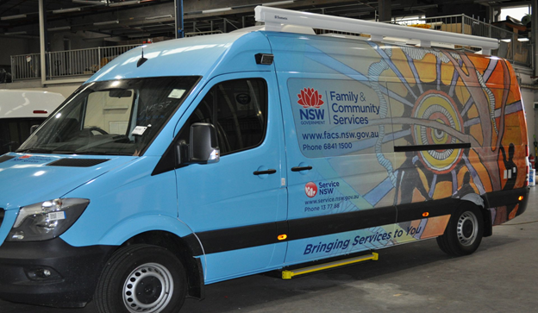
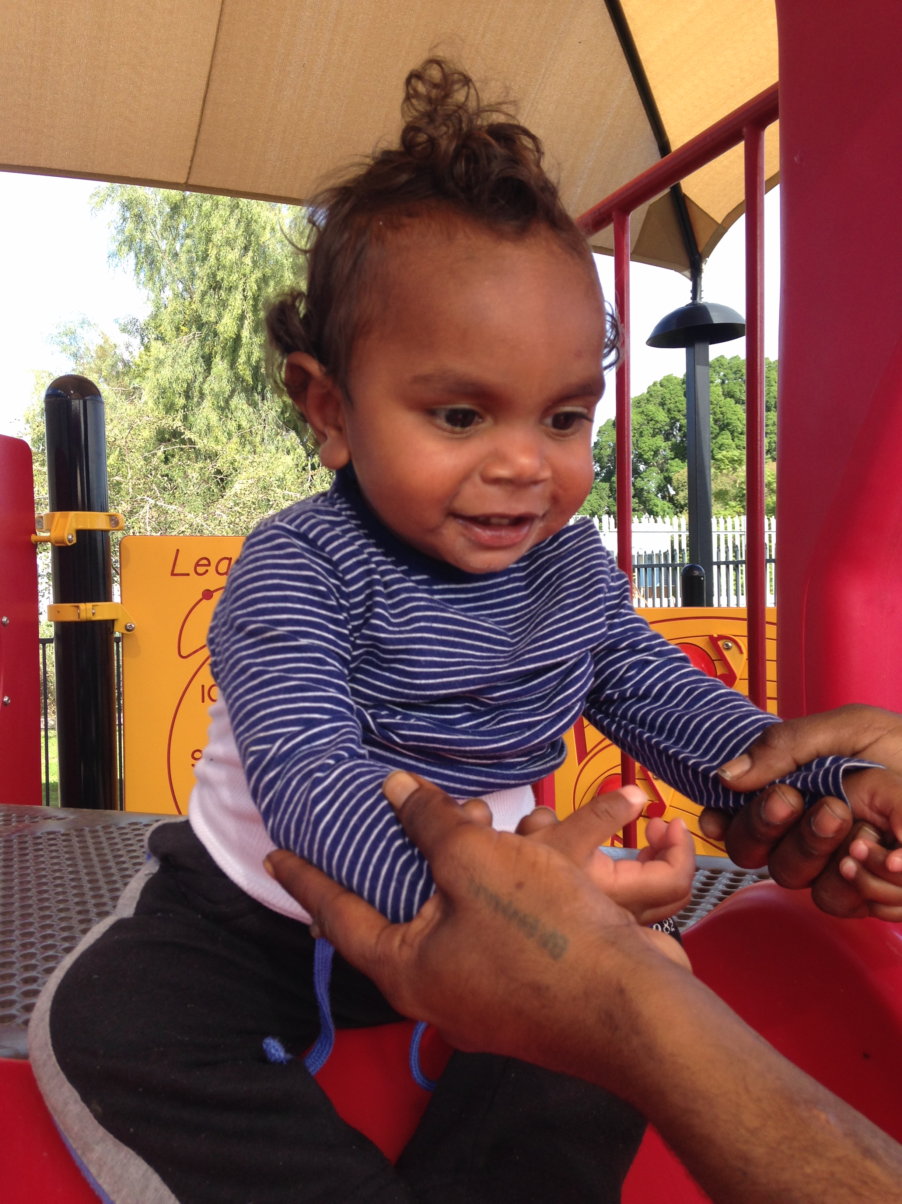
Western NSW key initiatives to support better outcomes for children and young people
Aboriginal Community Protocols
Mobile Child Protection Unit ( MCPU)
Complex Case Coordination meetings
Finding Families model
Family Group Conferencing
Walgett and Orange Aboriginal Medical Services with FACS – Tripartite Agreement
FACS Mobile Van
Manager Casework Practice Groups
Annual Western NSW Caseworker Conference
Cultural Case Planning
Quality Assurance and Continuous Improvement
(QACI) team
Notes:
Due to the challenges previously spoken about …with challenge comes opportunity to rethink how we deliver business and improve outcomes for the children in OOHC and more broadly the children in the CP system – which results in less children entering care….
Aboriginal Protocols with community
Bourke, Bre, Dubbo, Walgett and Orange
Responding to escalation of risk and also consulting around placement options for children entering care and the need for them to remain in country or explore relative and kin
Each agreement differs and each community have different wants – eg OOHC POP, in / out country / contact / cultural needs / restoration
WD commenced this work prior to GMAR guiding principles and we have been recognized for being progressive in this area and working to strengthen our relationships with the local community.
Cw forum - july last year , September 19/20 this year
These forums allow an avenue to roll out information and exchange practice ideas on what’s working across the district and aligns information from the QA rollout
Tripartite Agreement
This agreement recognises the contribution and commitment of the signed agencies in ensuring improved health outcomes for children and young people in statutory out-of-home-care through a coordinated multidisciplinary model of care that meets all legislative and regulatory requirements.
Work is being undertaken for Condobolin to also have an agreement with AMS within the next 12 months.
FAMILY GROUP CONFERENCING ( since June 2015)
20 referrals, 9 completed, 5 cancelled
15/20 referrals involved Aboriginal families
MOU ABORIGINAL MEDICAL SERVICE – Tripartite Agreement ( Health, FACS & AMS)
2 agreements endorsed 2015 ( Orange and Walgett)
All eligible CYP referred for a health plan
Currently 22 CYP attend Orange Aboriginal Medical Centre
CULTURAL CASE PLANNING ( since Feb 2015)
120 staff trained on cultural case planning
Ongoing training to capture new staff entering FACS
46 cultural case plans have been reviewed , 5 in progress
407 CYP have a cultural case plan (*baseline data May 2016)

Slide 7
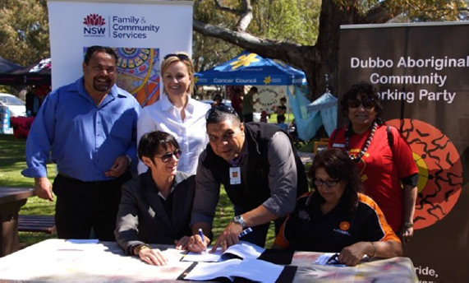
Aboriginal Community Protocols
Protocols developed between FACS and local Aboriginal Community Advisory Groups to assist in identifying suitable kinship carers for Aboriginal children and young people in need of care.
Aim to keep Aboriginal children and young people living within their local community on country and connected with family or kin. Broader function of supporting families before they reach crisis point.
Protocols signed in Dubbo and
Orange. In progress in Bourke,
Brewarrina, Walgett, Condobolin
Protocol sets out how FACS and the Advisory groups work together to ensure
culturally appropriate decision making for Aboriginal children and young people

Slide 8
Mobile Child Protection Unit (MCPU)
Specialist team of up to 10 caseworkers and one Manager Casework based in Dubbo.
Trial commenced in February 2015 to provide more responsive and consistent child protection services across upper western sector LGA’s of Bourke, Brewarrina, Walgett and Cobar
Well received by local caseworkers who work closely with the MCPU team and have more time to provide ongoing support s to families and try and prevent family breakdown
A preliminary evaluation by FACSAR has shown the MCPU show very positive results:
172% increase in completed home visits
90% increase in level 1 ROSH reports seen within 24 hours
Overall 83% increase in proportion of families seen

Slide 9
Questions?

