Slide 1
NSW Health
Ministerial Advisory Council on Ageing Forum
Setting the Scene
James Broughton, A/Director, Aged Care Unit
NSW Ministry of Health

Slide 2
Divisions of responsibility in Aged Care/Aged Health
NSW Government and Australian Government share stewardship for providing care for older people in NSW
services to older people is a shared responsibility
Australian Government responsibilities
Funding, regulatory and policy responsibility for aged care services under the Aged Care Act 1997
Primary health care and Primary Health Networks (PHN) including GPs
National Disability Insurance Scheme (NDIS)
Shared Responsibilities
The funding and delivery of health services to older people
Shared funding of some programs that support the wellbeing of older people e.g. Transition Care Programme and Multi-Purpose Services
State and territory responsibilities
System managers of public hospitals including emergency and non-admitted services, older peoples mental health services and specialist support for complex care in the community
Delivery of a number of Commonwealth funded aged care services
Joint statement to clarify the roles and responsibilities for the delivery of health care for people receiving aged care services
Notes:
Joint statement to clarify the roles and responsibilities for the delivery of health care for people receiving aged care services

Slide 3


NSW Health Strategic Priorities
NSW Future Health Strategic Framework 2022-2032
Supporting healthy ageing to ensure people can live more years in full health and independently at home is a key objective of the.
Ageing Well in NSW: Seniors Strategy 2021–2031
NSW Government’s plan to respond to the opportunities and challenges of our ageing population.
NSW Health initiatives are supporting the goals and objectives set out in the Future Health and Ageing Well Strategies.

Slide 4
NSW Health initiatives that support the Ageing Well in NSW Seniors Strategy
NSW Health

Slide 5
Population Health Programs
Ageing Well and Innovation: NSW Health initiatives supporting the Ageing Well in NSW Strategy
Get Healthy Service providing phone and online information and personalised health coaching https://www.gethealthynsw.com.au/
Active and Healthy including a local exercise directory and online learning https://www.activeandhealthy.nsw.gov.au/
Healthy Eating Active Living NSW social media channels (Facebook and Instagram)
Funding and support to health districts to provide equitable access to prevention activities that meet local needs e.g. Stepping On

Slide 6
Get Healthy Service testimonials
“I feel we achieved a way forward for me to improve my health and mobility that is realistic”.
  Eric, 77.
  “[My health coach] helped me to realise my mind set had changed for the better. It hadn’t occurred to me. Their support and positive attitude was so encouraging”.
  - Lesley, 67

Slide 7
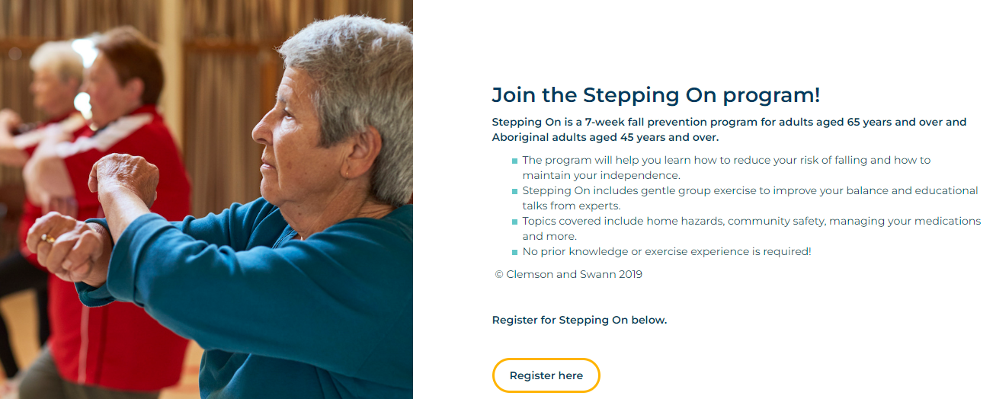
Ageing Well and Innovation: NSW Health funding and support to Local Health Districts
Example initiative being delivered by some LHDs: Stepping On Program
7-week falls prevention program for those who have had a fall or are fearful of falling
The program focuses on preventing falls, encouraging active living and maintaining independence.
Program outcomes show participants had improved mobility, leg strength and balance following the program.

Slide 8

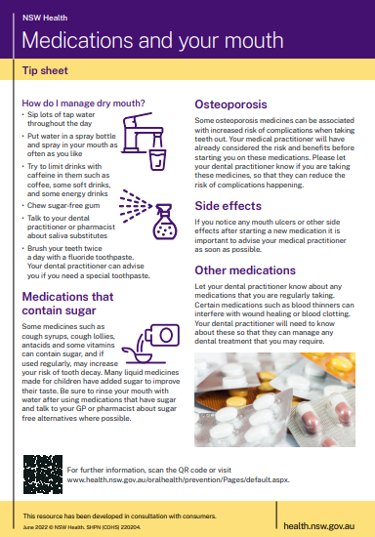
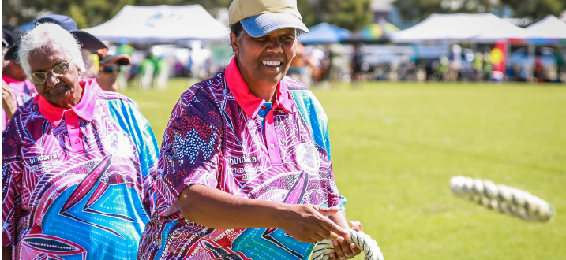
Additional NSW Health initiatives under the Ageing Well in NSW Strategy
Mental health and suicide prevention programs for older people with complex and acute needs
Supporting health and healing for Survivors of the Stolen Generations in NSW
Additional activities in the Ageing Strategy

Slide 9
Additional programs that sit outside the Ageing Strategy – delivered by NSW Health
NSW Health

Slide 10
Australian Government-subsidised Aged Care Services
Keeping people healthy and out of hospital
Commonwealth Home Support Programme (CHSP)
Transitional Aged Care Program (TACP)
Support at Home (SaH)
Residential Aged Care (RAC)
State Government Residential Aged Care Facilities (SGRACF)
Multi-Purpose Services (MPS)
Aged Care Assessment services
Aged Care Assessment Program (ACAP)
Regional Assessment Services (RAS)
Australian National Aged Care Classification (AN-ACC)
Post discharge therapy-based program following an acute incident to restore capacity and support living independently in the community
Joint funding between Commonwealth and State
NSW Health also provides
a range of hospital avoidance programs e.g. geriatric outreach services and ambulance secondary triage

Slide 11


Thank you

