Slide 1
Oral health and ageing
Australian Dental
Association
NSW Branch
Dr Jodie Olivier
Vice President ADA NSW

Slide 2
The number of teeth affected by tooth decay increases with age
Source: National Study of Adult Oral Health 2017-2018

Slide 3
Older people have higher rates of gum disease
69%
51%

Slide 4
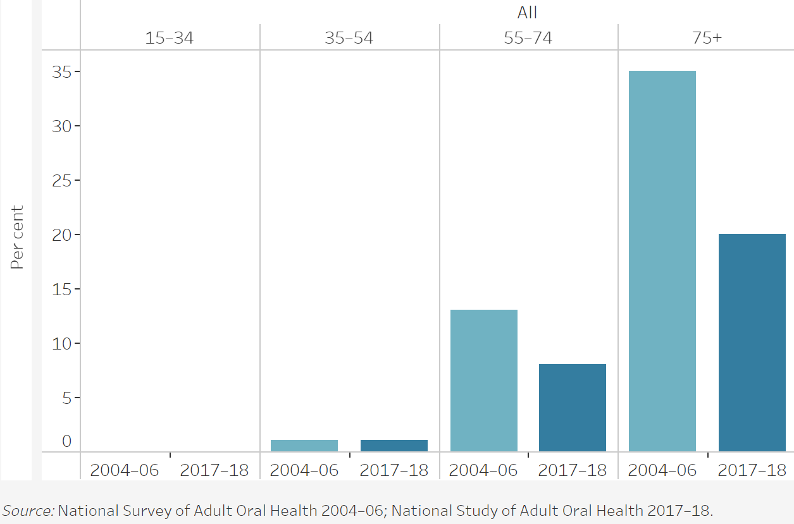
Older people have higher rates of tooth loss but are keeping their teeth for longer
Complete tooth loss
20%
8%

Slide 5
Oral health facts
The population is ageing
Oral health deteriorates with age
The majority of dental disease is due to tooth decay and gum disease
Oral health is linked with general health
Those who attend for regular dental check-ups have better oral health than those who only attend when there is a problem
The majority of dental costs are borne by the individual

Slide 6
Factors affecting oral health in older people
Accumulated dentistry
Diet and oral hygiene
Medical history
Reliance on others
Accessibility
Cost

