Slide 1

What is driving Aboriginal adult incarceration in NSW?
Workshop on Target 10: reduce the rate of Aboriginal adult incarceration

Slide 2


Justice system targets
      Adult
      incarceration
      Youth
      detention
      Domestic
      violence
10
11
13
By 2031, reduce the rate of Aboriginal* adults held in incarceration by at least 15%
By 2031, reduce the rate of Aboriginal young people (10-17 years) in detention by 30%
By 2031, the rate of all forms of family violence and abuse against Aboriginal women and children is reduced at least by 50%, as progress towards zero
Target 10 cannot be met without intervention
This presentation shows the drivers of adult incarceration leading up to 2019 – the reference year for the targets^
Targets 11 and 13 will be covered in a separate workshop
Target 11 can be met with less intervention, as Aboriginal youth detention is trending down
Trends in domestic violence are included in this presentation as these are relevant to Target 10
^More recent data are less reliable due to the impact of the COVID-19 pandemic on the justice system.
*Aboriginal includes Torres Strait Islander people

Slide 3

Trends in the rate of Aboriginal imprisonment
From 2006 to 2019
Aboriginal Imprisonment rate rose 39%
Non-Aboriginal rate rose 15%
In 2019 Aboriginal adults were 12 times more likely to be in prison
From 2006 to 2019
Aboriginal female Imprisonment rate rose 29%
Non-Aboriginal female rate rose 17%
In 2019 Aboriginal Women were 16 times more likely to be in prison
Aboriginal men were 9 times more likely to be in prison than women
Notes:
Reference:
ABS; https://www.abs.gov.au/statistics/people/crime-and-justice/prisoners-australia/latest-release

Slide 4
Snapshot of the 3,650 Aboriginal adults in custody in Feb 2020
1 in 25
Aboriginal men are in prison
62% reoffend within a year
26%
in Out of Home Care as a child
66%
prior DV offence
39%
first custody episode before 18
82% current drug problem
60% reported at risk of serious harm as a child
92% prior custody episode
33% new custodial sentence within a year
26%
have a child in Out of Home Care
8
median prior custody episodes
33%
current alcohol problem
12
median prior court appearances
66%
didn’t complete grade 10
60%
first court appearance before 18
13% diagnosed active psychosis
9% Female
91%
male
43%
sentence length of a year or less
59% never been employed a full year
33
average age
16
median age at first court appearance
42% receiving mental health treatment
30%
moved residence 3+ times in a year
Notes:
Notes:
All data (except for reoffending data and proportion of total Aboriginal adults) is based on Aboriginal adults in custody in February 2020 – population size: 3,652
Reoffending data is for the February 2019 release cohort

Slide 5
Target 10 in the NSW context
Aboriginal adult incarceration rate per 100,000
Continuation of historical trend* - up 34%
2,600
2,488
2,400
10+ times the
non-Aboriginal rate
2,200
2,000
1,855
1,855
2019 NSW incarceration rate
1,800
1,577
1,600
Closing the Gap target: reduce incarceration rate by 15%
1,400
1,200
1,000
2011
2013
2015
2017
2019
2021
2023
2025
2027
2029
2031
Projected NSW Aboriginal prison population - individuals
Continuation of historical trend* – up 69%
6,000
5,770
5,000
25% of the total prison population
4,300
2019 NSW incarceration rate – up 26%
4,000
3,419
3,000
3,660
Closing the Gap target: reduce incarceration rate by 15%
2,000
1,000
2011
2013
2015
2017
2019
2021
2023
2025
2027
2029
2031
*Unpublished statistical forecast based on trend in risk of imprisonment per population between 2006 and 2019
Notes:
Notes:
The incarceration rates differ slightly from the rates presented by the Productivity Commission. Work to streamline the rates is underway
References:
Data source: ABS
BOCSAR internal data reference: \\SYDSJWFP01.internal.justice.nsw.gov.au\STJA-BCS\Workgroup\Insights\JIA\JIAs - workings\21-20126 Closing the Gap\21-20332 Workshop 1 presentation\Adults - target 10\Data\20200603 Aboriginal imprisonment time series (projections & targets).xlsx

Slide 6





Summary: key drivers of Aboriginal adults in custody
Prison population increasing
More violent & breach offenders
More legal
actions
Increase in remand & bail breaches
High
imprisonment
rate
Total population up 61% in 10 years
Remand is growing faster than sentenced custody: up 143% in 10 years
Violent offences made up 75% of the increase in sentenced custody & 66% of the increase in remand (in 5 years)
Justice procedure offences made up 27% of the growth in sentenced custody
Proven appearances rose 10% in 5 years, leading to more prison sentences
Violent offending made up 27% of the increase in court volume and had relatively high imprisonment rates
The number of Court bail refusals rose by 40%
Bail refusal rates also rose by 22% for Police and 11% for courts
The volume of bail breaches established in court rose but the revocation rate fell
Some evidence of systemic bias
Multiple and frequent contacts with the system from a young age compounded by socio economic factors
Almost half of Aboriginal offenders reoffend within 6 months of release

Slide 7

Aboriginal adult prison population
Share of total growth
COVID-19 restrictions
Sentencing reforms
Change from Mar 2010 to Mar 2020:
Bail Act amendment (show cause)
Total population
Up 61%
1,390 extra people
New Bail Act
Sentenced
Up 36%
625 extra people
Remand
Up 143%
765 extra people
Notes:
Source:
ABS 45120DO001_202012 Corrective Services, Australia, Time Series, March Qtr 2010 to December Qtr 2020
(number of first day of the month)
Excel file: \\SYDSJWFP01.internal.justice.nsw.gov.au\STJA-BCS\Workgroup\Insights\JIA\JIAs - workings\21-20126 Closing the Gap\21-20542 Charts for ASU - policies and Aboriginal people in CJS\Data\ABS data - Aboriginal adults 2010-2020.xlsx

Slide 8
Summary: key drivers of Aboriginal adults in custody
Prison population increasing
More violent & breach offenders
More legal
actions
Increase in remand & bail breaches
High
imprisonment
rate
Total population up 61% in 10 years
Remand is growing faster than sentenced custody: up 143% in 10 years
Violent offences made up 75% of the increase in sentenced custody & 66% of the increase in remand (in 5 years)
Justice procedure offences made up 27% of the growth in sentenced custody
Proven appearances rose 10% in 5 years, leading to more prison sentences
Violent offending made up 27% of the increase in court volume and had relatively high imprisonment rates
The number of Court bail refusals rose by 40%
Bail refusal rates also rose by 22% for Police and 11% for courts
The volume of bail breaches established in court rose but the revocation rate fell
Some evidence of systemic bias
Multiple and frequent contacts with the system from a young age compounded by socio economic factors
Almost half of Aboriginal offenders reoffend within 6 months of release

Slide 9

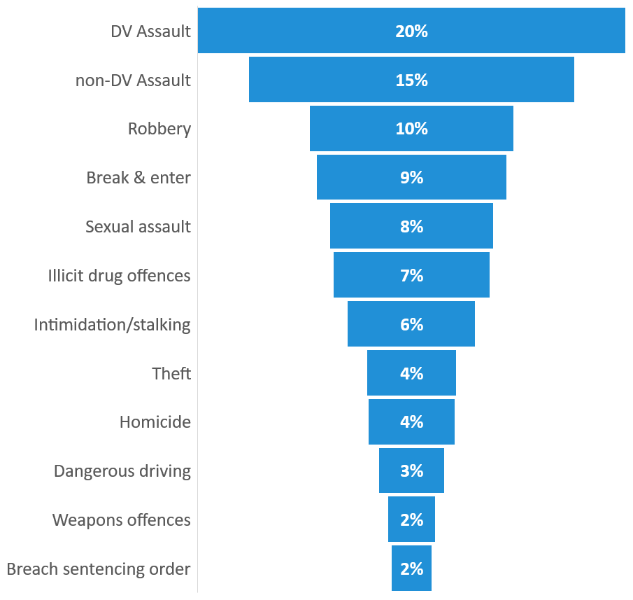
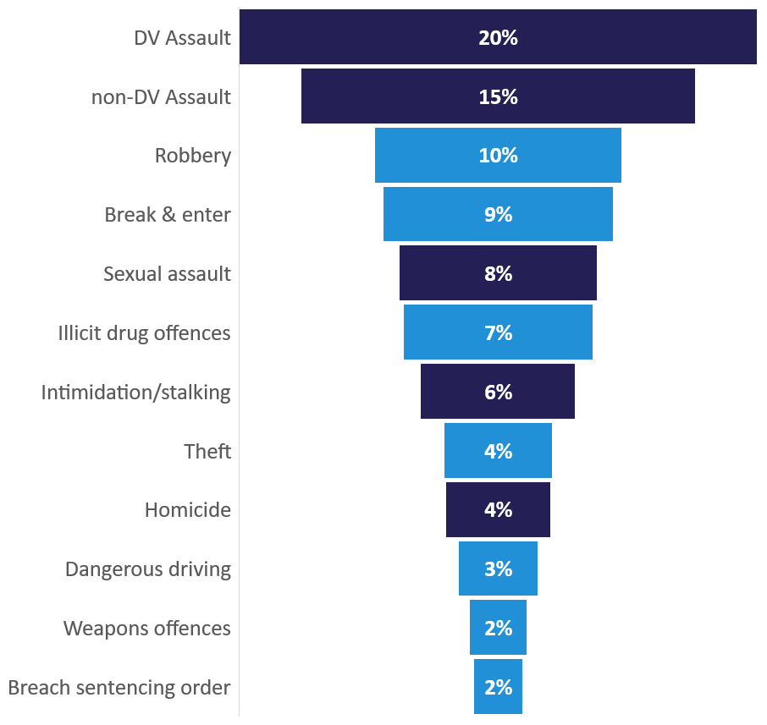
Changing offence types in prison
Aboriginal adult remand: top offences
Change in offence mix, from 2015-2019
Violent
Non-violent
241,
183,
115,
107,
92,
88,
72,
50,
Violent offences are a large and growing share of remand
Of the remand population:
  55% were for violent offences
  29% for DV offences
Over the 5 years to 2019:
  Two thirds of total growth was due to violent offences
  A further 10% was due to drug offences
Remand population Dec 2019: 1,191
Notes:
Notes:
Remand population by offence shows top 91% of total population as at December 2019 (Total pop: 1,191)
Violent offences includes: Assault & related (DV and non DV), intimidation and stalking, abduction & harassment, sexual assault, homicide/murder
DV offences include any offence with a DV element (e.g it includes property damage that is DV related)
DV breakdown not available for custody data prior to 2018 & not represented in second chart
Reference: BOCSAR custody data tables table 2 & dashboard http://reporting.justice.nsw.gov.au/reports/powerbi/BOCSAR/BOCSAR_TESTING/custody_snapshot_comparison
Internal reference 1: \\SYDSJWFP01.internal.justice.nsw.gov.au\STJA-BCS\Workgroup\Insights\JIA\JIAs - workings\21-20126 Closing the Gap\21-20332 Workshop 1 presentation\Adults - target 10\Data\Adult Custody Population Profile- with dv and justice offences breakdown.xlsx
Internal reference 2: \\SYDSJWFP01.internal.justice.nsw.gov.au\stja-bcs\Workgroup\Insights\JIA\JIAs - workings\21-20126 Closing the Gap\21-20332 Workshop 1 presentation\Adults - target 10\Data\Adult Custody Population Profile - December 2019.xlsx

Slide 10
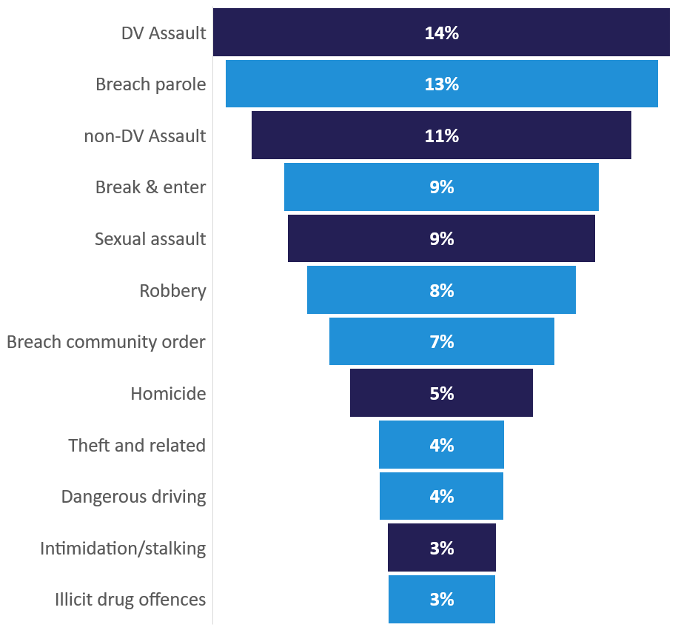
Changing offence types in prison
Aboriginal adult sentenced: top offences
Change in offence mix, from 2015-2019
Violent
Non-violent
316,
299,
263,
218,
213,
186,
156,
127,
Violent and breach offences represent a large share of sentenced custody
Of the sentenced population:
  44% were for violent offences (incl DV assault)
  18% were for DV offences
  20% were for breach of parole or community order
In the 5 years to 2019:
  Nearly two thirds of growth was due to violent offences
  A quarter was due to sentencing order breaches
87,
86,
75,
74,
Sentenced population Dec 2019: 2,312
Notes:
Notes:
Sentenced population by offence shows top 91% of total population as at December 2019 (Total pop: 2,312)
Violent offences includes: Assault & related (DV and non DV), intimidation and stalking, abduction & harassment, sexual assault, and homicide/murder.
Breach community based order includes breach ICO. BOCSAR is currently working to prepare more comprehensive data on breach of ICO
Justice procedure offences includes: breach sentencing order, breach parole, breach violence order
DV cut not available for custody data prior to 2018 & not represented in second chart
Reference: BOCSAR custody data tables table 2 & dashboard http://reporting.justice.nsw.gov.au/reports/powerbi/BOCSAR/BOCSAR_TESTING/custody_snapshot_comparison
Internal reference 1: \\SYDSJWFP01.internal.justice.nsw.gov.au\STJA-BCS\Workgroup\Insights\JIA\JIAs - workings\21-20126 Closing the Gap\21-20332 Workshop 1 presentation\Adults - target 10\Data\Adult Custody Population Profile- with dv and justice offences breakdown.xlsx
Internal reference 2: \\SYDSJWFP01.internal.justice.nsw.gov.au\stja-bcs\Workgroup\Insights\JIA\JIAs - workings\21-20126 Closing the Gap\21-20332 Workshop 1 presentation\Adults - target 10\Data\Adult Custody Population Profile - December 2019.xlsx

Slide 11
Summary: key drivers of Aboriginal adults in custody
Prison population increasing
More violent & breach offenders
More legal
actions
Increase in remand & bail breaches
High
imprisonment
rate
Total population up 61% in 10 years
Remand is growing faster than sentenced custody: up 143% in 10 years
Violent offences made up around two thirds of the increase in sentenced custody & remand (in 5 years)
Sentencing order breaches made up a quarter of the growth in sentenced custody
Proven appearances rose 10% in 5 years, leading to more prison sentences
Violent offending made up 27% of the increase in court volume and had relatively high imprisonment rates
The number of Court bail refusals rose by 40%
Bail refusal rates also rose by 22% for Police and 11% for courts
The volume of bail breaches established in court rose but the revocation rate fell
Some evidence of systemic bias
Multiple and frequent contacts with the system from a young age compounded by socio economic factors
Almost half of Aboriginal offenders reoffend within 6 months of release

Slide 12
Court appearances
STABLE
16% INCREASE
15% INCREASE
Matters brought to court rose, increasing total convictions
The rise in convictions was not due to changes in the conviction rate or imprisonment rate, both were stable
The six offences to the left were the top growing offences in sentenced custody, they also made up 37% of growth in proven court appearances
Violent offences made up 27% of growth in proven appearances
Violent
Non-violent
Notes:
Notes:
The conviction rate is the proportion of all court appearances that are proven.
Reference: BOCSAR 21-20698 proven and finalised appearances
\\SYDSJWFP01.internal.justice.nsw.gov.au\STJA-BCS\Workgroup\Insights\JIA\JIAs - workings\21-20126 Closing the Gap\21-20332 Workshop 1 presentation\Adults - target 10\Data\ac21-20698 Finalisations in NSW Courts Aboriginal (proven, custody).xlsx
\\SYDSJWFP01.internal.justice.nsw.gov.au\STJA-BCS\Workgroup\Insights\JIA\JIAs - workings\21-20126 Closing the Gap\21-20332 Workshop 1 presentation\Adults - target 10\Data\21-20159 proven appearances 2015-19 (court vols, imprisonment rate, growth).xlsx

Slide 13
Offence types in court & prison sentences
Aboriginal proven appearances 2019
Violent
Non-violent
Offences with high imprisonment rates have more influence on the prison population
Traffic & illicit drug offences made up 29% of court appearances in 2019 but had low imprisonment rates
Violent offences have a proportionately high imprisonment rate, exerting more influence on the prison population than other offence types
Note: all offences in the chart grew in volume from 2015 to 2019.
Homicide and miscellaneous offences are not pictured as they both have small volumes in court and did not grow over the period.
Notes:
Notes:
Breach sentencing order includes: breach community based order and former breach bond, breach suspended sentence
Violent offences includes: Assault & related (DV and non DV), intimidation and stalking, dangerous acts, abduction & harassment, robbery, and sexual assault
Chart excludes miscellaneous offences and homicide
Reference: BOCSAR 21-20159 proven appearances 2019
Internal reference: \\SYDSJWFP01.internal.justice.nsw.gov.au\STJA-BCS\Workgroup\Insights\JIA\JIAs - workings\21-20126 Closing the Gap\21-20332 Workshop 1 presentation\Adults - target 10\Data\21-20159 proven appearances 2015-19 (court vols, imprisonment rate, growth).xlsx

Slide 14
Summary: key drivers of Aboriginal adults in custody
Prison population increasing
More violent & breach offenders
More legal
actions
Increase in remand & bail breaches
High
imprisonment
rate
Total population up 61% in 10 years
Remand is growing faster than sentenced custody: up 143% in 10 years
Violent offences made up around two thirds of the increase in sentenced custody & remand (in 5 years)
Sentencing order breaches made up a quarter of the growth in sentenced custody
Proven appearances rose 16% in 5 years, leading to more prison sentences
Violent offending made up 27% of the increase in court volume and had relatively high imprisonment rates
The number of Court bail refusals rose by 40%
Bail refusal rates also rose by 22% for Police and 11% for courts
The volume of bail breaches established in court rose but the revocation rate fell
Some evidence of systemic bias
Multiple and frequent contacts with the system from a young age compounded by socio economic factors
Almost half of Aboriginal offenders reoffend within 6 months of release

Slide 15
Bail refusal volumes and rates
Aboriginal bail decisions
Aboriginal bail refusal rates
Bail refusal volumes & bail refusal rates were both up
The total number of bail decisions grew by 26%
The number of incidents where a person was police bail refused but court bail granted rose 78%
The rate of police and court bail refusals both increased
Notes:
Reference: BOCSAR 21-202105
Internal BOCSAR reference:
\\SYDSJWFP01.internal.justice.nsw.gov.au\STJA-BCS\Workgroup\Insights\JIA\JIAs - workings\21-20126 Closing the Gap\21-20332 Workshop 1 presentation\Adults - target 10\Data\20210706 Bail and Breach data pivots.xlsx

Slide 16
Bail breach and revocation
Court bail revocations for Aboriginal adults
Bail breaches established in court rose; most did not result in revocation
Most bail breaches did not result in revocation, the bail revocation rate fell from 2015-19
Where the breach involved a further offence, 46% resulted in revocation in 2019.
Up 51%
41%
Bail breaches and revocations
45%
37%
35%
40%
31%
31%
35%
46% revoked
2851
30%
21% revoked
2418
25%
29% revoked
1865
2004
20%
30% revoked
1419
15%
880
10%
31% revoked
583
694
700
756
5%
33% revoked
A single bail breach incident can involve more than one breach category
0
0%
36% revoked
2015
2016
2017
2018
2019
Bail breaches - up 101%
Bail revocations - up 51%
Bail revocations (%)
Notes:
Notes:
The first chart shows bail breaches that are proceeded against by Police, the data does not include matters where Police decide not to take any action on breach.
The revocation rate is the share of all bail breaches that result in bail being revoked (i.e. the person moving into remand).
A single bail breach incident may involve more than one breach category. For example, a person could breach bail by committing a further offence and failing to report or meet curfew.
Reference: BOCSAR 21-202105
Internal BOCSAR reference:
Graphs - \\SYDSJWFP01.internal.justice.nsw.gov.au\STJA-BCS\Workgroup\Insights\JIA\JIAs - workings\21-20126 Closing the Gap\21-20332 Workshop 1 presentation\Adults - target 10\Data\20210706 Bail and Breach data pivots.xlsx

Slide 17


Proportionate impact of remand drivers
7%
Reoffence revocations
2015 Remand
2019 Remand
10%
Technical breach
revocations
Higher rate of
court bail refusal
30%
17% was due to increased bail revocations after breach
1,723
more Aboriginal adults entered remand in 2019 than
in 2015
Matters proceeded against to court
53%
83% of the rise was due to an increase in people bail refused

Slide 18
Summary: key drivers of Aboriginal adults in custody
Prison population increasing
More violent & breach offenders
More legal
actions
Increase in remand & bail breaches
High
imprisonment
rate
Total population up 61% in 10 years
Remand is growing faster than sentenced custody: up 143% in 10 years
Violent offences made up around two thirds of the increase in sentenced custody & remand (in 5 years)
Sentencing order breaches made up a quarter of the growth in sentenced custody
Proven appearances rose 16% in 5 years, leading to more prison sentences
Violent offending made up 27% of the increase in court volume and had relatively high imprisonment rates
The number of Court bail refusals rose by 40%
Bail refusal rates also rose by 22% for Police and 11% for courts
The volume of bail breaches established in court rose but the revocation rate fell
Some evidence of systemic bias
Multiple and frequent contacts with the system from a young age compounded by socio economic factors
Almost half of Aboriginal offenders reoffend within 6 months of release

Slide 19

Why the Aboriginal imprisonment rate is so high
Imprisonment rate, 2019
1. Extensive criminal histories of Aboriginal defendants
19%
9%
Non-Aboriginal adults
Aboriginal adults
Higher imprisonment rate, in part explained by prior contacts with the justice system
Aboriginal adults were more than twice as likely to be sentenced to prison in 2019.
Aboriginal adults were also significantly more likely to have prior contact with the criminal justice system.
BOCSAR research suggests potential systemic biases, but further work is needed.
2. Some evidence of racial bias in decision making
Bail
Aboriginal defendants more likely to be bail refused by Police than non-Aboriginal defendants (Klauzner and Yeong (2021) found a 2.8 percentage point difference)
Sentencing
Aboriginal people 1 percentage point more likely to be imprisoned for serious assault after controlling for additional covariates (Thorburn and Weatherburn, 2018)
Notes:
Notes:
Prior breach offence includes: breach of custodial order, breach of community-based order and breach of violence restraining orders.
Non-Aboriginal excludes unknown.
Reference: BOCSAR 21-20159 proven appearances 2019
BOCSAR internal reference: \\SYDSJWFP01.internal.justice.nsw.gov.au\STJA-BCS\Workgroup\Insights\JIA\JIAs - workings\21-20126 Closing the Gap\21-20332 Workshop 1 presentation\Adults - target 10\Data\21-20159 proven appearances 2019 (cohort of Aboriginal ppl in cjs).xlsx

Slide 20
Re-offending after release from custody
Re-offending rate after release 2019
Most common type of re-offence for Aboriginal adults
Note that the percentages presented are cumulative
Reoffending is common soon after release
Almost half (46%) of Aboriginal adults offend within 6 months of release from custody (compared to 30% of
non-Aboriginal adults)
The most common reoffence types are theft, assault, breach AVO, driving/licence offences and drug possession.
Notes:
Notes:
Re-offending rates are cumulative
Re-offence type is the offence type by 6 months after release
Reference: BOCSAR 21-20112 reoffending database
BOCSAR internal reference: \\SYDSJWFP01.internal.justice.nsw.gov.au\STJA-BCS\Workgroup\Insights\JIA\JIAs - workings\21-20126 Closing the Gap\21-20332 Workshop 1 presentation\Adults - target 10\Data\Reoffending and bail summaries - reoffend after custody.xlsx

Slide 21
Summary: key drivers of Aboriginal adults in custody
Prison population increasing
More violent & breach offenders
More legal
actions
Increase in remand & bail breaches
High
imprisonment
rate
Total population up 61% in 10 years
Remand is growing faster than sentenced custody: up 143% in 10 years
Violent offences made up around two thirds of the increase in sentenced custody & remand (in 5 years)
Sentencing order breaches made up a quarter of the growth in sentenced custody
Proven appearances rose 16% in 5 years, leading to more prison sentences
Violent offending made up 27% of the increase in court volume and had relatively high imprisonment rates
The number of Court bail refusals rose by 40%
Bail refusal rates also rose by 22% for Police and 11% for courts
The volume of bail breaches established in court rose but the revocation rate fell
Some evidence of systemic bias
Multiple and frequent contacts with the system from a young age compounded by socio economic factors
Almost half of Aboriginal offenders reoffend within 6 months of release

Slide 22
Potential Impacts and Levers

Slide 23
Understanding the scale of the Adult target
Projected NSW Aboriginal prison population
Continuation of historical trend*
2031 population if current incarceration rate is maintained
Closing the Gap target
Adult incarceration target
By 2031, reduce the rate of Aboriginal adults held in incarceration by at least 15%
In 2019 population terms, a reduction of 15% equates to approx. 500 prisoners
*Unpublished statistical forecast based on trend in risk of imprisonment per population between 2006 and 2019
Notes:
Internal reference:
S:\Workgroup\Insights\JIA\JIAs - workings\21-20126 Closing the Gap\21-20250 Scenario testing

Slide 24
Comparing the strength of different levers
What we need to do per year to remove 50 Aboriginal adults from prison 10% of target reduction |  |  |  | Share of annual volume Aboriginal adults
Specific offences |  | Avoid 115 Break and Enter court actions per year |  | = 10% of B&E matters
 |  | Avoid 430 DV assault court actions per year |  | = 16% of DV assault matters
 |  | Avoid 210 non-DV assault court actions per year |  | = 9% of non-DV assault matters
Reoffending after prison |  | Stop 380 post-custody offending incidents per year |  | = 16% of post-release offending
Some offence types have very little direct impact on imprisonment
Avoiding:
ALL Goods in Custody court actions → would only remove 30 Aboriginal adults from custody
ALL Drug Possession court actions → would only remove 8 Aboriginal adults from custody
Note: All analysis undertaken on an average basis, and outcomes should be taken as indicative. Custody impacts are estimated as average point in time (stock).
Notes:
Internal reference:
S:\Workgroup\Insights\JIA\JIAs - workings\21-20126 Closing the Gap\21-20250 Scenario testing

Slide 25
Comparing the strength of different levers
What we need to do per year to remove 50 Aboriginal adults from prison 10% of target reduction |  |  |  | Share of annual volume Aboriginal adults
Bail |  | Court bail refuse 300 fewer Aboriginal adults per year |  | = 6% of Court bail refusals
 |  | Avoid 900 technical bail breaches per year |  | = 60% of technical bail breaches
Sentence /court |  | 3-4 day discount on custodial sentences for all Aboriginal adults |  | = 1.4% of average custodial penalty length
 |  | Sentence 175 Aboriginal adults to an Intensive Correction Order instead of custody |  | = 3.5% of custodial sentences
 |  | Shift 220 matters from District Court to Local Court (i.e, ‘Table offences reform Tranche 3’ for some aggravated Break & Enter, aggravated robbery and drug supply offences) |  | = 12% of District Court finalisations
Note: All analysis undertaken on an average basis, and outcomes should be taken as indicative. Custody impacts are estimated as average point in time (stock).
Notes:
Internal reference:
S:\Workgroup\Insights\JIA\JIAs - workings\21-20126 Closing the Gap\21-20250 Scenario testing

Slide 26
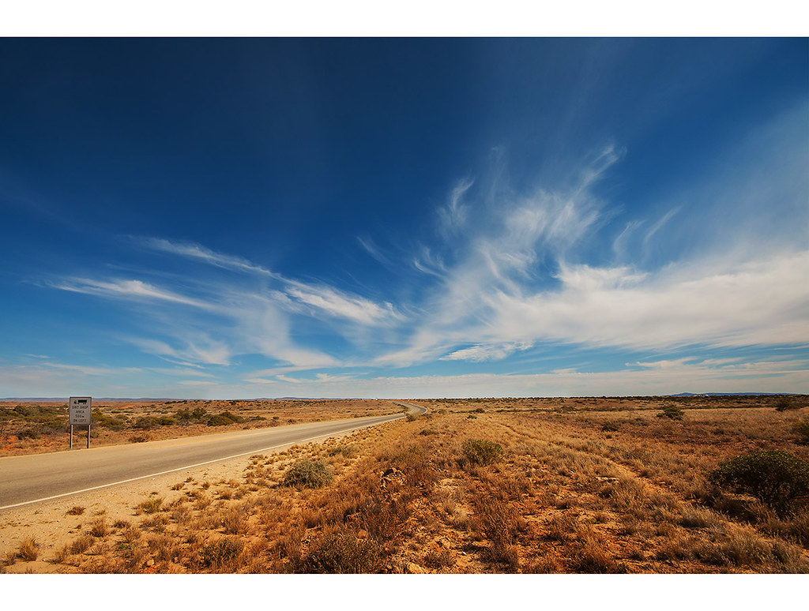

Potential levers
Reducing entry into the justice system
    Reduce crime (specifically the highest contributors, like DV)
    Reduce arrests
    Divert from the justice system
    Better respond to risk factors (like mental health and drug use)
Improving the justice system
    Redirect from remand to bail (e.g, focus on addressing recent increases in bail refusals)
    Reduce technical breaches of conditions on orders
    Alternative court processes and programs
    Faster court processes
Sentencing
    Reduce length of imprisonment
    Reduce short prison terms
    Improve community sentencing options
    Improve compliance with sentencing orders
    Reduce reoffending on community orders
Custody and post-release
    Reduce risk factors for offenders in prison
    Increase likelihood of parole
    Better use of time on parole
    Reduce returns to prison, focusing on pre-release planning and post-release supports
    Redirect to alternative places of detention or supervision

