Slide 1

Improving national domestic violence surveillance by text mining police narratives
Dr Georgios Christophoros Karystianis
School of Population Health,
UNSW

Slide 2
What is domestic violence?
Punching
Kicking
Hair pulling
Pushing
Stabbing
Kneeing
Elbowing
Slapping
…
Physical
Social
Major societal and
public health problem
Sexual
Psychological
Financial
Verbal
Drug and alcohol use, self-harm, mental and physical trauma, disability, death, PTSD, suicidal behavior, social stigma
Women
Individuals with mental illness
Consequences
Children
Elderly
Veterans
1
Notes:
Complex and worldwide phenomenon
Large range of risk factors
Variety of consequences:
Stigmatization
Suicidal thoughts and attempts
Severe physical injuries
Depression
Post-traumatic stress disorder
Substance abuse
Increased health care costs

Slide 3



Domestic violence in Australia
Physical/sexual
violence¹
Annual burden against women:
  $AUD22.2 billion.
For each preventable incidence of violence to women:
  over $20,000 in costs can be saved².
If current rates of violence to women could be reduced by 10%:
  over the next decade, an estimate of $1.6 billion in costs can be avoided²
murdered every week¹
1 AIHW. Family, domestic and sexual violence in Australia. 2018. https://www.aihw.gov.au/reports/domestic-violence/family-domestic-sexual-violence-in-australia-2018/contents/summary
2 The National Council to Reduce Violence against Women and their Children. The cost of violence against women and their children. Canberra: Commonwealth of Australia; 2009.
2

Slide 4
Domestic violence data gaps in Australia
Routine reporting mostly based on:
  Hospital presentation data
  Court and crime records
  One-off surveys and research projects.
Nuanced information on DV provided by qualitative research:
  One-on-one interviews and/or focus groups
  Limited due to small sample size & time consuming
  Might introduce biases to the reporting.
3

Slide 5
What are the knowledge gaps?
Current data sources often do not record information on key victim and perpetrator characteristics such as:
Abuse types
Causes of the event
Mental health status
Self-harm and suicide
Anatomical parts
Stalking
Presence of children
Property damage
Alcohol use
Injuries
Threat of future violence
Use of weapons
Coercive control
Licit/illicit drugs
Disabilities
Access to such information would be extremely valuable for policy development, resource allocation, and service delivery
4
Notes:
Injuries (apart from those requiring a hospital attendance/admission)

Slide 6
Domestic violence police records
Police are (almost always) the first responders in domestic violence (DV) events.
E.g., NSW Police Force (NSWPF) attends yearly 100,000+ DV events.
DV police records
Fixed fields
        Standardized information:
        postcode, premises type, age
        Type of offence
        Weapon class
        Post code
5

Slide 7

Domestic violence police records
Police are (almost always) the first responders in domestic violence (DV) events.
E.g., NSW Police Force (NSWPF) attends yearly 100,000+ DV events.
DV police records
Fixed fields
Event narratives
        Free text describing details not present in the fixed fields
        Mental health status
        Injuries
        Abuse types
        …
6

Slide 8
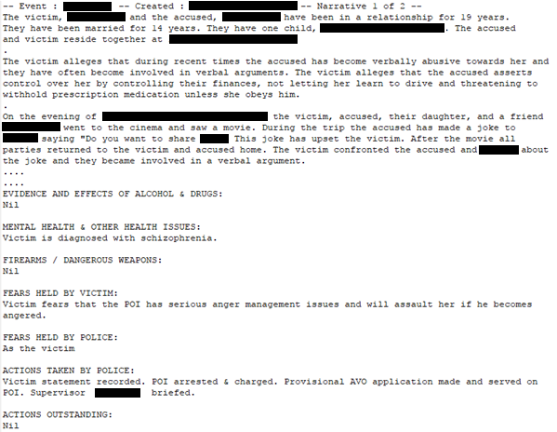
Narrative example
7

Slide 9

Problems with police records
Large numbers of data
Time consuming
Difficult to inspect, identify and
synthesize information from
police records
Record length
Context
Emotionally draining
8

Slide 10

How can we unlock this information?
9
Disclaimer: Willem Dafoe is a fantastic actor

Slide 11
How can we unlock this information?
Text mining:
  The application of automated technologies to identify information of interest from large amounts of unstructured (i.e., textual) data.
Successfully applied for 30+ years in various fields to:
    Identify previously unknown information
    Fill information gaps
    Recognise biases.
Text mining employs a variety of approaches:
    Rule-based, machine learning, deep learning, hybrid methods.
10

Slide 12
Filling knowledge gaps in domestic violence
Information gap | Hospital/ED admissions* | ABS personal safety survey | Court outcomes | Ambulance | Text mining police narratives
Perceived role of licit or illicit drugs | - | - | - | - | 
Mental health of victims and perpetrators | - | - | - | - | 
Cause(s) of the event | - | - | - | - | 
Mild to moderate injuries | - | - | - | - | 
Severe injuries |  | - | - |  | 
Reports of coercive controlling behaviours | - | - | - | - | 
Abuse types | - |  | - | - | 
Threats of further violence | - |  | - | - | 
Weapons used |  | - | - |  | 
Justice outcome | - | - |  | - | 
*Note: only 0.2% of DV events resulted in a hospitalisation within 48 hours (most non-injury related causes)
11

Slide 13
New South Wales work so far
Developed a text mining system to process domestic violence police records to extract:
  Mental health mentions for perpetrators and victims
  Victim injuries
  Abuse types
  Perpetrator threats
  Coercive controlling behaviours
  Self-harm and suicidal behaviours.
91% system accuracy (how well information is identified compared to experts).
Evaluated and implemented the method on 500K DV police records across a ten year period.
System and findings published in peer reviewed journals.
12

Slide 14

Outputs
Non-fatal strangulation surveillance
Co-development of an app with NSWPF
Mental health surveillance
Nursing homes surveillance
CRE grant for DV surveillance
Abuse types and victim injuries surveillance
MRFF grant for DV surveillance
Autism/dementia surveillance
Coercive control surveillance
Linked police records to health records
Advocated for mental health focus in DV
Predicted DV offences
13

Slide 15
Examples of text mining insights
14

Slide 16

Mental illness in domestic violence
  64,587 events (16%) had at least one mental illness mention
  Over three-quarters (79%) of mental illnesses were associated with POIs vs. 21% with victims
  Depression was the most common condition in both victims (22%) and POIs (19%)
15

Slide 17
Mental illness in domestic violence
16

Slide 18
Mental illness in domestic violence
17

Slide 19
Abuse types
18

Slide 20
Victim injuries
19

Slide 21
Indigenous domestic violence insights
35.0% (149,696) of FDV events involved an Aboriginal victim or POI.
22.0% (93,282) of FDV events involved an Aboriginal victim.
24.0% of women Aboriginal victims were abused by non-Aboriginal men.
20

Slide 22
Indigenous domestic violence insights
22

Slide 23

Domestic violence in nursing home settings
  Victims were mostly older (80+ years) females.
  POIs were mostly younger (55+ years) males inflicting visible injuries (e.g., bruises).
  Dementia was the most common condition in both POIs (56%) and victims (73%).
  Physical abuse was the most common abuse type (80%).
23

Slide 24
National domestic violence surveillance system (DVWatch)
  Demonstrate the feasibility of a national domestic violence data collection (resource) by text mining police narratives (world’s first).
  Report on domestic violence based on text mined information customized to local/national requirements.
  Future possibilities
Link outputs to external data sources
Respond to ad hoc requests
Predictive models
NSW health
…
Sexual assault
Coercive control
24
Notes:
Develop predictive models for domestic violence outcomes.

Slide 25
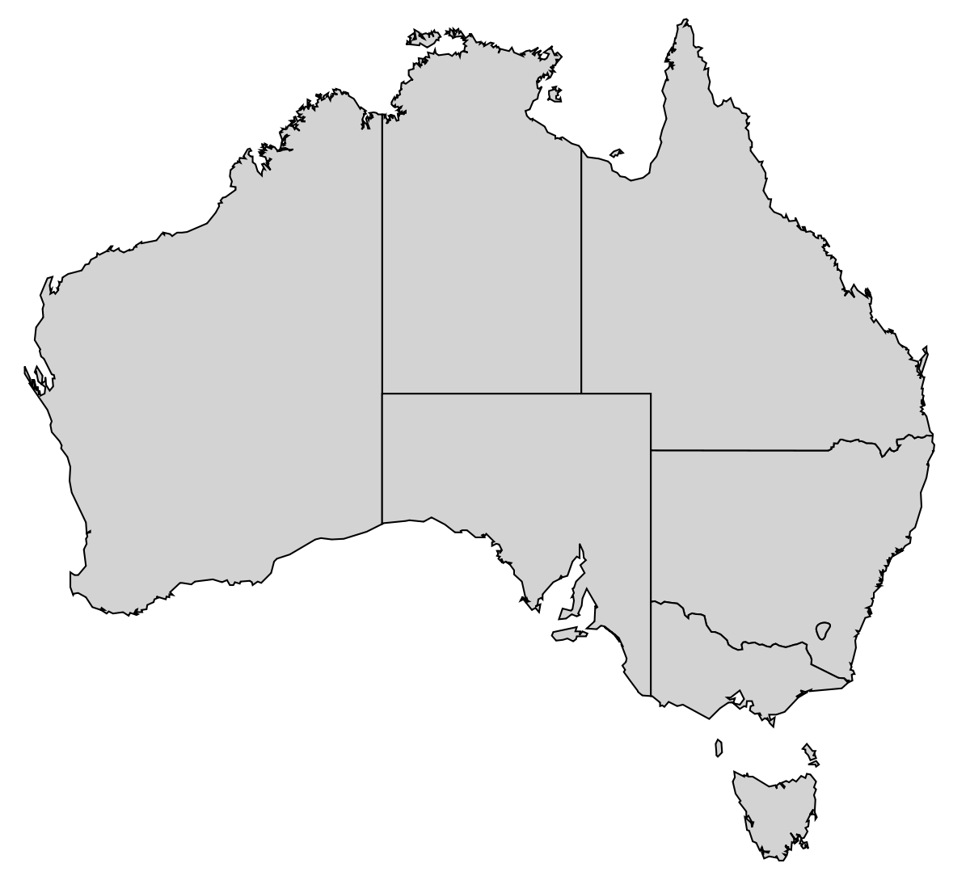
Progress so far (1)
DVWatch
A national FDV data resource available for research that will report on:
Mental illnesses
Victim injuries
Abuse types
Threats
Weapons used
Cause of the event
Self-harm and suicidal behavior
Text mining
Covers almost 70% of the entire Australian Population!
25

Slide 26
Progress so far (2)
  Applied and received ethics approval to apply our system to three additional jurisdictions (NSW exc).
  Involved in discussion with representatives from each jurisdiction to determine:
    Research approvals
    Technical and resource implications.
  Put in an NHMRC and MRFF grant to support this type of work for the next four years.
  Seed funding from a Centre of Research Excellence (CRE) in perpetrator violence.
  Endorsed by ANROWS and AIHW as project partners.
  Include remaining jurisdictions (ACT, SA, NT, VIC)
26

Slide 27
Benefits
Improve police recording practices
Visibility of priority groups
Improve intervention and prevention strategies
Fill in knowledge gaps in DV
Efficient use of existing data
Highlight importance and quality of law enforcement data
Annual DV report in Australia
Low cost, fast implementation
27
Notes:
Improve early intervention and prevention strategies for vulnerable populations and hotspot areas.
Provide visibility on key population groups (e.g., migrants, veterans, people with disability, etc)

Slide 28
Publications and reports from this work
Karystianis et al. Automatic extraction of mental health disorders from domestic violence police narratives: text mining study. JMIR. 2018 Sep;20(9).
Karystianis et al. Automated analysis of domestic violence police reports to explore abuse types and victim injuries: text mining study. JMIR. 2019;21(3):e13067.
Karystianis et al. Prevalence of mental illnesses in domestic violence police records: text mining study. JMIR. 2020;22(12):e23725.
Hwang et al. Domestic violence events involving autism: a text mining study of police records in New South Wales, 2005-2016. Research in Autism Spectrum Disorders. 2020 Oct 1;78:101634.
Karystianis et al. Domestic violence in NSW residential care facilities: a text mining study. The Gerontologist. 62 (2), 223-231.
Karystianis, Butler. We analyzed almost 500,000 police reports of domestic violence. Mental health was an issue. The conversation. (Jan 2021) https://theconversation.com/we-analysed-almost-500-000-police-reports-of-domestic-violence-mental-health-was-an-issue-153649
Adily et al. Text mining police narratives to identify types of abuse and victim injuries in family and domestic violence events. Trends and Issues in Crime and Criminal Justice [electronic resource]. 2021 Jul(630):1-2.
Adily et al. Text mining police narratives for mentions of mental disorders in family and domestic violence events. Trends and Issues in Crime and Criminal Justice [electronic resource]. 2021 Jul(629):1-6.
Karystianis et al. Automatic text mining of family and domestic violence records: An approach for future research. Report to the criminology research advisory council (June 2021)
Wilson et al. Prevalence and characteristics associated with non-fatal strangulation during domestic violence events in New South Wales: a text mining study using police narratives. Violence against women. 2022 Aug;28(10):2259-85.
Karystianis et al. Utilizing text mining, data linkage and deep learning in police and health records to predict future offences in family and domestic violence offences. Frontiers in Digital Health. 2021. https://doi.org/10.3389/fdgth.2021.602683.
Karystianis et al. Mental illness concordance between hospital clinical records and mentions in domestic violence police narratives: data linkage study. JMIR formative research. 2022 Oct 20;6(10):e39373.
Karystianis et al. Surveillance of domestic violence using text mining outputs from Australian police records. Frontiers in Psychiatry. Frontiers in Psychiatry. 2022 Feb 9:2412.
Reutens et al. Characteristics of domestic violence perpetrators over 55 years based on text mining of police records (Submitted July 2023).
Karystianis et al. Text mining domestic violence police narratives to identify behaviours linked to coercive control (Submitted August 2023).
Kim, Karystianis. Text mining police narratives to identify coercive control behaviours. Bureau of Crime Statistics and Research (Upcoming September 2023).
28

Slide 29

Thank you for your time
But after that set, forget it
29

Slide 30
Indigenous domestic violence insights
21

