Slide 1

Investigating bias towards Aboriginal people in
police bail decisions
Ilya Klauzner

Slide 2

Acknowledgement of Country
BOCSAR acknowledge the Traditional Custodians
of the lands throughout NSW and their continuing connection to Country, culture and community. We pay our respects to Elders past, present and emerging.
Notes:
Gadigal people of the eora nation

Slide 3

Background
Aboriginal people are overrepresented in custody
  Aboriginal Australians account for 2.2% of the NSW population but 27.8% of the remand population
Inequality in remand is rising
  From 2015 to 2022 the Aboriginal remand population increased by 67%
  The non-Aboriginal population increased by 19%
Notes:
Remand occurs when bail is denied

Slide 4
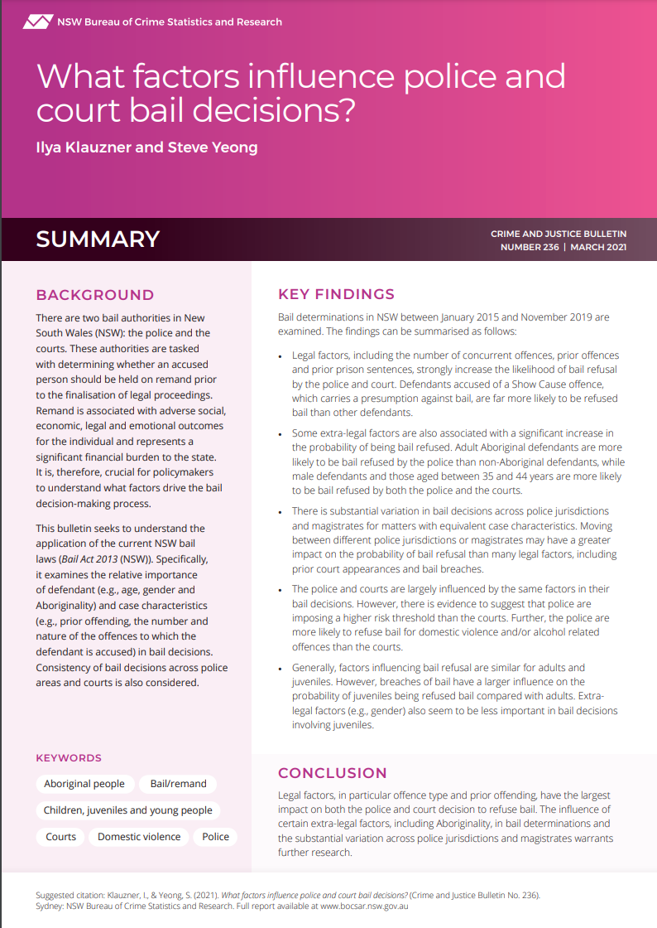
BOCSAR’s (2021) previous bail study
Klauzner and Yeong analysed NSW police bail decisions between 2015 and 2019
  Aboriginal defendants were 20.4% more likely to be denied bail by police accounting for relevant factors
Klauzner and Yeong isn’t able to detect bias
Police custody managers may consider a wide range of unobservable factors in their bail decisions
Custody managers are concerned with reducing the risk of bail misconduct
Notes:
Prior offences, and severity of current offences. Criminal associations, family connections, reasons to be free. Define custody managers. Now we’re going to use a different method to test bias

Slide 5
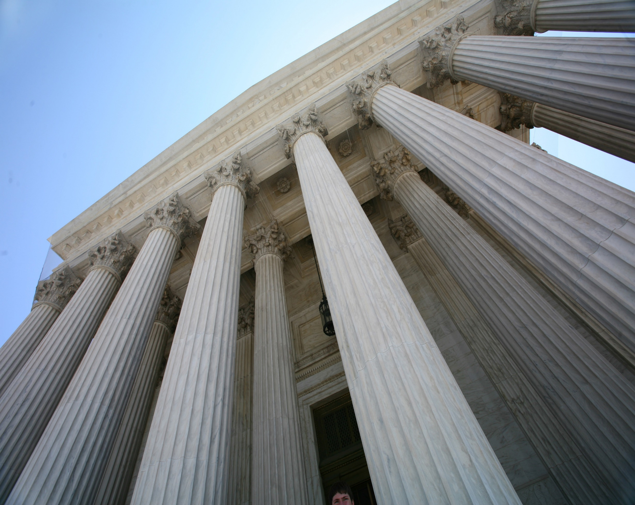
In today’s presentation…
Background
My Method
Bail in NSW
Results
Discussion
Notes:
Nothing to see here. Just go through it quickly

Slide 6
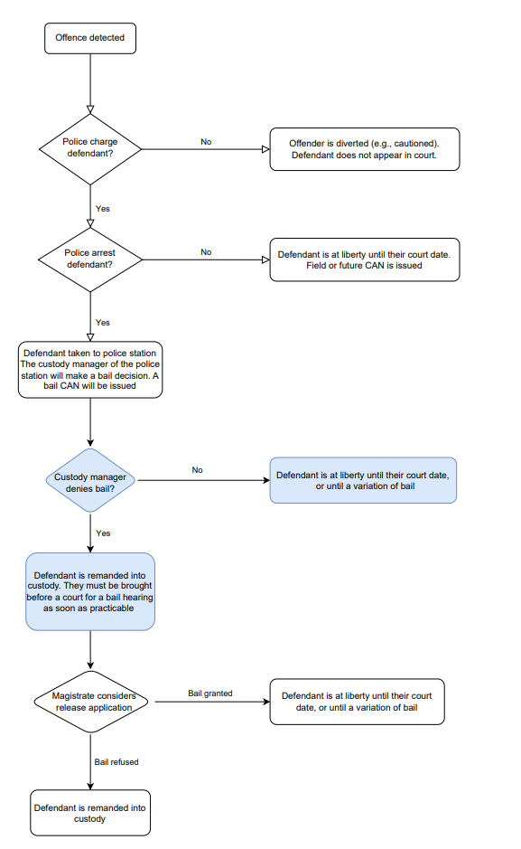
Bail in NSW
Bail decisions in NSW are made by police custody managers and magistrates
  This study focuses on police bail decisions
There are many police decisions before the formal bail decision
Decisions are made under the unacceptable risk test
Notes:
The first bail decision that determines whether a defendant will enter custody. Not necessary to see the flow chart, just that there are a lot of decisions

Slide 7
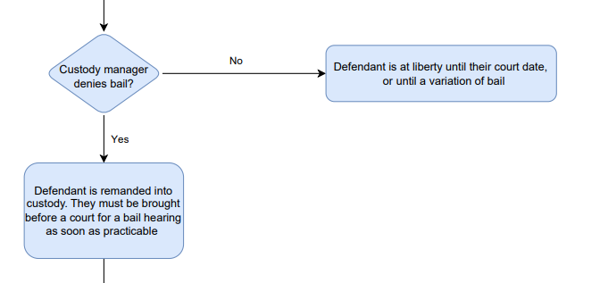
Bail in NSW
Bail decisions in NSW are made by police custody managers and magistrates
  This study focuses on police bail decisions
There are many police decisions before the formal bail decision
Decisions are made under the unacceptable risk test
Notes:
The first bail decision that determines whether a defendant will enter custody

Slide 8

Assessing bias with the unacceptable risk test
To assess bias, we must consider if custody managers are unfairly or inconsistently applying the unacceptable risk test to Aboriginal people
In making a bail decision a custody manager must consider whether a defendant is at risk of the following bail concerns:
  fail to appear at any proceedings for the offence, or
  commit a serious offence, or
  endanger the safety of victims, individuals or the community, or
  interfere with witnesses or evidence.
  Bail Act 2013 (NSW)
Notes:
Look at what custody managers are trying to achieve to see if they are doing it fairly

Slide 9
46% of Aboriginal people are granted bail compared to 65% of non-Aboriginal people
BUT
29% of Aboriginal people released on bail reoffend or abscond compared to 16% of non-Aboriginal people
How do we find a way to calculate potential bias?
Research Questions
Do Aboriginal and non-Aboriginal defendants with the same probability of receiving bail, have the same risk of reoffending and absconding on bail?
Are police custody managers consistently minimising the risk of reoffending and absconding on bail for Aboriginal and non-Aboriginal defendants?
The Challenge

Slide 10
In today’s presentation…
Background
My Method
Bail in NSW
Results
Discussion

Slide 11
Our definition of bias
Notes:
Stylised and simple illustration of the custody manager’s bail decision

Slide 12
Our definition of bias
Refused

Slide 13
A more lenient threshold (e.g., for non-Aboriginal defendants)
A harsher threshold (e.g., for Aboriginal defendants)
An example of biased decision-making
Refused
Refused
Notes:
Note who we observe

Slide 14
A more lenient threshold (e.g., for non-Aboriginal defendants)
A harsher threshold (e.g., for Aboriginal defendants)
An example of biased decision-making
Refused
Refused
Defendants at the margins of release
Notes:
If we can observe these defendants we can observe a custody managers thresholds and observe whether they are different for Aboriginal and non-Aboriginal defendants. Use marginal as a short-hand

Slide 15
e.g., non-Aboriginal defendants
e.g., for Aboriginal defendants
An example of unbiased decision-making
Refused
Refused

Slide 16
Our test is a difference in outcomes
If marginal Aboriginal defendants have a lower rate of bail misconduct than marginal non-Aboriginal defendants:
  Custody managers are likely biased against Aboriginal defendants
If marginal Aboriginal defendants have a higher rate of bail misconduct than marginal non-Aboriginal defendants:
  Custody managers are likely biased against non- Aboriginal defendants

Slide 17

How do we find these ‘marginal defendants’?
We use custody managers and the fact that there are lenient and harsh custody managers
Within a PAC and time period, the allocation of custody manager to defendant is random
The instrumental variable strategy allows us to use this variation to find:
  Impact of release on bail misconduct
  Separately for Aboriginal and non-Aboriginal defendants
  For defendants that would have been released on bail if they received the most lenient custody manager, but would have been denied bail if they received the harshest custody manager
It’s the difference in the impacts that matters
If the impact of release on misconduct is lower for Aboriginal defendants:
  Custody managers are likely biased against Aboriginal defendants

Slide 18
Sample
All bail CANs between 28th January 2015 and 28th February 2021
We exclude:
  Field and future CANS
  Young people 17 and below
  Custody managers with less than 15 bail decisions in a year
  Accused already in custody for another offence
  Any more than one bail decision per person per day
129,154 non-Aboriginal defendants
49,636 Aboriginal defendants
2,237 custody managers

Slide 19
Outcome variables
Any misconduct
Any reoffence
Abscond
Any proven offence or absconding charge before finalisation
Any proven offence before finalisation
A defendant charged with failing to appear at any point during their index offence
Violent reoffence
Serious reoffence
Detectable reoffence
A homicide, acts intended to cause injury, sexual assault, or robbery and related offence committed before finalisation
A serious property, drug, or violent offence committed before finalisation
A homicide, robbery, break and enter, theft of a motor vehicle, illegal use of a motor vehicle or theft from retail offence committed before finalisation
Notes:
What do I mean by bail misconduct? Detection bias, absconding is also not susceptible to detection bias; excluding trafficking /dealing in non-commercial quantities

Slide 20
In today’s presentation…
Background
My Method
Bail in NSW
Results
Discussion

Slide 21





Characteristics of Aboriginal and non-Aboriginal defendants that were refused bail
Gender
Index offence
Prior prison
16% of Aboriginal defendants and 11% of non-Aboriginal defendants were women
27% of Aboriginal defendants and 19% of non-Aboriginal defendants were charged with a property offence
57% of Aboriginal defendants and 31% of non-Aboriginal defendants had at least one prior prison sentence
Age
Remoteness
Prior court appearances
25% of Aboriginal defendants were between 18 and 24 compared with 18% of non-Aboriginal defendants
46% of Aboriginal defendants and 71% non-Aboriginal defendants lived in a major city
72% of Aboriginal defendants and 47% of non-Aboriginal defendants have three of more prior court appearances
Notes:
Big differences in average outcome so we need to look at the margins

Slide 22
Results
The impact of bail release on misconduct is similar for Aboriginal and non-Aboriginal defendants at the margins of release

Slide 23
Results

Slide 24
In today’s presentation…
Background
My Method
Bail in NSW
Results
Discussion

Slide 25

Summary
Across a range of misconduct outcomes, both marginal Aboriginal and marginal non-Aboriginal defendants had similar rates of bail misconduct
This suggests that custody managers apply a similar threshold for Aboriginal and non-Aboriginal defendants, in the risk of bail misconduct above which they will refuse bail
There is no evidence for bias by custody managers once accounting for bail misconduct
We only examined bail CANs
Our definition of bias is narrow
  It only tests bias perpetrated by individual custody managers
Notes:
There is no comment on whether the bail act is fair; historical and institutional discrimination, present impacts of colonialism and dispossession. Institutional discrimination is discrimination occurring through organisations by policies and laws

Slide 26

Implications
Investments in strategies to reduce reoffending among Aboriginal people may be effective in reducing disparities in bail refusal rates
Further research in the charging/arresting decision could be undertaken to see if police show bias in other areas
Structural bias in the criminal justice system should also be examined
Notes:
Policies to support people on bail and follow conditions etc.; There is no comment on whether the bail act is fair; historical and institutional discrimination, present impacts of colonialism and dispossession

Slide 27
THANK YOU
Any questions?

Slide 28
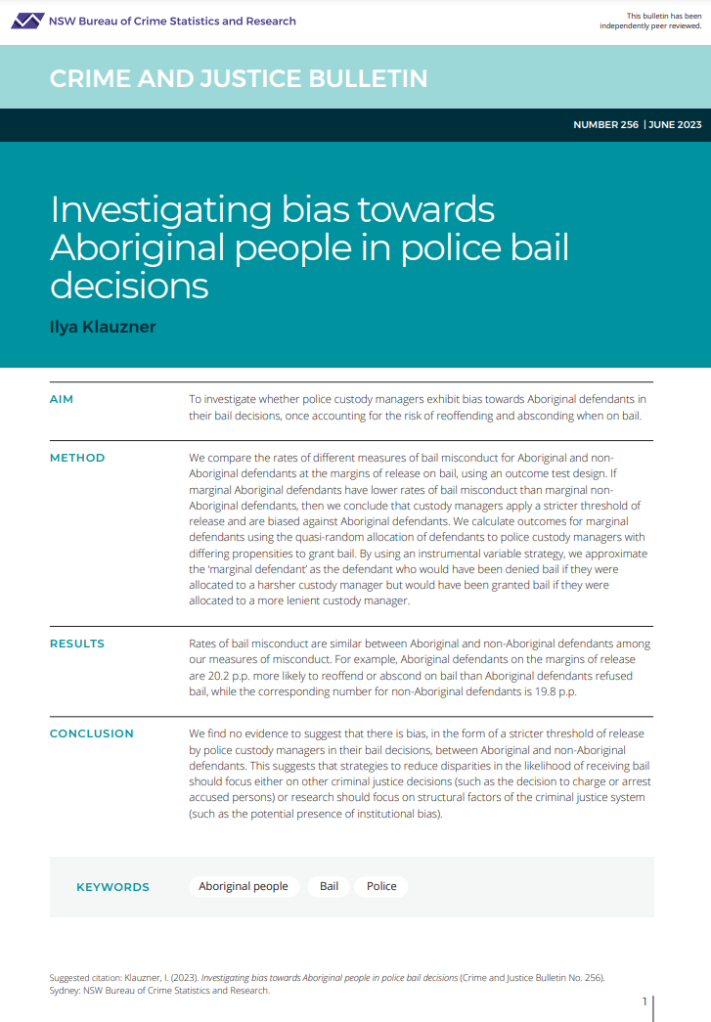
GET IN TOUCH
CONTACT US
6 Parramatta Square
Level 5, 10 Darcy St, Sydney NSW 2000
(02) 8346 1100
ilya.klauzner@justice.nsw.gov.au
https://www.bocsar.nsw.gov.au/
@BOCSAR
NSWBOCSAR
Notes:
If you’re interested in our paper, it’s published on the BOCSAR website, and you can contact us after the conference if anything comes to mind.

Slide 29
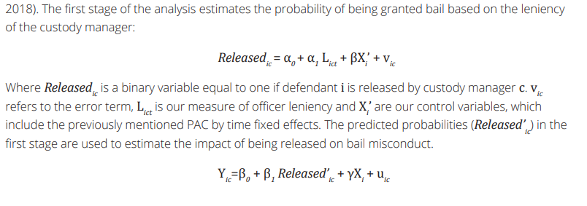

Slide 30
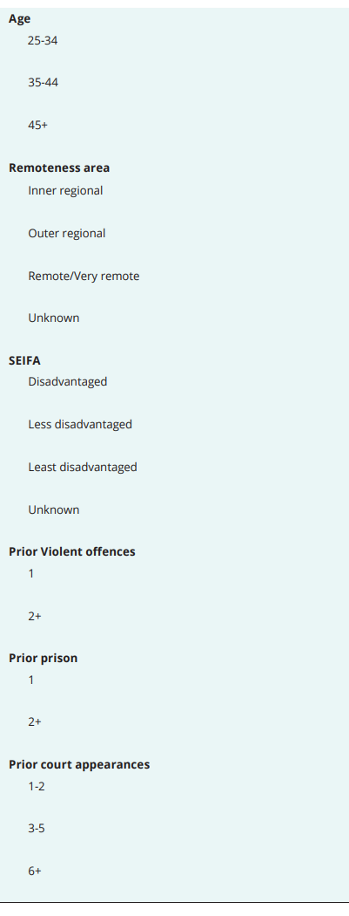
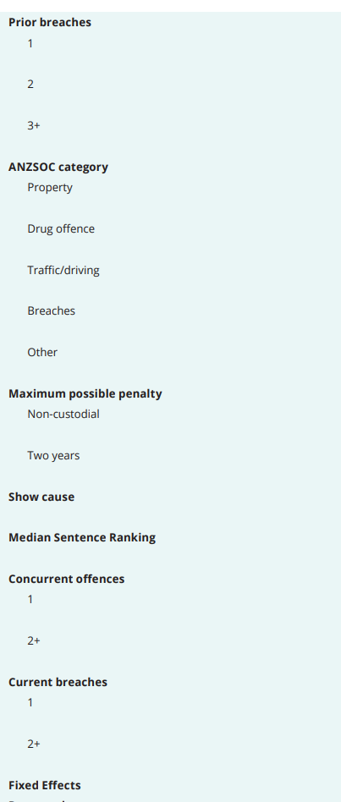
INTRODUCTION

Slide 31
GET IN TOUCH
Henry Deane Building
20 Lee St, Sydney NSW 2000
CONTACT US
(02) 8346 1100
Adolescens deterruisset. Persius legimus appareat sed eu tollit terno deseruisse. No velas integre adolescens homero tamquam suscipiantur molestiae mel option dolorem forensibus et quo.
bcsr@justice.nsw.gov.au
https://www.bocsar.nsw.gov.au/
@BOCSAR

