Slide 1
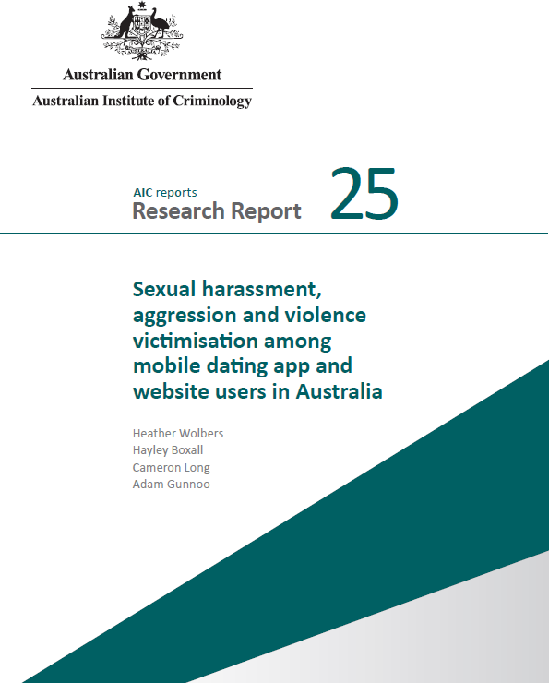
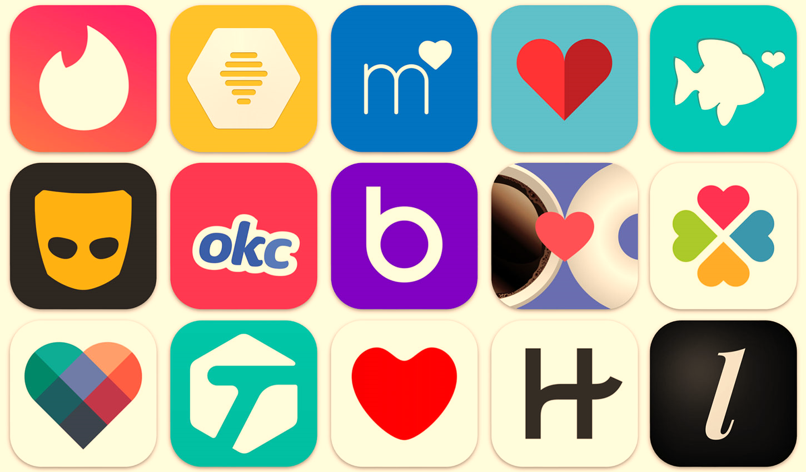
Preliminary findings
Sexual harassment, aggression and violence victimisation

Slide 2

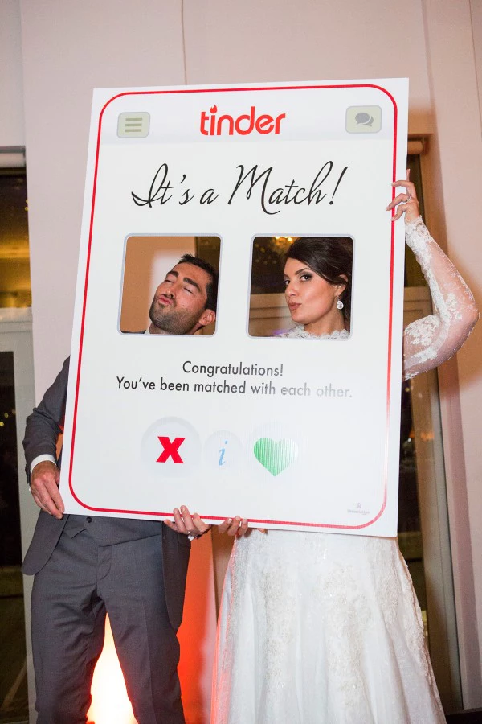
3.2 million users in 2021
Most users are 25–34 years old
Most common way of meeting new partners
Notes:
Data refs
https://takeatumble.com.au/insights/lifestyle/online-dating-statistics/#:~:text=1.,apps%20in%20Australia%20in%202021.&text=According%20to%20a%20December%202021,classified%20as%20non%2Dpaying%20users.

Slide 3
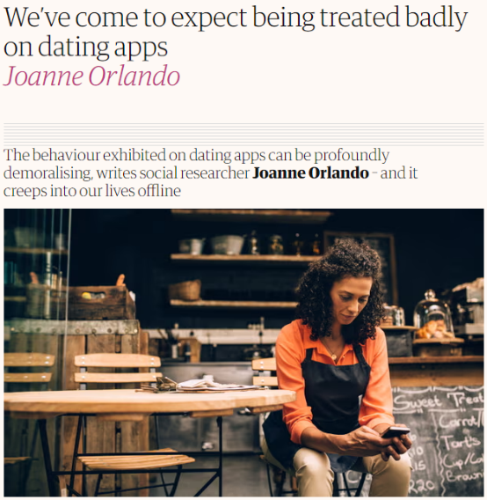
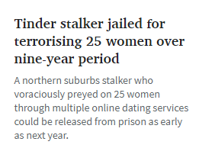
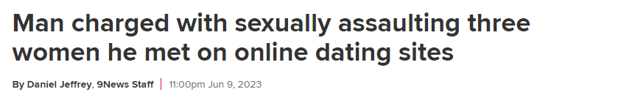
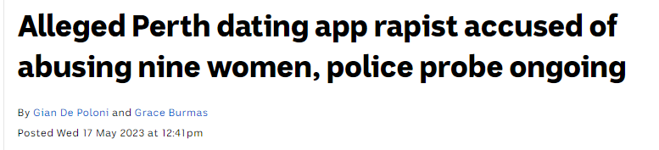
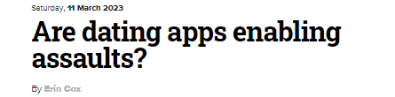
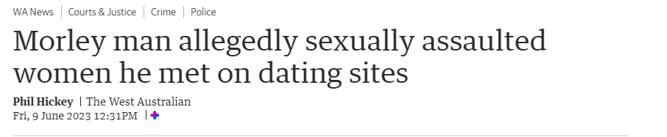
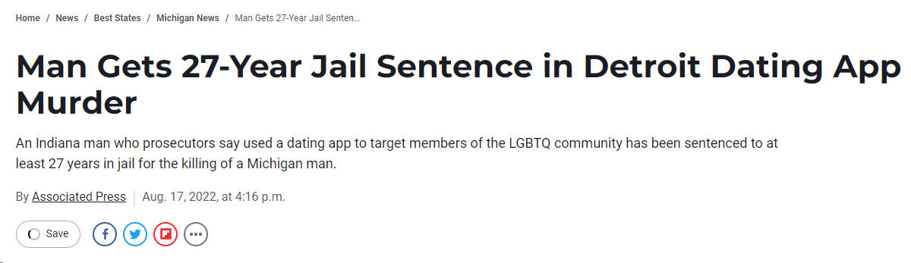
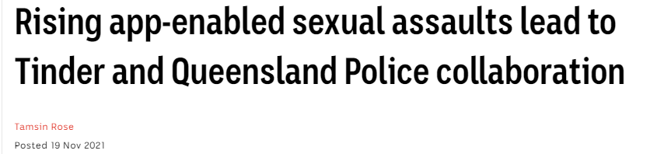
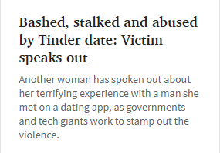
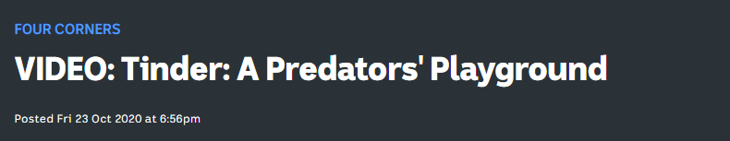

Slide 4
Survey Methodology
Roy Morgan face-to-face calibration survey (n=1,045)
Proportional quota sampling of Pure-profile and Dynata surveys
(n=9,214)
23 June 21
9 August 21
ABS population for Australians aged 18+
Quotas adjusted for age- and gender-based propensity to have used a dating app in last 5 years
Removal of erroneous, nonsense responses (n=9,987)
Notes:
Rather than representative of entire AUS population 18+; more representative of AUS population 18+ who have used/currently use a mobile dating app/website
S.
Average completion time approx. 13 minutes

Slide 5
Data were representative of Australians aged 18+ who use mobile dating apps
Sample was skewed younger
Approx 57% in target aged 34 or under
30% Of AUS population
Approx 17% of people in target pop aged 50+ compared with 45% among AUS population
35-49 approx. 26% in both target and AUS population
Notes:
As a result, sample was slightly different to the AUS population
Another thing is that the LGB+ people were oversampled as these people more likely to experience than hetero
Result is data that is skewed away from the ‘general’ AUS population

Slide 6
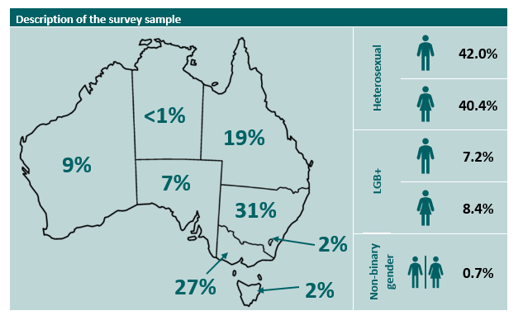
Description of the survey sample (N=9,987)
2%
Notes:
Mention about gender, transgender etc.
LGB+
Based on our questions, structured around ABS standards, only asked for respondent gender, not biological sex
We had a sexuality question – unable to fully demarcate different groups other than simple split of heterosexual vs not.
Hence using LGB+ rather than LGBTQIA+

Slide 7




OFFICIAL
First Nations
7.8%
Disability
11.6%
NESB
8.6%
Regional/Remote
19.4%
OFFICIAL
Notes:
NESB = non-English speaking background

Slide 8
Survey domains
Sociodemographic characteristics
Use of mobile dating apps/websites in last 5 years
Experiences of:
sexual harassment, aggression and violence (online & in-person)
being sent requests to facilitate child sexual exploitation
attempts to recruit them into exploitative conditions
Reporting behaviours (limited to sexual harassment, aggression and violence)

Slide 9
Survey domains
Sociodemographic characteristics
Use of mobile dating apps/websites in last 5 years
Experiences of:
sexual harassment, aggression and violence (online & in-person)
being sent requests to facilitate child sexual exploitation
attempts to recruit them into exploitative conditions
Reporting behaviours (limited to sexual harassment, aggression and violence)

Slide 10
Limitations
No inclusion of questions on perpetration
Cannot link victimisation to specific apps/websites
Exploration of victimisation experiences is limited to gender and sexual identity

Slide 11
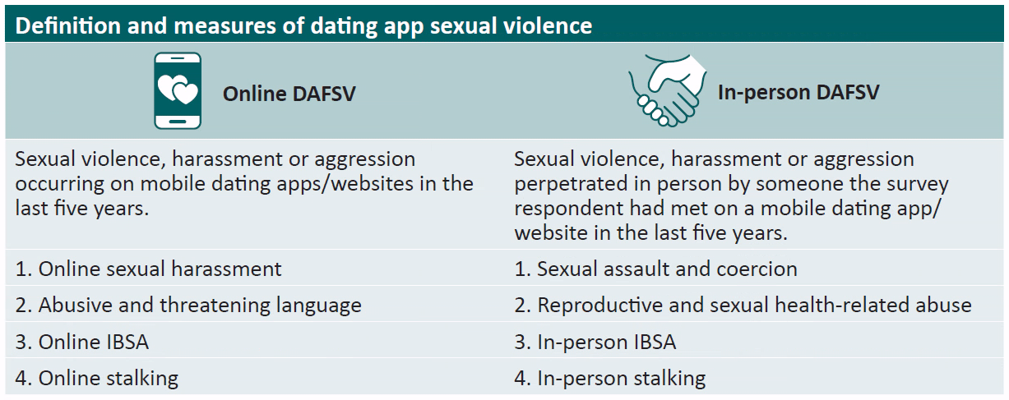
Dating App Facilitated Sexual Violence

Slide 12

Online DAFSV Prevalence
72.3% had been subjected to at least one form of online DAFSV in the last 5 years
69.0% had been sexually harassed
45.5% had been subjected to abusive and threatening language
27.6% had been stalked online
18.8% had been subjected to online IBSA

Slide 13
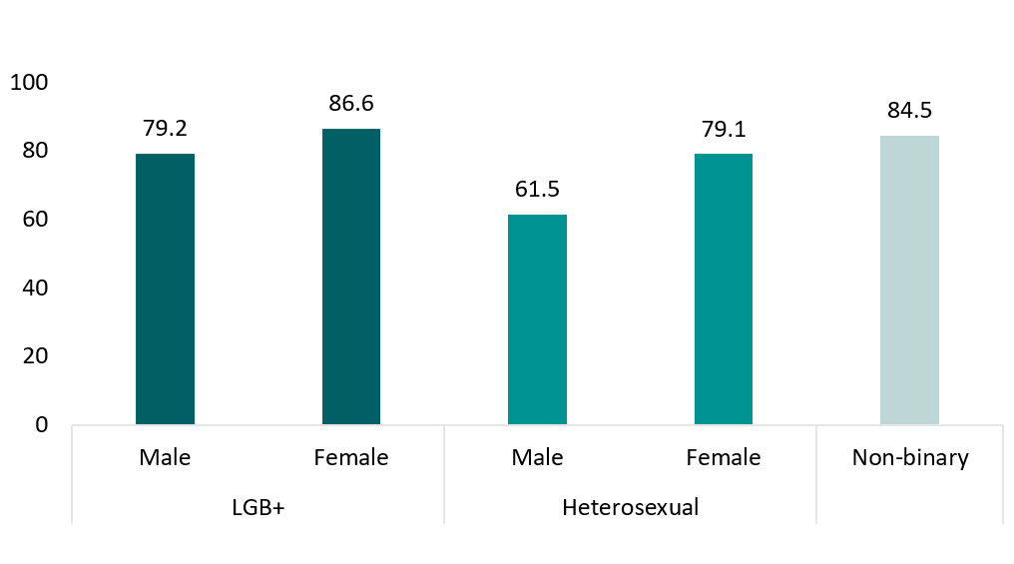
Experiences of online DAFSV, by gender and sexuality (%)

Slide 14
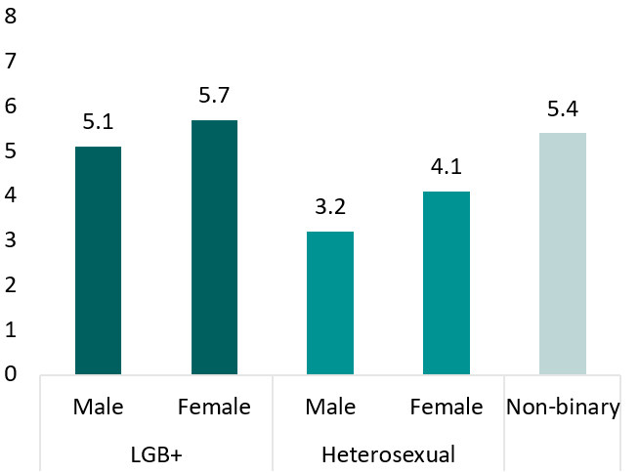
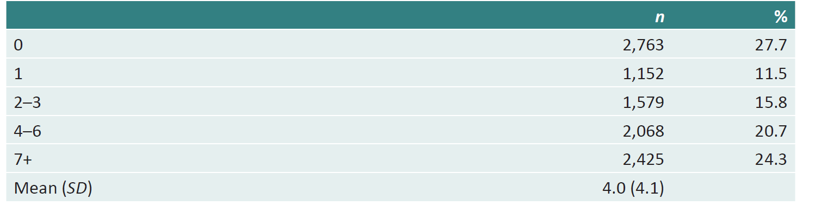
Number of online DAFSV behaviours experienced
60.8% experienced multiple behaviours

Slide 15

In-person DAFSV Prevalence
34.0% had been subjected to at least one form of in-person DAFSV in the last 5 years
27.3% had been sexually assaulted or coerced
18.8% had been subjected to reproductive and sexual health related abuse
14.3% had been stalked in-person
10.5% had been subjected to in-person IBSA

Slide 16


Sexual assault and coercion
Pressured respondent verbally to perform unwanted sexual acts
22.0%
Attempted to engage in sex act when respondent could not consent
15.8%
Use of physical violence (including threats) to make respondent engage in sex acts
13.0%
Spiked the respondent’s drink to coerce them into performing sexual acts
10.0%
10.3% one person
5.5% multiple people

Slide 17
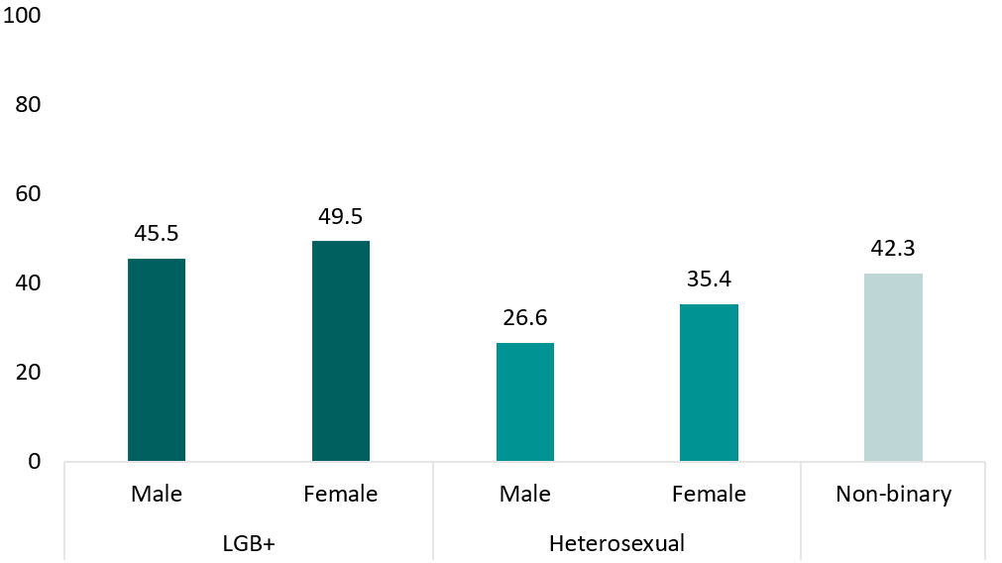
Experiences of in-person DAFSV, by gender and sexuality (%)

Slide 18
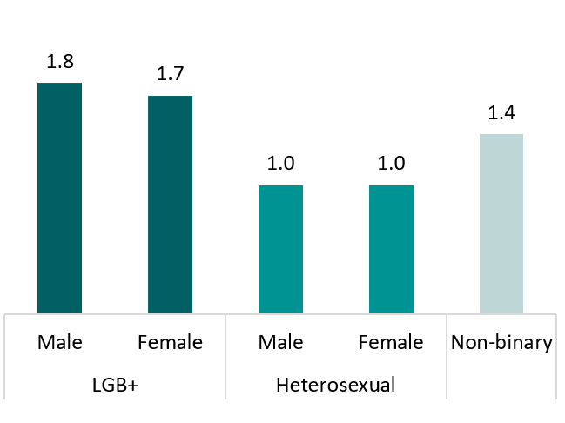
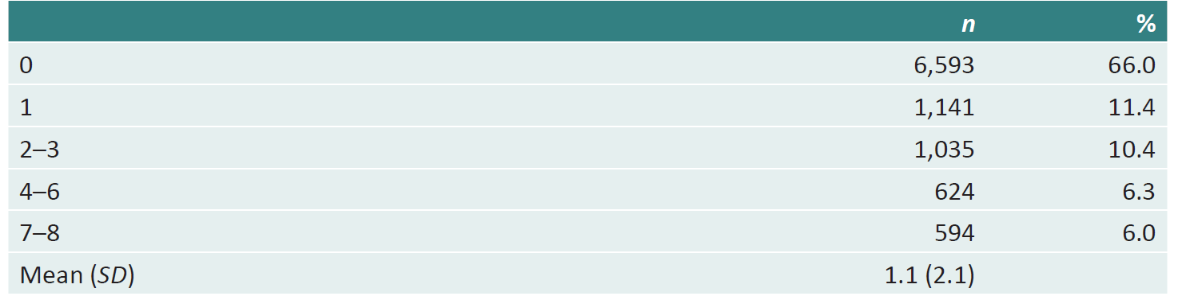
Number of in-person DAFSV behaviours experienced
22.7% experienced multiple behaviours

Slide 19
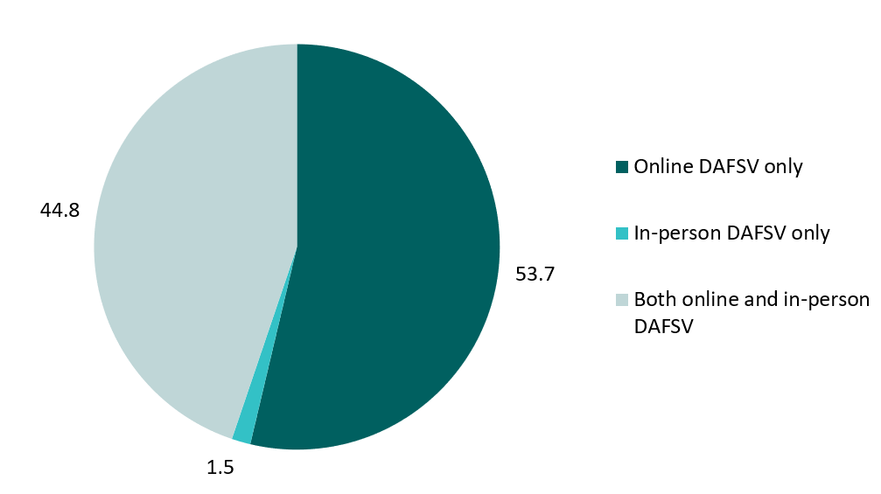
Co-occurrence of online and in-person DAFSV

Slide 20
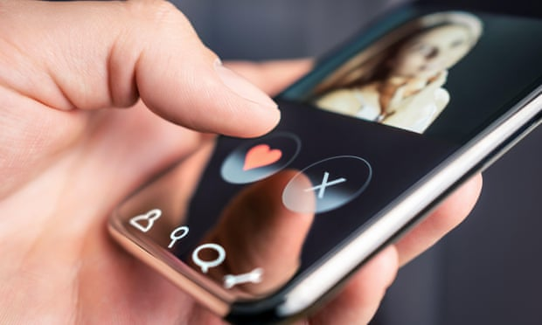
In the last five years…
3 in 4 respondents had experienced online DAFSV, and 1 in 3 have been subjected to in-person DAFSV
DAFSV experiences are often not isolated or singular incidents
LGB+ respondents reported the highest rates of DAFSV

Slide 21
What can we do?
Prevent perpetrator exploitation of dating platforms
Support users who experience harm
Empower users through information provision
Promote technological solutions

Slide 22

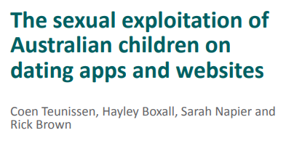
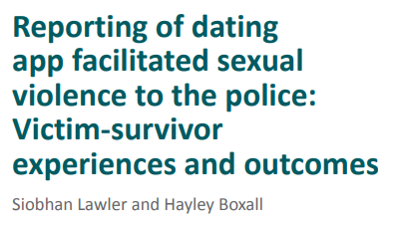
Notes:
DAFSV among users with disability
Platform usage and self-protection behaviours
Reporting to dating platforms
Risk factors for experiencing CSAM requests
Children’s use of dating apps
Recruitment into exploitative conditions

Slide 23
OFFICIAL
Heather Wolbers
heather.wolbers@aic.gov.au
OFFICIAL

