Slide 1
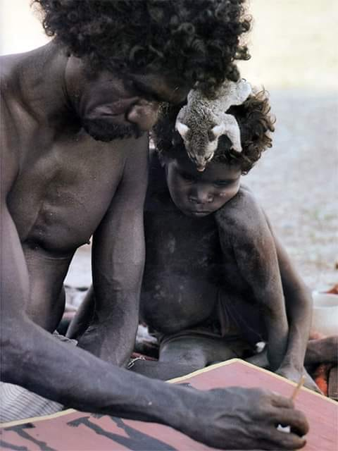
Two Laws talking: Establishing a shared starting point for reducing violence, creating safe communities, and reducing Aboriginal incarceration
Applied Research in Crime and Justice Conference 2023
International Convention Centre, Sydney
14-15 August 2023
Professor Victoria Hovane
Law School, UWA
Managing Director, Tjallara Consulting Pty Ltd
E: vhovane@outlook.com
© Tjallara-Hovane Trust 2023

Slide 2
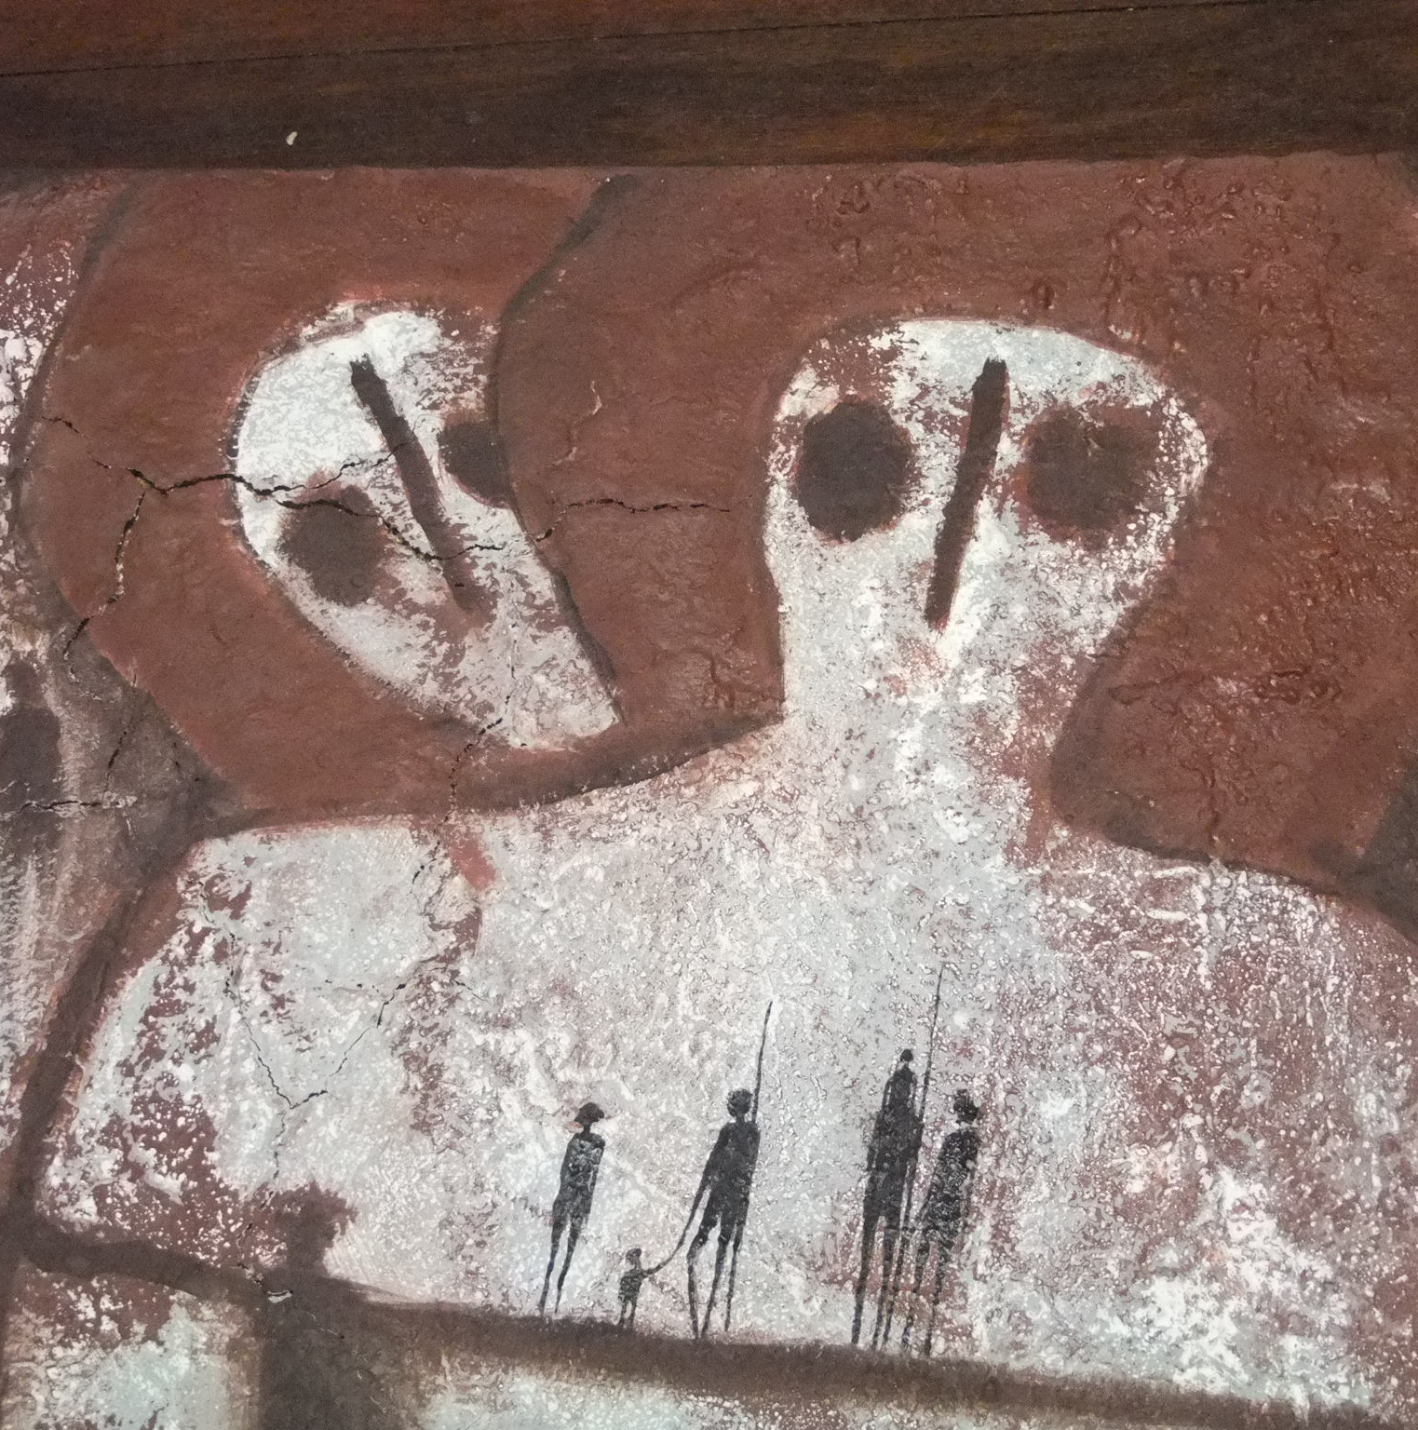
Acknowledgement
Remembering victims
© Tjallara-Hovane Trust 2023
(Artist: Hughie Arwon)
Notes:
Before I begin, I would like to acknowledge that we meet here today on unceded country that continues to be governed by two systems of Law.
I acknowledge the traditional custodians of the land on which we gather here today, the Gadigal People of the Eora Nation, and pay my respects to all our Old People who have gone before us; our ancestors; for the positive legacy they left to us; which is our Laws and our Cultures across this nation. These enduring cultural structures and ways of being, provide a blueprint for how we can live today, in our contemporary families and communities, in a good way, with integrity and respect, strong in our cultures, our identities, in healthy and respectful relationships, understanding our roles and responsibilities as Aboriginal men, women, young people and children.
I also take a moment to acknowledge the passing of yet another Aboriginal woman to family violence in WA last week. She was a mother, daughter, sister, and an aunty in her family. Her name is Tiffany.

Slide 3

Overview
Diversity of views - a WA perspective on how we can respond to violence in our communities and reduce incarceration rates
Background and some efforts to address overrepresentation and disadvantage
Aboriginal worldviews
Noongar Trauma and Healing Model
Implications for policy and practice
© Tjallara-Hovane Trust 2023
Notes:
I acknowledge and it’s important for you to remember that there are a diversity of views from our cultures and communities across Australia.
Today I’ll be providing a WA perspective, that may have

Slide 4
Background: Royal Commission into Aboriginal Deaths in Custody (1991)
Highlighted factors such as economic position, health indicators, housing, their access or lack of it to land and employment, education, and the role of alcohol and other drugs in risk of incarceration.
A focus on justice system alone will not address violence in Aboriginal communities and incarceration rates
© Tjallara-Hovane Trust 2023
Notes:
Terms of Reference: Examine all deaths in custody 1980 to 1989 and to take account of any social, cultural and legal matter which may have a bearing on the deaths
Commissioner Patrick Dodson examined the Underlying Issues associated with incarceration of Aboriginal people and the deaths
Highlighted that being a member of the Stolen Generations = increased risk of incarceration
339 Recommendations

Slide 5
Background: Aboriginal
Aboriginal knowledge systems, ways of knowing, being and doing. NOT just about western academic research and empiricism
Our stories of wellbeing and how to live a good life. Our stories of invasion, massacres, stolen lands, stolen men to prisons, stolen wives and children, racism and discrimination.
Academic research highlighting
  Colonial patriarchal violence, including policies and practices that directly target Aboriginal and Torres Strait Islander relationships and families resulting in intergenerational trauma (e.g., Atkinson 2000; Blagg, et. al., 2020).
  Impacts of socio-economic factors including social and emotional wellbeing, employment, education, housing, and health and incarceration (AIHW, 2021)
  Social and structural discrimination deeply embedded in society, coupled with the historical trauma that results in many forms of illness, depression and other mental health conditions, are key factors contributing to violence in our communities (e.g., Anderson & Tilton 2017; Cripps & Davis 2012)
© Tjallara-Hovane Trust 2023
Notes:
Aboriginal knowledge systems
Research highlighting colonial patriarchal violence
Violent dispossession and the killing of our senior knowledge holders and leaders;
the Stolen Generations and the loss of successive generations to our families and kinship systems (knowledge and continuation of culture, country, and language; roles and responsibilities, practices, ceremonies, and stories)
the missions: being locked on the missions for successive generations and having every opportunity to exercise responsibility and decision-making taken away from us for generations (McDaniel, 2009).
Child Protection procedures that are inherently and systemically racist

Slide 6
Efforts to address overrepresentation and disadvantage
Culturally adapting mainstream programmes and services
Systems not understanding how to be trauma-informed and culturally safe – what does that look like in practice? (Example of psych assessment)
Closing the Gap Agreements and initiatives (promotes cultural safety in responses to determinants of health. Current agreement signed in 2020).
Youth diversion (Blagg & Tulich,2018) and Community Courts
Development of justice reinvestment initiatives (the need for assessing community readiness to respond to complex issues).
© Tjallara-Hovane Trust 2023
Notes:
Evaluations of diversion programs for Aboriginal and Torres Strait Islander young people consistently highlight the importance of programs being focused on the cultural context of the young person and the need to incorporate Aboriginal and Torres Strait Islander custom and law
Good practices are highly localised, holistic and involve whole-of-community approaches, taking place in the presence of Elders, reconnecting young people with cultural identity and sense of belonging to country. ‘On-country’ models in particular have the advantage of sharing ‘cultural match’. Most successful programs are ‘those grounded in and drawing upon the family, kinship, social and cultural networks of the young person’
Justice reinvestment initiatives generally include
Local aspirations, ideas and solutions about prevention and diversion
Collaboration between local organisations
My observations from our work with one initiative is that a significant gap has been assessing community readiness to lead such an initiative. This constitutes a critical risk to the success of the project.

Slide 7
Creating a shared starting point:
Spirituality - The Dreaming
The Dreaming refers to the complex Aboriginal system of belief and Law which tells the story of
how the spirit and human worlds came into being
beliefs, philosophy and laws which govern everyday life.
While there is much that can be generalised, there are different experiences of the Dreaming from one part of Australia to another (MacDonald, 2016).
© Tjallara-Hovane Trust 2023
Notes:
Our starting point to understanding our cultural perspectives begins with our spirituality and The Dreaming.

Slide 8
Two concepts
Law continues to provide guidelines for everyday living (KALACC, 2006). It is given to us by our ancestors, and we don’t have the right to change it. It is stable and enduring.
“…the unchanging legacy of creative ancestors who formed the world in the Dreamtime…and established the all-encompassing moral and practical rules by which succeeding generations of Aboriginal people have lived for thousands of years” (KALACC, 2006, p.15, Presenter’s emphases).
© Tjallara-Hovane Trust 2023
Notes:
Our Bosses from the Kimberley say this ….

Slide 9
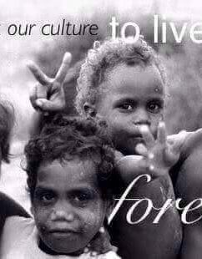
…a complex system of governance which regulates people’s social, political and economic lives…it also defines the kinship structures, cultural traditions and spiritual beliefs of all Kimberley peoples and governs the restricted esoteric practices of its initiated members…(it) provides the basis for traditional medicine, education and specialised training. This knowledge is encoded within the Dreaming stories, ceremonies, song cycles, cultural activities and dances of all language groups in the region” (KALACC, 2006, p.16, Presenter’s emphases).
© Tjallara-Hovane Trust 2023

Slide 10
Dreaming stories contain the moral and spiritual rules that govern human interaction and ensure harmony between all living things and the country that gives them life. The religious aspects of Law are therefore interwoven into every aspect of Aboriginal people’s existence (KALACC, 2006, p. 38, Presenter’s emphases).
© Tjallara-Hovane Trust 2023

Slide 11
Culture or the ways in which people apply Aboriginal Law may be subject to change in response to western influences (KALACC, 2006).
  “It’s how you live, how you talk, how you just present yourself…So, our young people these days don’t realize culture not only means ceremonial time…” (KALACC, 2006, p.49).
© Tjallara-Hovane Trust 2023

Slide 12
Creating a shared starting point
Aboriginal people believe that the same life forces that animates human life also animate animals, plants, watercourses, celestial bodies, mountains and deserts.
All forms of life, human and non-human, animate and inanimate, are interdependent and require looking after to maintain the health and balance of life as it is known and as it should be lived.
In this cultural system, health and wellbeing cannot be understood in simple biological or even social/psychic terms: good health as well as illnesses are expressions of what is going on in the whole of life (MacDonald, 2016).
Notes:
So the data about ongoing over-representation in incarceration, as perpetrators and victims of violence, of lower life expectancy and chronic diseases, highlight the extent to which our whole world is ailing.

Slide 13
Creating a shared starting point
Aboriginal children are said to have pre-existed in a place in the land as spirits where they kept company with their ancestors.
Aboriginal children and their personhood were/are thus conceptualised within spiritual, social (kin) and spatial (country) contexts.
Their spiritual and security of their being, begins in infancy, and with the right social and spatial placement of the baby, the spiritual and security of their being could be further consolidated as the child grew up (MacDonald, 2016).
The explicit social and spiritual embedding of the person defines the life trajectory of individuals and is a condition or foundation for well-being.
All ‘right’ forms of children’s behaviour, is an effect of still being close to the Dreaming, that is, to the moral foundation of society.
© Tjallara-Hovane Trust 2023

Slide 14
Aboriginal child-rearing practices developed an adult who’s identity is centred around relationship.
An adult who grew up through such a system understood himself as a self through constant and consistent connection: a social self.
For this person, relationship was more important than objects; and these relationships included and were deepened by continuity with the land and the spirit world.
Developmental milestones were framed around knowledge and skills needed to successfully navigate life in a strictly regulated environment – Not in terms of readiness for school or according to chronological age.
Relationships of equivalence between family members endure throughout life and present a moral principle: a person might be punished for the transgression committed by his relative (MacDonald, 2016).
Creating a shared starting point
© Tjallara-Hovane Trust 2023
Notes:
Care-givers/parents did not attempt to shape their children through discipline.
They didn’t toilet train, they breast-fed as long as possible, they made no efforts to schedule or control children.
All social life was organised around nurturing, which refers to ‘the giving and receiving of care, nourishment and protection which is initiated in the creation, bearing and rearing of children’.
Parenting is a skill learned from being parented and it is specific to the demands of a particular way of life in all its facets. Aboriginal children learnt as they lived: alongside experienced and knowledgeable parents and others.
Developmental milestones – observation from senior man in a remote town – children don’t know how to light a fire, cook a kangaroo in the coals – noted the importance of teaching them and these teachings being incorporated into a family program.
Teaching in Aboriginal society was thus as formal and structured as that employed by a physical education teacher or sports coach in a post-industrial society. In addition to formal training, Aboriginal children acquired skills to collect food, for hunting, fishing, cooking, and making implements by imitation, especially of their older siblings, and by observation and direct participation of all the activities of those around them.

Slide 15
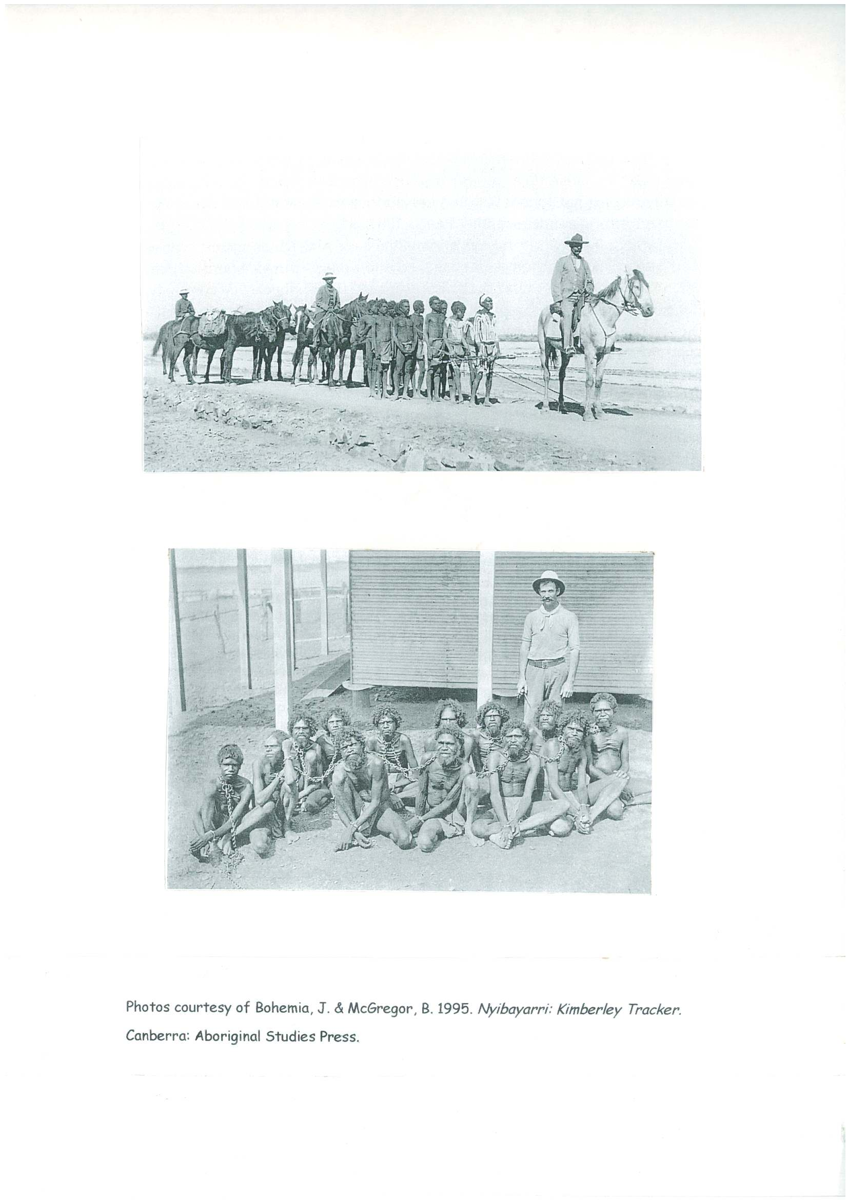
Colonisation happened

Slide 16
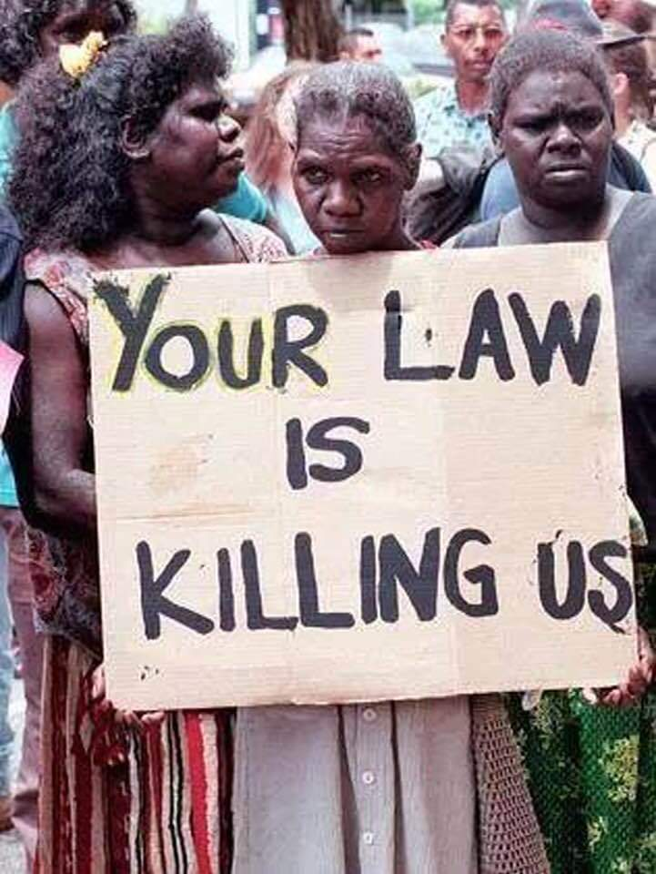
The imposition, from above, of mainstream social and legal norms constantly threatens to unravel the fabric of Law and Culture
“it’s not that Culture is dying on its own, gardiya [white] law is killing it … Kimberley still have Law and Culture and Language. It needs watering and fertilising from the Western world.”
“White men need to recognise our Law and Culture and Language, government white people, before we can sit together to talk about these issues.”

Slide 17
Complex Trauma
Chronic Systems failure
Chronic experiences of injustice
Family & Domestic Violence
Self-medication with substances
Abuse & neglect
No recognition of Lore
Forced removals
Institutional Racism
Racism
Racialised incarceration
Separation from Country
Constant triggers of loss
Culturally unsafe service system
Economic marginalisation
Grief & loss
Grief & loss
Deliberate fracturing of kinship system and the cultural structures that are protective factors, disconnection from Country, prohibitions on practicing Lore and Culture that ensure everyone is cared for and looked after
Grief & loss
Grief & loss
Collective trauma of invasion and ongoing colonisation
Notes:
But then we had colonisation

Slide 18
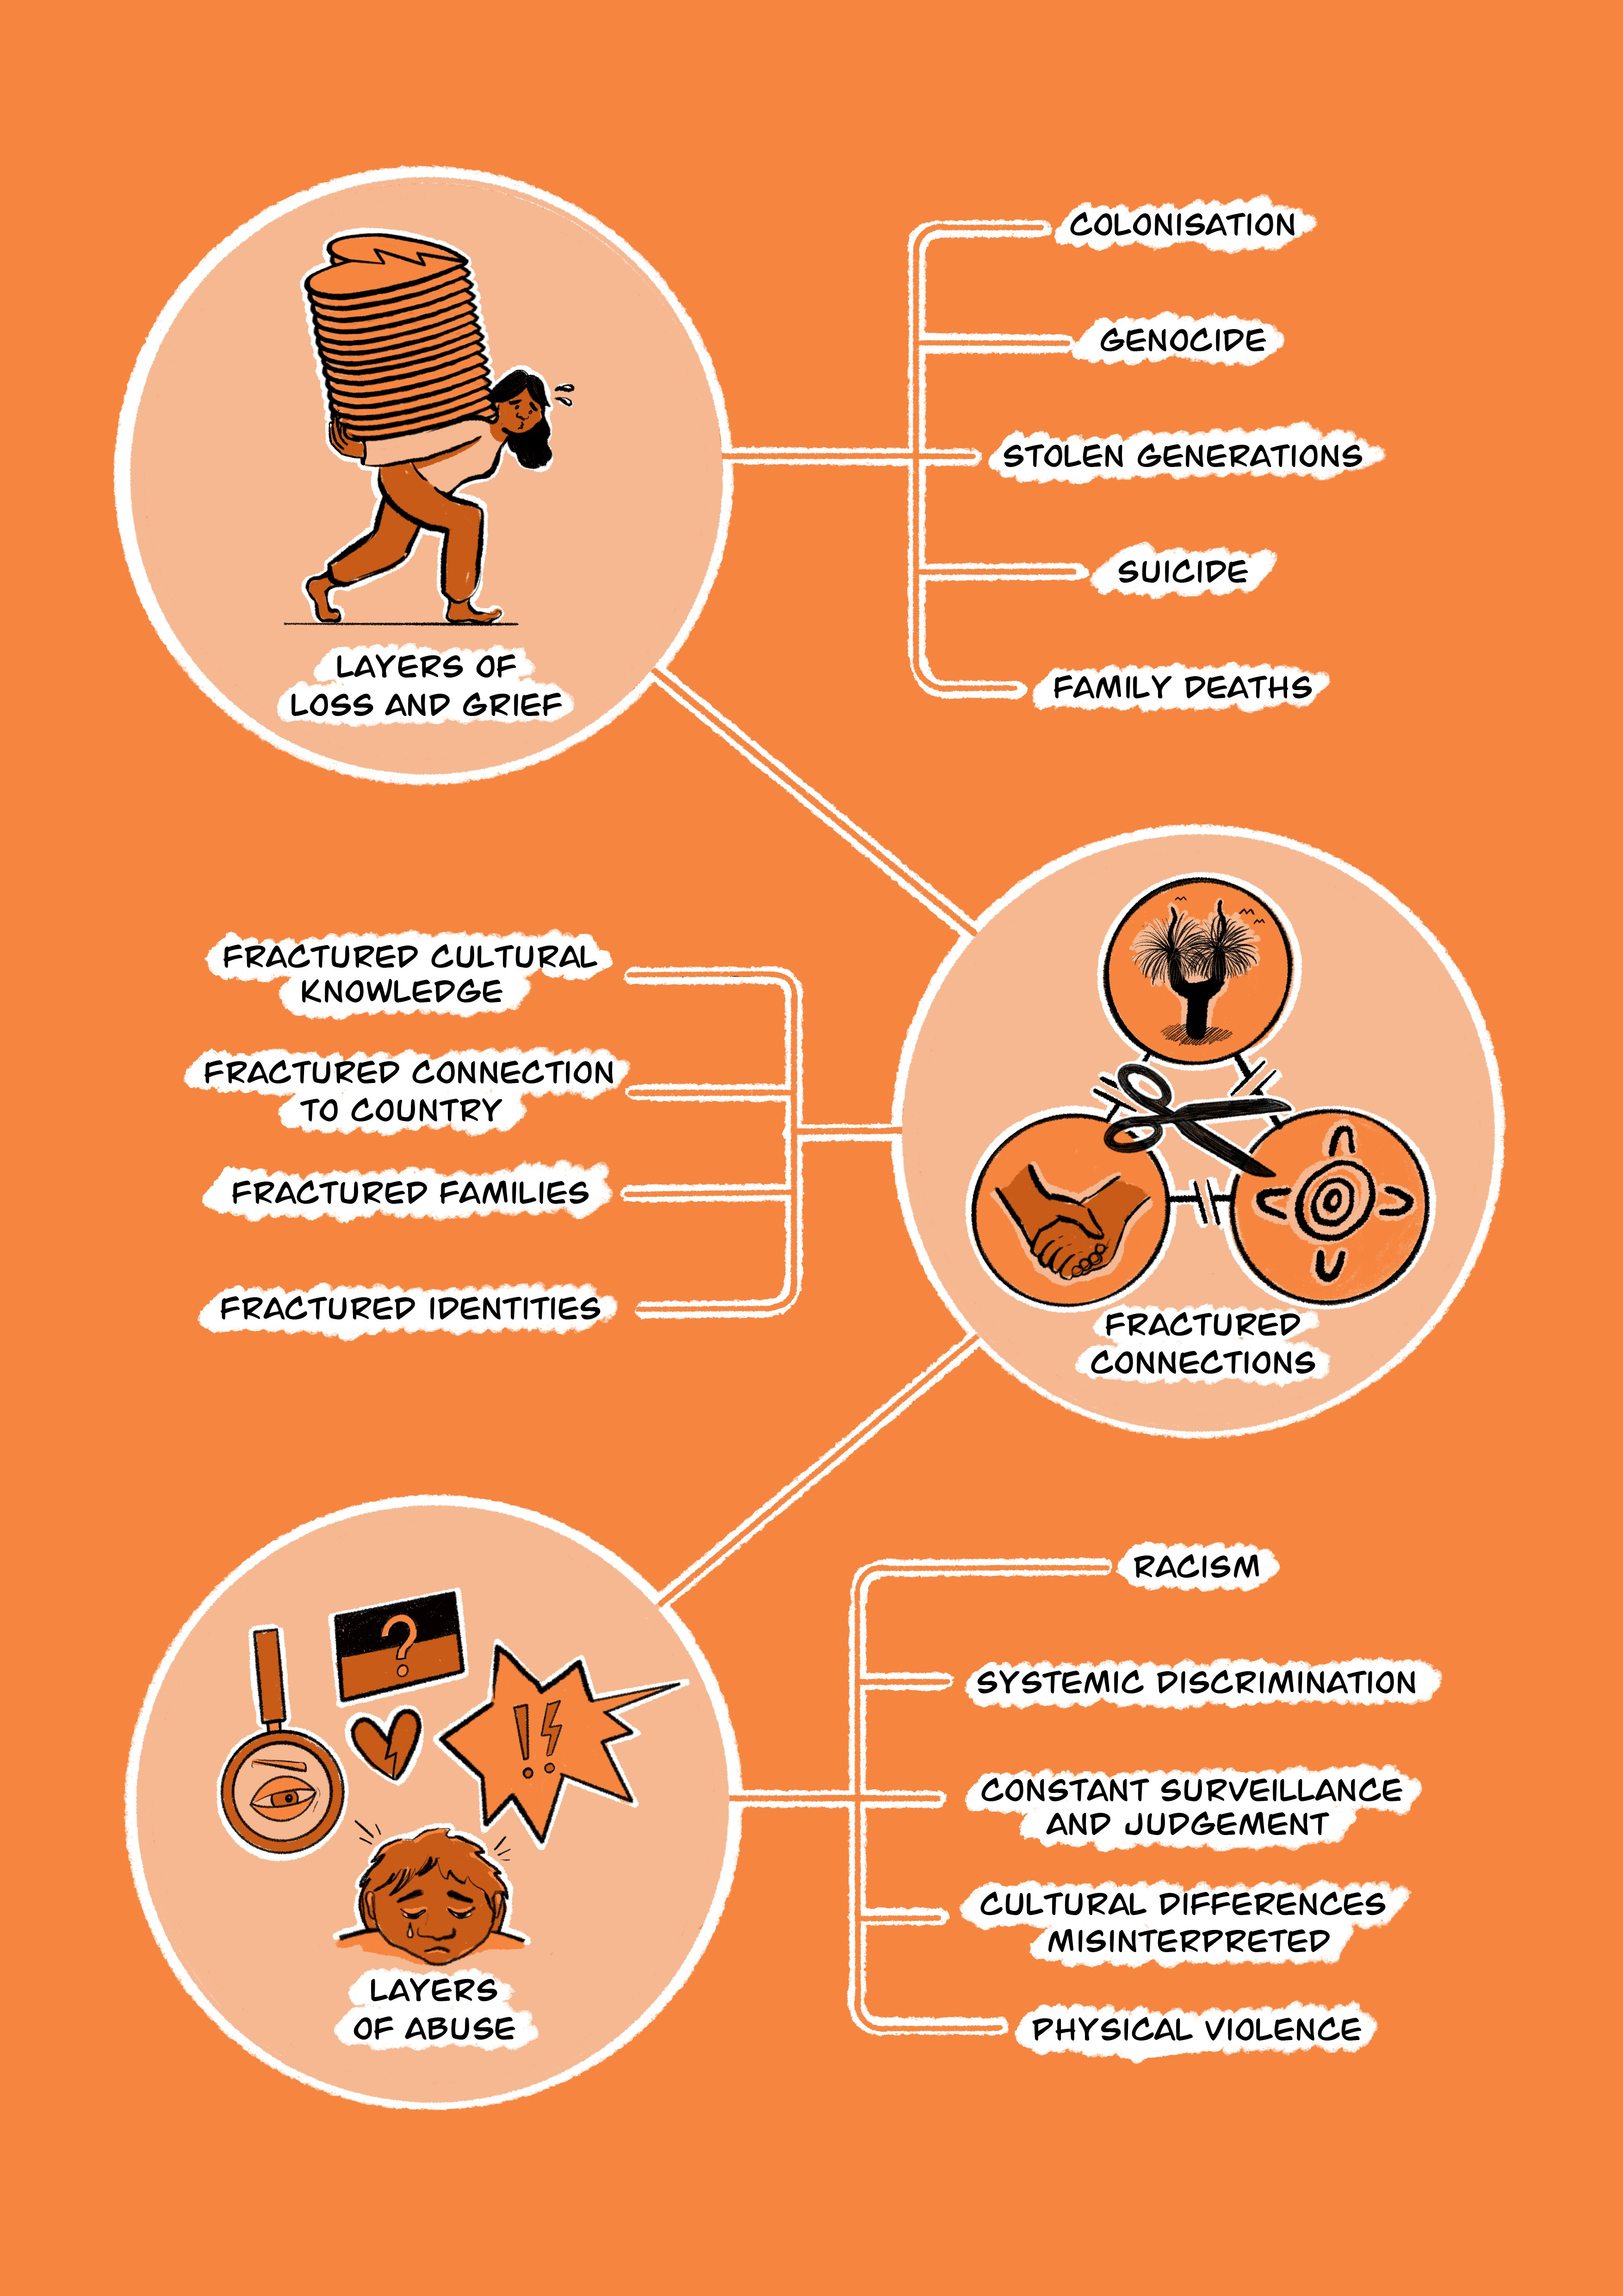
Noongar Trauma and Healing Model
(Hovane, V., Sellers, L., Pickett, K., Mogridge, R., Pickett, L., Wallam, D., Chan, S. (2023).
Noongar Theory of Trauma
Onset and Causes
© Yorgum Healing Services 2023

Slide 19
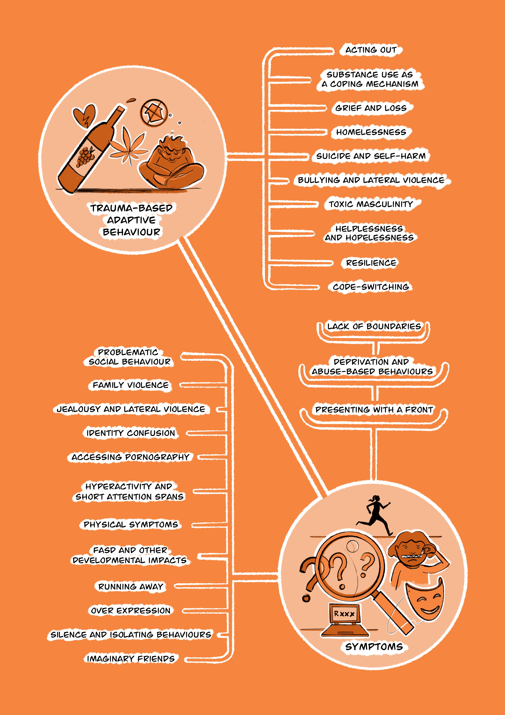
Noongar Trauma and Healing Model
(Hovane, V., Sellers, L., Pickett, K., Mogridge, R., Pickett, L., Wallam, D., Chan, S. (2023).
Noongar Theory of Trauma
Impacts of Trauma - Symptoms
© Yorgum Healing Services 2023
Notes:
A short note on western feminism that has dominated the family violence space for too long: It is suggested that feminist goals are about securing women’s autonomy, liberty and equality.
We claim a different perspective. Our template is one where we have different, but equally important roles and responsibilities. Story about funeral wake.

Slide 20
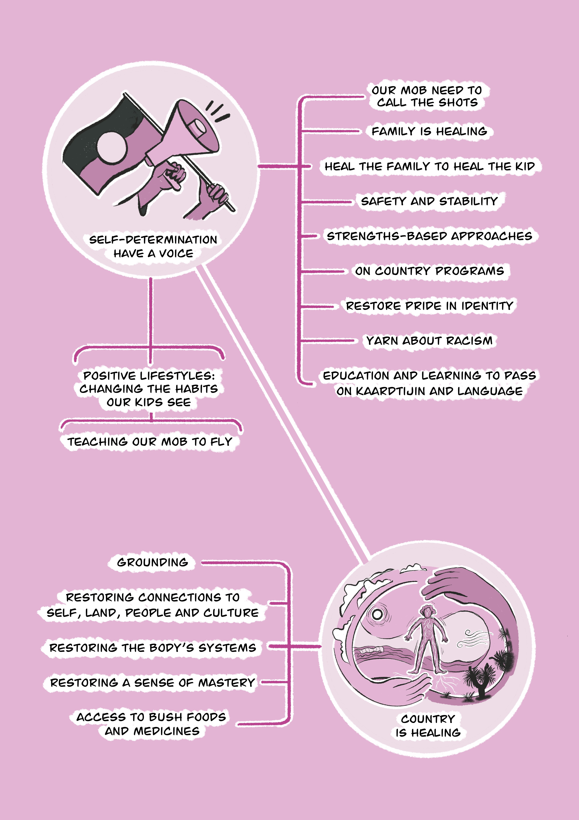
Noongar Trauma and Healing Model
(Hovane, V., Sellers, L., Pickett, K., Mogridge, R., Pickett, L., Wallam, D., Chan, S. (2023).
Noongar Theory of Trauma
Therapeutic responses to heal that trauma.
© Yorgum Healing Services 2023

Slide 21
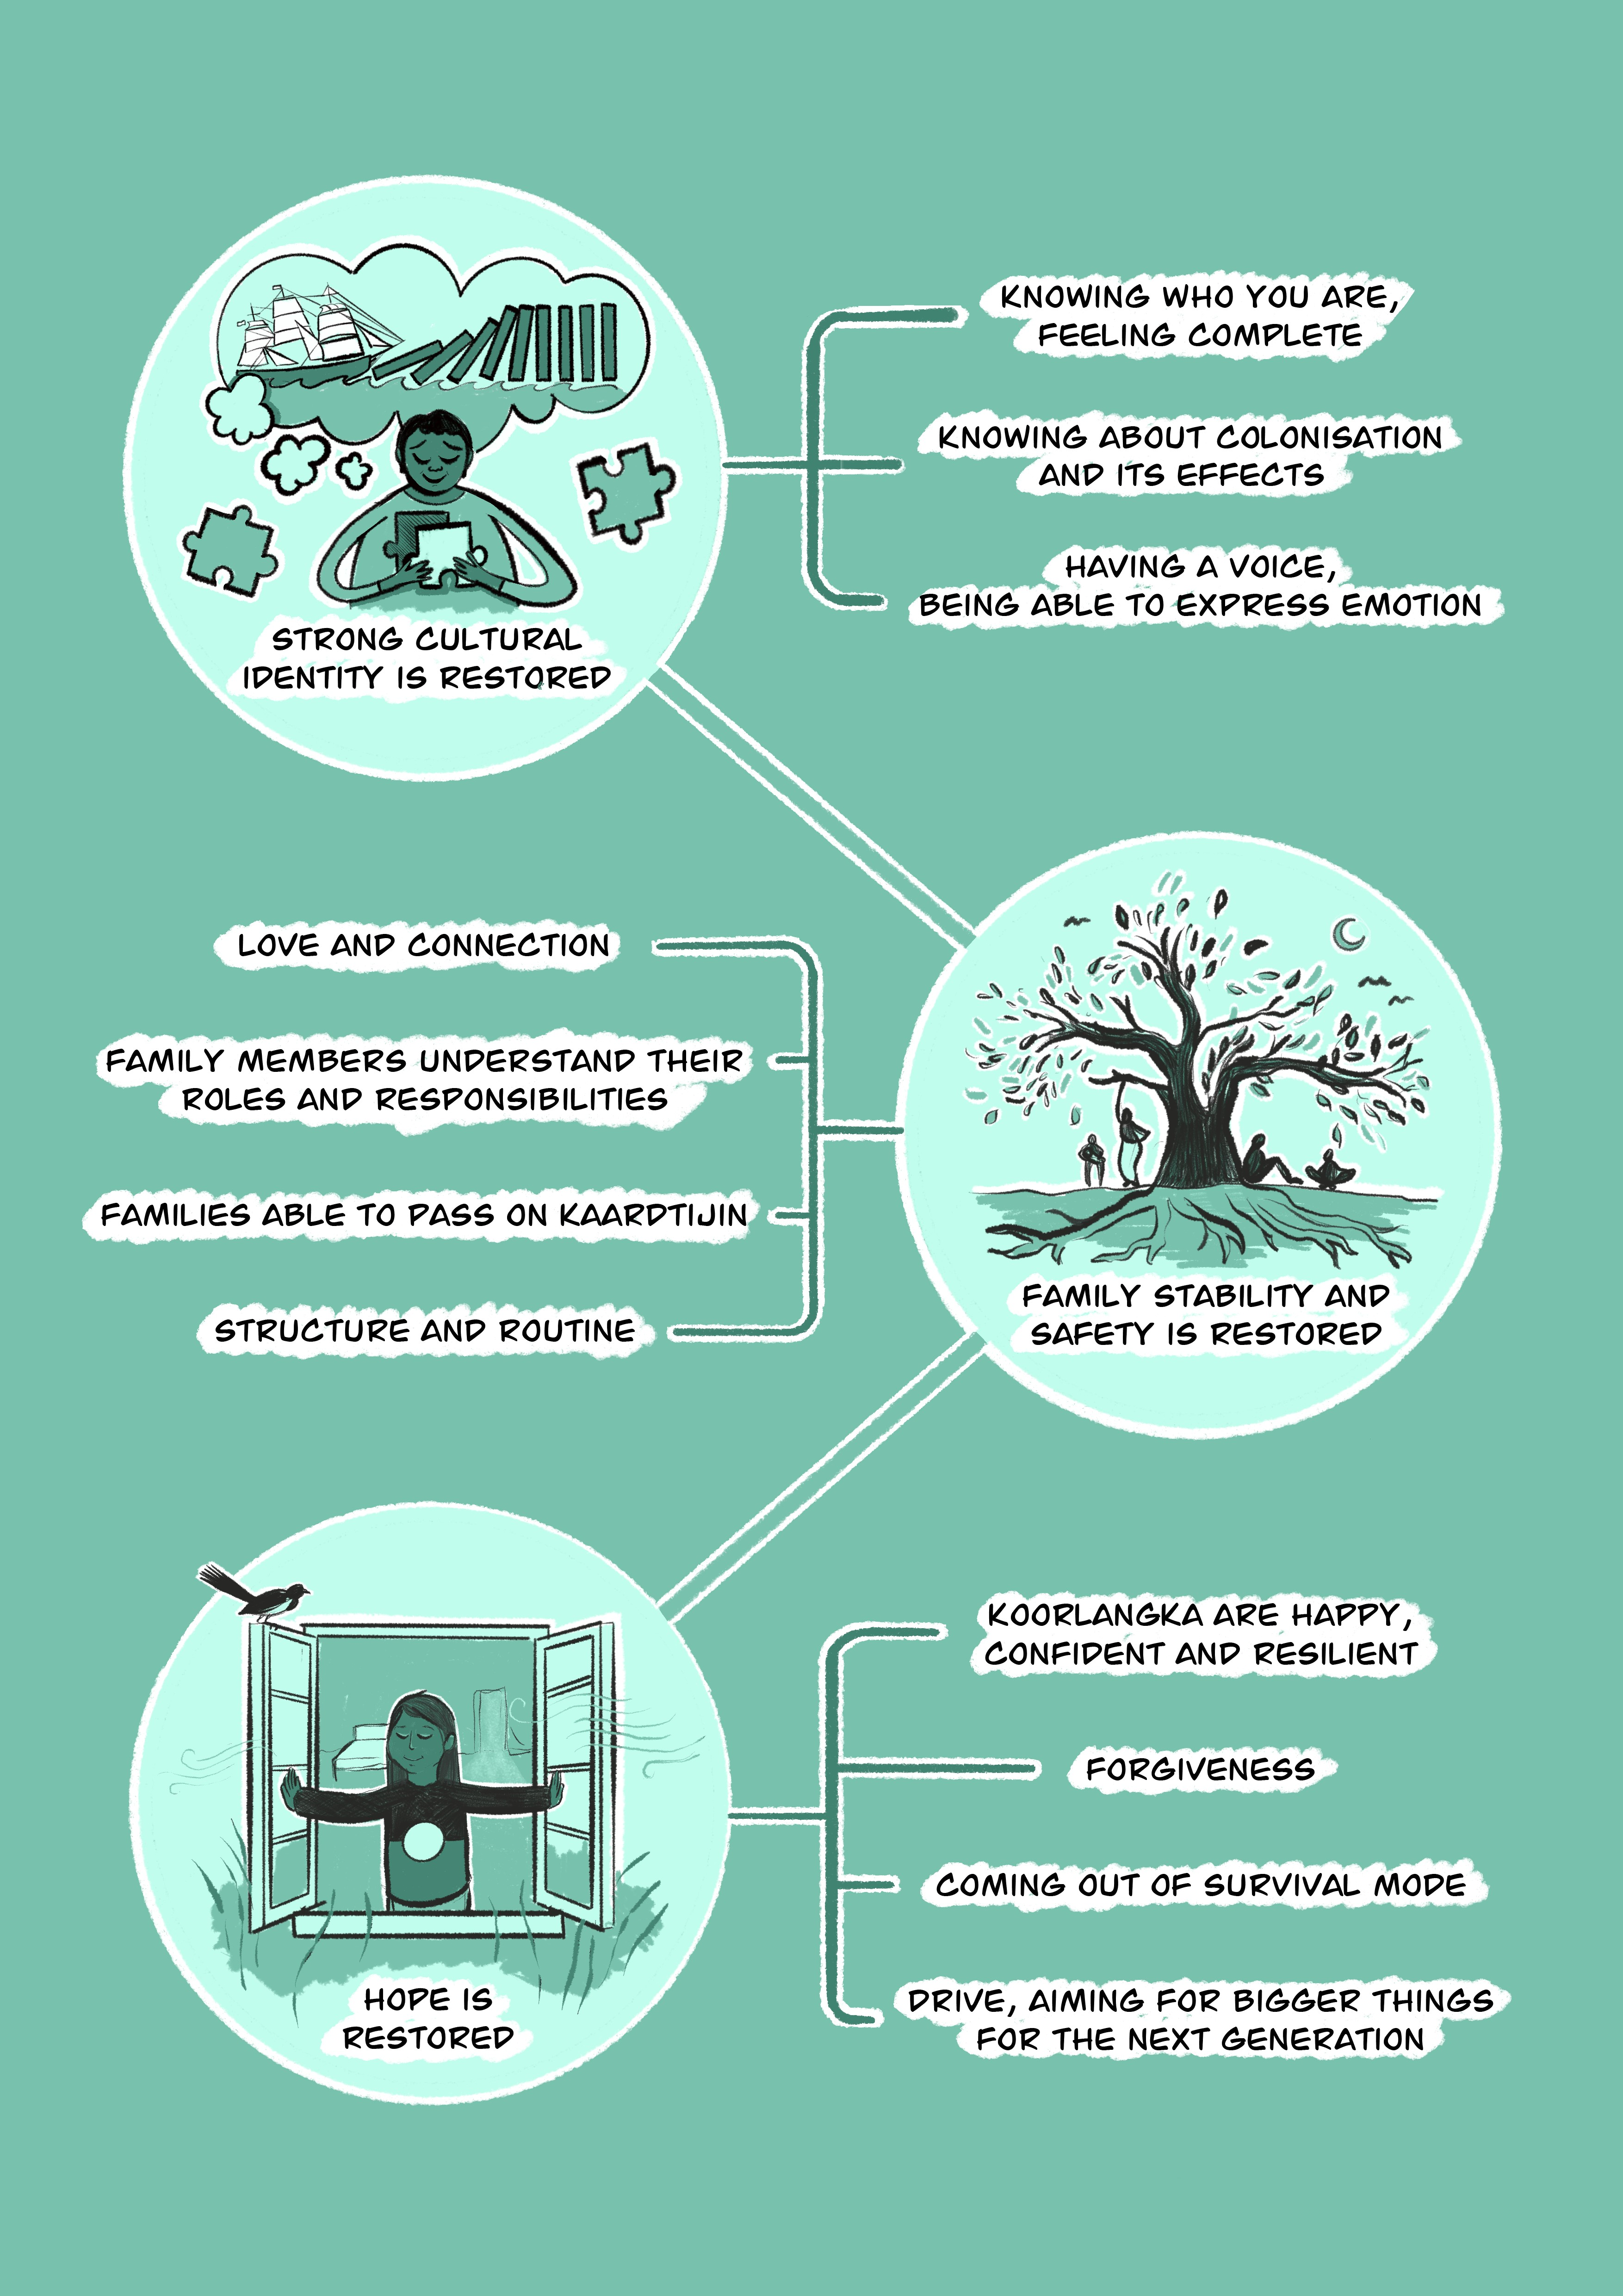
Noongar Trauma and Healing Model
(Hovane, V., Sellers, L., Pickett, K., Mogridge, R., Pickett, L., Wallam, D., Chan, S. (2023).
Noongar Theory of Trauma
What healed people, families and communities might look like.
© Yorgum Healing Services 2023

Slide 22
Implications for policy and practice
Be evidence-informed (Aboriginal knowledge systems included)
A different paradigm based on Law and Culture, holistic, trauma-based, recognises the strengths and cultural resources available in our cultural perspectives.
A different way of working with Aboriginal communities, families and individuals – Aboriginal-led, community-based solutions. Self-determination is critical to a strengths-based approach
Community readiness for change must be assessed and inform implementation activities.
Cultural governance is essential (not a reference group but Cultural Bosses or leaders, or their nominated representatives – ensuring the right people are at the table; the right people providing permissions, e.g., culture bound syndromes)
“Cultural Bosses managing Law and culture daily for education, health, community and cultural governance, self-esteem and the management of country” (Sullivan & Kinnane, 2015).
© Tjallara-Hovane Trust 2023
Notes:
Community readiness refers to understanding a community’s capacity to engage with and
implement programmes, policies and other strategies aimed at reducing family violence/incarceration rates/creating safety, within the context of local values, norms, attitudes and perceptions regarding family violence, youth offending behaviour, etc.

Slide 23
Thank you
Questions?
© Tjallara-Hovane Trust 2023

