Slide 1

Predictive factors in attempted and completed suicides in Queensland correctional facilities
Applied Research in Crime and Justice Conference, Sydney
13-14 February 2019
Dr Sandy Sacre
Director, Research, Evaluation and Performance
Dr Jenny Bell
Manager, Research and Evaluation Unit
Dr Alexia Lennon
Principal Adviser, Research and Evaluation Unit
Ms Mel Conway
Senior Adviser, Research and Evaluation Unit
Notes:
I’m Jenny Bell, current Manager of Research and Evaluation at Queensland Corrective Services here with the director of Research, Evaluation and Performance at QCS, Sandy Sacre.
We have a small research and evaluation team at QCS conducting a range of research activities including internal evaluation and research around QCS programs and initiatives, we contract out external research projects as well as facilitating access to QCS data for external researchers.
We also have some capacity to conduct research projects on areas of both interest to QCS but also to the wider criminal justice area. This project we are presenting today is one of these.The study is titled predictive factors in attempted and completed suicides in Queensland correctional facilities. The issue of suicide is complex and tragic in itself amongst the general population, but that complexity is enhanced amongst the prisoner population, an already vulnerable group, with conditions for suicide and self-harm exacerbated by the experience of incarceration. So the question then we wanted to look at is what is it about prison experience that provides the conditions for suicide to be more likely to occur? What are some of these factors within the prison environment that are worth highlighting to agencies charged with looking after individuals during their period of incarceration that they need to be aware of to possibly limit or prevent the incidents of suicide and serious self-harm happening. Ultimate question is what can we do to prevent such incidents occurring?
It is just an exploratory and small scale project at this stage that we intend to build upon – at this stage though it does provide at least some insights into these questions.

Slide 2
Overview
Purpose of the study
Reported statistics on prisoner suicide rates
Current literature on predictors and risk factors
Parameters of our study
Results
Other observations?
Implications for policy and practice
Notes:
So where we’re heading with the presentation:
I’ll provide a review of the purpose of the study
Provide some reported statistics on rates of suicide and self-harm amongst the prisoner cohort
Briefly touch on some of the literature which has identified some predictors and risk factors
I’ll go over the parameters of our study including the time period and the sample
Then go over the results
Finish up with some other observations as a result of the analysis and then overall what some of these results may mean for policy and practice in this area

Slide 3
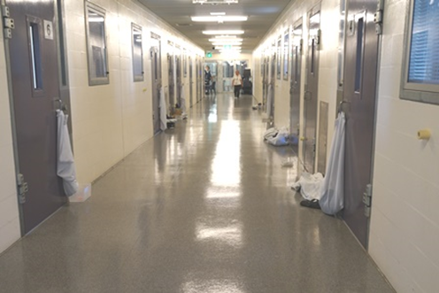
Purpose of the Study
Prisoners are at much higher risk of suicide than the general population (Fazel et al., 2017)
Understanding of risk factors associated with suicide and serious self-harm within prisoner populations less developed (Hawton et al., 2014)
Potential learnings in relation to strategies for suicide prevention & management of the risk of serious self-harm
Notes:
So it’s been well established in the literature that prisoners are at a much higher risk of suicide than the general population.
However understanding of the risk factors associated with suicide and serious self-harm within prisoner population, while the body of literature is growing, it remains under-developed.
Understanding in more detail what are the risk factors provides some potential learning in relation to suicide prevention and management of the risk of serious self-harm for correctional agencies.

Slide 4
Prisoners at higher risk of suicide
Prisoners have higher rates of suicide (typically 3-5 x general population) (Willis et al., 2016)
Enter prison with more risk factors for suicide than those in general community (Konrad et al., 2007; Larney et al., 2012)
Remain at elevated risk of suicide following release (Daigle & Naud, 2012; Pratt et al., 2006)
Almost 25% of prison entrants have history of self-harm (AIHW, 2015)
4% of dischargees report self-harming in prison (AIHW, 2015)
7% of entrants are identified at risk of self-harm or suicide (AIHW, 2015)
Notes:
Some stats from the literature:
International research shows that prisoners have higher rates of suicide with (this is typically 3-5 times the general population)
Individuals who enter prison have more known risk factors for suicide than those in the general population (so already a very highly vulnerable group)
Following release from prison, they remain at an elevated risk of suicide
Around of quarter of those entering prison have a history of self-harm
Other stats show that 4% of those released from prison report that they self-harm in prison
7% of entrants into prison are identified as being at risk of self-harm or suicide

Slide 5
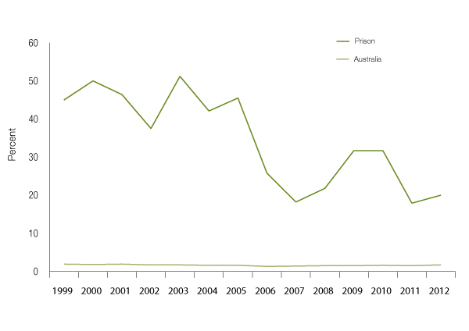
High rates of Suicide in Prison compared with General population
(Self-Inflicted Deaths: Prison vs Community 1999-2012)
Source: National Deaths in Custody Program, AIC data file; Australian Bureau of Statistics, Causes of Death, 1999–2012
Notes:
This chart showing self-inflicted deaths in prison compared to that in the Australian population,
Bottom line is the suicide rate within the general population (mean of 1.6%) while the top line is the suicide rate within prison in relevant population, 1999–2012 (mean of 35%) – but you can see that the rates are coming down. So Australia has had some success in reducing suicide within prisons due to a range of factors….
For example not shown here but the rates of self-inflicted deaths within custody for indigenous offenders has been trending downwards ( possibly as a result of a lot of flow-on work as a result of the Royal Commission into Aboriginal Deaths in custody which was completed in the early 1990s)
There have been physical changes to the prison cells to make things like hanging (which has historically been one of the main method for self-inflicted deaths within custody, particularly for indigenous offenders) less likely i.e. hanging points such as bars on the windows have been removed
That said, while this is a positive trend, any suicide within custody (or indeed the general population) is never acceptable and is a tragic event for all involved.
(if questioned about the rate)– so the overall proportion of indigenous suicides has not increased in line with the increased representation of indigenous persons in the Australian prison population (Willis et al )

Slide 6
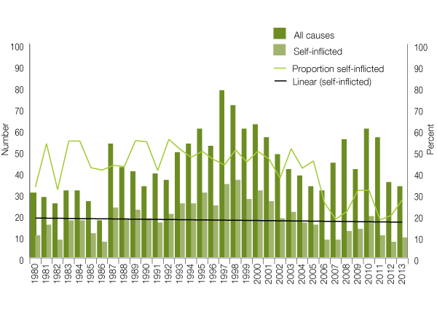
Self-inflicted deaths represent less than a third of deaths in prison
(Deaths in Prison Custody 1980-2013)
Source: National Deaths in Custody Program, AIC data file
Notes:
Since 2006, self-inflicted deaths have consistently represented less than a third of deaths in prison custody

Slide 7
Range of predictors and risk factors identified in the literature - 1
History of self-harm is a risk factor (Marzano et al., 2016) but doesn’t need to be serious self-harm (Hawton et al, 2014)
Males: older age (esp. 30-49); previous moderate or high lethality self-harm (Hawton et al., 2014)
Females: life sentence; previous self-harm (Hawton et al., 2014)
Suicide rates higher amongst those prisoners on remand/ unsentenced (Austin et al., 2014)
No associations with rates of overcrowding, ratio of prisoners to staff, prison capacity, mean cost per prisoner per day, mean length of imprisonment (Fazel et al., 2017)
Notes:
Range of predictors and risk factors identified in the literature. TO highlight some that have been reported
History of self-harm is a risk factor, but it doesn’t necessarily need to be serious self-harm.
Males, particularly older age groups, and in particular of the age group of 30-49; and have previous moderate or high lethality of self-harm
For Females – being on a life sentence, and or have had previous self harm attempts are risk factors for suicide.
A study by Fazel and colleagues found no associations with rates of overcrowding, ratio of prisoner to staff, prison capacity, mean cost per prisoner per day or the average length of imprisonment.

Slide 8
Range of predictors and risk factors identified in the literature - 2
History of self harm & attempted suicide in & out of prison; History of adverse life events; Family history of suicide; More negative experiences of prison (e.g., bullying); High suicidal intent; Short period in custody or in current prison; Co-morbidity of psychiatric disorders (Marzano et al., 2016)
Attempts due to prisoner being unable to cope in prison; motivated by psychotic symptoms; instrumental motives; “unexpected” by the prisoners themselves; associated with withdrawal from drugs (Rivlin et al., 2013)
Notes:
A study by Marzano and colleagues found that a history of selfharm and attempted suicide in and out of prison, a history of adverse life events, family history of suicide, more negative experiences of prison (e.g. bullying), high suicidal intent, shorter periods in custody or in their current prison, and experiencing psychiatric disorders were predictors of suicide
Other predictors identified in a study by Rivlin and colleagues who developed a typology of prisoners which highlighted such risk factors for near-lethal suicide attempts as prisoners being unable to cope in prison; they had psychotic symptoms such as hearing voices that were telling them to hurt/ kill themselves or were experiencing severe paranoia; instrumental motives i.e. they didn’t actually want to die but were making the attempt to get a certain outcome such as to be transferred out of their cell; those where the suicide attempt was unexpected i.e. otherwise apparently well adjusted prisoners were overwhelmed in a short period of time by series of adverse life events inside and outside of prison..too the prisoner, the attempt was unexpected, unforeseen or out of character; or finally the attempt was associated with withdrawal from drugs.

Slide 9
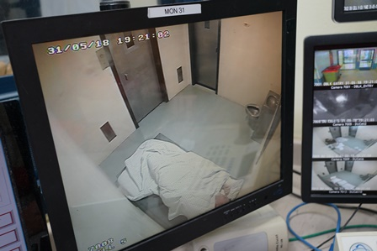
QCS Study: Possible Predictors from the Literature
Age
Gender
Indigenous vs non-Indigenous
Mental health and self-harm history; previous attempts
Time in custody
Most serious current offence/charge
Remand vs sentenced
Notes:
Our study drew on the literature to provide a framework for the possible predictors of suicide or serious self-harm. So things that were identified in the literature that were determinants in suicide:
i.e. age (older ages 30-40s+ more likely than younger in their 20s),
gender (suicide rates for males higher than females),
Indigenous
mental health (if have had mental health history) and self-harm history,
time in custody (suicide more likely where an individual had been in custody for a shorter length of time), most serious offence/ change (more serious/ violence offences come up in the literature), or remand vs sentenced

Slide 10
QCS Study: Other Potential Predictors
First custodial period
Accommodation area within centre
Time of day
Recent/impending transfer
Identified concern / level of monitoring
Shared cell vs own cell
Protection status
Safety order
Flag (e.g. cognitive impairment)
Substance misuse
Significant recent stressors (e.g. family conflict, bereavement, recent/upcoming court, media attention)
Receiving visits
History of experiencing sexual assault/abuse
Notes:
We considered however a range of other potential factors to look at and include in the analysis
Whether individual was on their first experience within custody
Their accommodation i.e. residential or in the secure or crisis unit/ medical/ MSU of some form
The time of day i.e. morning, evening, over night
Whether they had or were about to experience a transfer from their current cell or centre
The level of monitoring they were under at the time of the attempt
Whether they were in a shared cell or in their own cell
Whether they were a protection prisoner or not – protection prisoners are those identified as needing protection because they are at risk i.e. likely to not feel safe so have been segregated somewhat i.e. association issues with the prison, sex offenders
Whether they were on a safety order or not – don’t feel safe because of risk to themselves or because of a risk of others
What flags had been raised on them i.e. cognitive impairment, sex offender etc
Whether they had a history of substance misuse
Significant recent stressors such as family conflict, relationship breakdown, media attention about their offence
Receiving visits (as a proxy for social/ family support)
A history of the trauma of experiencing sexual assault/ abuse. (could be as a child, in an institution as youth etc or within custody)

Slide 11
Sample
Time period: 1 October 2016 to 30 Sept 2018
Manually extracted from the Integrated Offender Management System (IOMS)
‘Attempted suicide’ definition for recording in offender database (IOMS): Self-harm that reasonably appears to have been intended to cause death or would likely have caused death if assistance had not been rendered
Checked medical emergency and self-harm incident data to ensure no cases were missed
Completed suicide (N = 4) (3 Male; 1 Female)
Attempted suicide (N = 134 incidents; 80 individuals)
Notes:
Our time period was 2 years October 2016 – to get the latest data
Data was manually extracted from QCS’ offender management system IOMS
When entering an incident into the system, the officers would use this definition of attempted suicide i.e. that is self-harm that reasonably appears to have been intended to cause death or would likely have caused death if assistance had not been rendered. This is what we extracted then.
We also checked medical emergency and self-harm incident data to ensure that no case were missed –for example in some instances some were coded twice i.e. coded as attempted suicide as well as self-harm; so it could be the case that it is sometimes difficult for the officer to determine whether it was an attempted suicide or self-harm.
Our resulting sample then was 4 completed suicides of which 3 were male and 1 was female
And 134 attempted suicide incidents (though 80 individuals with a proportion having multiple suicide attempts)

Slide 12
Analyses
Mostly categorical variables
Compared completed vs attempted (small number of completers precluded regression analysis)
Recoded by “level of seriousness” and compared
  1 = completed or extremely serious (hospitalised & made no alert/not seen)
  2 = serious but not hospitalised and/or made alert/done in view of staff)
Regression: Age; number correctional episodes; days from admission to custody
Chi square analyses comparing two seriousness groups on dichotomous categorical variables
Notes:
So the analysis we carried out was only very exploratory and preliminary analysis at this stage. Variables were mostly categorical (DO NOT SAY….has two or more categories but there is no intrinsic ordering to it i.e. gender, accommodation area).
We firstly looked at comparing completed suicides vs attempted, though we were limited in the analysis that could be done on this because of the only small number of completed suicides (however there are some observations of interest which I’ll come to).
We then looked at the data another way, recoding the incidents by ‘level of seriousness’ of attempts which then allowed us to compare two groupings – 1 those of completed or extremely serious attempts (i.e. the individual was hospitalised and no alert was made or the attempt was not seen by staff or other prisoners; and 2 – those who were serious but less so than the others i.e. were not hospitalised and/ or made alert/ done in view of staff or other prisoners). Note that serious still may mean that the intent is there but just that they’ve chosen less lethal methods.
Regression analysis conducted to assess the impact of variables of age, number of correctional episodes, days from admission to custody on completed/ extremely serious suicide attempts
Chi square analysis conducted on the categorical variables.

Slide 13
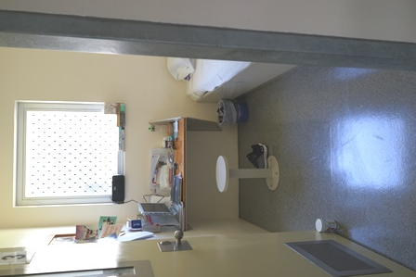
Incidents (N=138)
Days between admission to custody & incident: Range 1 – 6305; mean = 896 or 2.4 years)
Time of day:
  61% daytime (between 7am & 5pm)
  30% evening (between 5 & 11pm)
  9% night (between 11pm and 7am)
Custodial centres: Higher incidence at centres with high concentration of remand, protection &/or vulnerable prisoners (e.g., with crisis units)
Accommodation area
  Secure units – 37%
  Detention /Maximum Security Units – 30%
  Crisis /Safety /Medical Units – 27%
  Residential units – 4%
  Other (e.g., in transit) – 2%
Notes:
So this is looking at the full number of incidents (includes the completed suicides here) and trends in the incidents themselves.
The average time between admission to custody and the incident was 2.4 years
Time of day – just under two thirds occurred in the daytime, just under one thirds in the evening and less than 10% occurred overnight
There was higher proportion of the incidents occurring in centres with a high proportion of prisoners on remand, protection and or vulnerable prisoners
In considering the accommodation area where the incident occurred – fairly evenly spread across the secure units, detention units/ MSU or the crisis/ safety/ medical units (all these areas where a prisoner would be accommodated if they were more at risk). Only a small proportion occurred in the residential areas of the prison (Residential – where prisoners have more freedom, typically employed, have progressed to this type of area because of good behaviour; and are considered low risk).

Slide 14
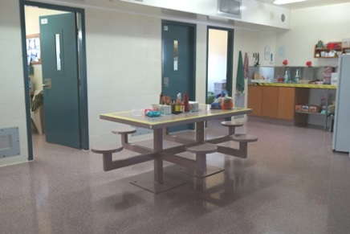
Incidents (N=138)
Location of incident:
  81% in cell (only 15 / 138 were in shared cells)
  13% in common area (e.g., yard, landing)
  3% in other location (e.g., vehicle, interview room, air lock)
  2% in bathroom adjoining cell
  1% in hospital
Methods:
  33% strangulation / asphyxiation
  32% hanging
  28% laceration
  7% other (e.g., choking, overdose, head banging)
Notes:
The overwhelming majority of the incidents occurred in their cell, however interestingly only 15 of the 138 incidents we where an individual was in a shared cell – most of the incidents occurred when a prisoner was on his own in a cell. A need then to give consideration to shared cells being a possible protective factor for risk of suicide – all talk about the problems that are caused by overcrowding and there is no doubt the negative impacts this would have however removing the double ups may cause other issues when you are talking about preventing suicide or self-harm
The methods used – around a third each of strangulation/ asphyxiation (tying something around next), hanging (attached to something else as well as themselves) and slightly less of lacerations (e.g. cutting arms, neck etc). Only a small proportion tried other methods such as choking, overdosing, head banging etc.

Slide 15
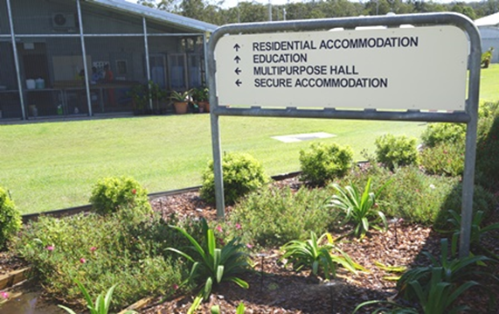
Incidents (N=138)
33% taken by ambulance and hospitalised
41% alerted staff (immediately prior or after) or made attempt whilst directly observed by staff
65% on a safety order
91% self-harm history flag
Observation level at time of incident:
  6% on continuous visual observation
  40% visually observed every 15 to 30 minutes
  12% visually observed every hour
  8% visually observed every 2 hours
  34% not on visual observation schedule
Notes:
Around a third were serious enough to be taken by ambulance and hospitalised
Just under half alerted staff or made the attempt while being directly observed by staff
Two-thirds of the incidents occurred while an individual was on a safety order
91% of the incidents occurred while an individual had a self-harm history flag
Observations were interesting – two thirds were on some form of obs with nearly half on high levels i.e. continuous or every 15 to 30 mins. However 34% were not on any observation schedule at the time of the incident.

Slide 16
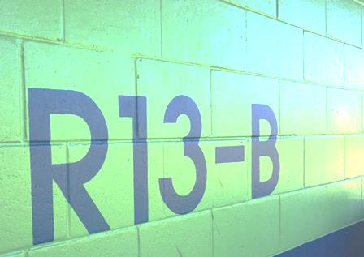
Completers (n=4*)
Age: 21 - 51 (M = 38.5)
Correctional episodes: 1 - 3 (M = 2)
Days between admission to custody & incident: 6 -144 (M = 66)
Non-completers (n=80)
Age: 17 -62 (M = 32)
Correctional episodes: 1 - 22 (M = 4)
Days between admission to custody & incident: 1 - 6206 (M = 588)
*Note: small sample size; indicative only
Notes:
So then we looked at it at the individual person level – note that these are just observations as the base size is so low but some are worthy of noting.
So we had 4 completers they were generally older in age than the individuals who were non-completers; had been in custody for a shorter period of time and had had generally fewer correctional episodes

Slide 17

More Likely in Completions Vs Attempts
Completions more likely to occur at night (75% vs 7%)
In secure (75% vs 36%) or residential unit (25% vs 3%) than special crisis unit or detention unit (0% vs 60%)
In cell (100% vs 81%)
Method hanging (75% vs 31%)
Remand (100% vs 42%)
Most serious offence homicide (100% vs 12%)
First time in custody (50% vs 25%)
Not on visual observations (75% vs 33%)
Media attention (75% vs 11%)
Recent / current family issues (100% vs 32%)
Safety order (75% vs 65%)
Notes:
Looking at the comparisons of these individuals –
All four of the individuals that completed suicide did so in their cell, were on remand, their most serious offence was homicide and they had reported recent or current family issues
For three of these four individuals - the suicide occurred at night, they were in a secure unit, their method was hanging, they were not on visual observations, their offence had attracted significant media attention and they were on a safety order.
(Used ANZSOC code for most serious offence)

Slide 18
Less Likely in Completions Vs Attempts
Raise alert or do in view of staff (0% vs 42%)
Indigenous (0% vs 32%)
Flagged as sex offender (0% vs 33%)
Cognitive impairment (0% vs 32%)
Protection (0% vs 54%)
History of sexual assault / abuse (0% vs 50%)
Mental illness (25% vs 89%)
Substance misuse (25% vs 56%)
Notes:
Alternatively, none of these four individuals raised an alert or did it in view of staff, none were indigenous, none had a cognitive impairment, none had a history of sexual assault or abuse, none were protection prisoners, none were flagged as a sex offender.

Slide 19
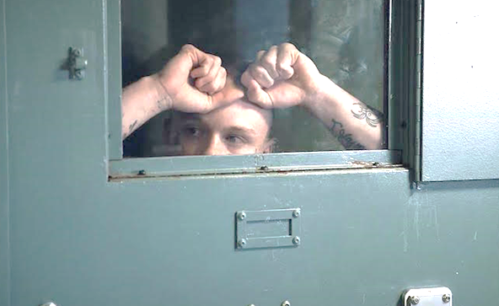
Completer Case Study
Male, aged 33
On remand for attempted murder
Significant media attention to crime
Method: In cell by hanging at 7.40am
On visual observations every 2 hours
On safety order
Admitted to custody six days prior (first time)
Withdrawing from amphetamines
Court mention for charges was scheduled to be in one week after suicide
Very serious suicide attempt with gun four days prior to entry into custody – in police incident after partner threatened to leave relationship
Serious overdose three years prior, again in context of partner indicating end of relationship
Notes:
E81398 220052 7/11/2017 13/11/2017 740 CCC Secure In cell N Hanging 1 N M 33 High N Remand Attempted Murder; Serious Assault w/weapon QPS Y 1 SHEH Y Low Y 1 N N Y N Y N Y N Y Y Admitted to custody 6 days prior; Court mention one week after suicide for charges; withdrawing from Amphetamines; Suicide attempt via gun shot to head 4 days prior in police incident after partner threatened to leave relationship; serious overdose 3 years prior, again when partner indicating end of relationship
Domestic incident.
So when he attemped suicide he did it seriously – not self-harm, serious intent to end his life (used lethal methods),

Slide 20
Non-Completer Case Study
Male, aged 40
Sentenced for serious assault resulting in injury
Method: In cell in Maximum Security Unit by strangulation at 6.30pm
On visual observations every hour & safety order
Admitted to custody just under two years prior to incident
Second correctional episode
On protection
Mental illness, substance misuse history & reported past sexual assault victim
Chronic painful physical disorder
Upcoming court in 3 months - said "I can't do another 5 years"
History of self-harm & serious suicide attempts, including hanging & cutting from young age, trying to shoot self when incarceration was imminent (gun misfired)
Notes:
C61673 214527 1/09/2015 30/08/2017 729 1825 WFDCC MSU In cell N Strangulation 3 N Y M 40 Max N Sentenced Serious asault resulting in injury (remainder) N 2 ESO; SHEC; E; MAXH; IR; PR Y medium N 8 Y N Y Y Y Y Y Y Y History of self-harm & serious suicide attempts, including hanging & cutting from young age, trying to shoot self when incarceration was imminent (gun misfired); said "I can't do another 5 years"; more court in 3 months; reports being victim of sexual assault in past; chronic painful physical disorder
Similarities between the two individuals.

Slide 21
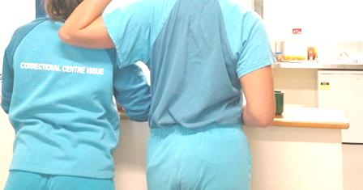
Completer/Extremely Serious Attempters (N= 23)
Vs Serious Attempters (N=61)
Regression: Age, number of custodial episodes & number of days between admission & incident did not predict seriousness of attempt
Chi square analyses - Non-significant differences:
Legal status
Method
Cognitive impairment
Protection status
Media attention
Safety order
Recent/current stressors
Location of incident
Gender
Indigeneity
First time in custody
Flagged as sex offender
History of sexual assault or abuse
Recent visits
Recent /upcoming court
Recent / imminent move
Notes:
So as I said, then we looked at the data another way to try to get a better picture of some possible predictors using a different grouping to create a larger sample size.
So firstly age, number of custodial episode and number of days between admission and incident did not predict seriousness of attempt.
For other variables we did a simple chi square analysis to assess if there were any significant differences between these two groups:
So no significant differences between the two groups in terms of these variables listed here…..

Slide 22
Levels of Visual Observation
Count
Extremely serious attempters and completers were significantly less likely to be under regular visual observation than less serious attempters, ᵡ2 (4, N = 84) = 10.49, p<.05.
Notes:
But for a small number of other variables there were some significant differences:
So for the level of visual observations, completers and serious attempters were less likely to be on obs.
So this was interesting for us – so these guys may have been waiting until they were off obs to do something more serious

Slide 23
History of Mental Illness
Count
Extremely serious attempters and completers were significantly less likely to have a history of mental illness than less serious attempters, ᵡ2 (4, N = 84) = 4.32, p<.05.
Notes:
Similarly, the completers or less serious attempters were less likely to have had a history of mental illness….so by all appearances and prior diagnosis they were generally fine mentally.

Slide 24
Substance Misuse
Count
Extremely serious attempters and completers were significantly less likely to have a substance misuse history than less serious attempters, ᵡ2 (4, N = 84) = 3.92, p<.05.
Notes:
Again, completers and extremely serious attempters were significantly less likely to have had a history of substance misuse.

Slide 25
Accommodation Area
Count
Extremely serious attempters and completers were significantly more likely to be accommodated in residential and less likely to be accommodated in a detention, crisis or maximum security unit than less serious attempters, ᵡ 2 (4, N = 84) = 10.77, p<.05.
Notes:
Completers and extremely serious attempters were significantly more likely to be accommodated in residential and less likely in areas such as detention/ crisis or MSU. So effectively they were flying under the radar and perhaps had even manoeuvred themselves deliberately out of these areas into somewhere they would be more likely to succeed in their attempt.
Less serious attempters more likely to be on our radar and in places where they would be monitored more.

Slide 26
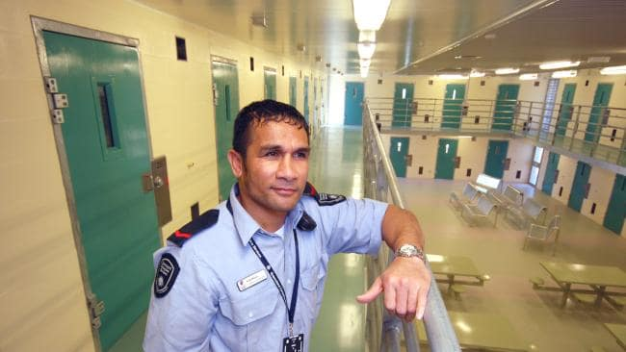
Other observations?
Prisoners who are determined to end their lives are less likely to raise alerts and seem to work towards an opportunity to execute their plan “out of the blue”, e.g., wait for move to single cell or when observations are reduced / ceased
Nevertheless, there are often strong warning signs:
  Remand for homicide
  Previous attempts using lethal means e.g., guns
  Early weeks of admission, often first custodial episode
  Acute stressors – family, court, media attention
Completers’ stressors & behaviours are often more acute than chronic
Difficult to formulate clear typologies: Often overlap between serious & less serious behaviours in same individuals
Notes:
So the study raised some other possible questions for us though too some of which I’ve touched on already i.e. are those prisoners who are more determined to end their lives, are they less likely to raise alerts and seem to work towards an opportunity to execute their plan, seemingly ‘out of the blue’.
Nevertheless, there are often strong warning signs which we’ve identified:
On remand for homicide (or a serious offence)
Previously attempts have used high lethality methods (e.g. gun)
In early weeks of admission, often first custodial episode – huge adjustment, stressors of the new environment
Acute stressors – family/ relationship breakdown, upcoming court or have had recent court appearance so a period of change; significant media attention typically related of course to the seriousness/ severity of the offence – but may mean a lot of things for the individual i.e. intense shame and guilt, they may have killed someone they love, family have disowned them because of the severity of the offence
The stressors and behaviours for completers seem to be more acute than chronic – so something may have just happened that has triggered the attempt so these are hard to predict i.e. difficult phone call with family etc.
Finally, difficult to form clear typologies – there is often overlap between serious and less serious behaviours in the same individual. And the literature confirms this last point that they are not mutually exclusive groups.
Limitations here….
Only 2 years of data – included only 4 completers
Very manual qualitative data extraction

Slide 27
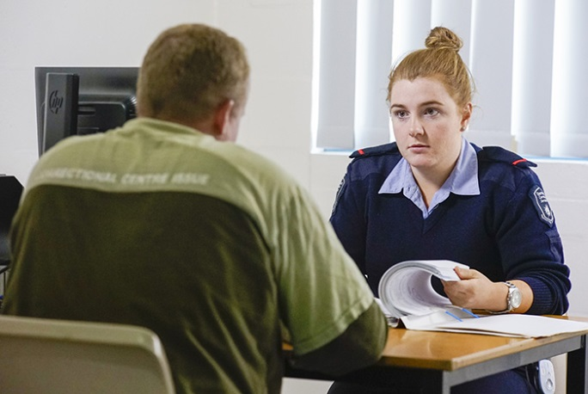
Implications for policy and practice
Need to focus on both prison/ system level factors as well as individual level factors
Visual observations – consideration to be given to irregular, as well as observations /checks at regular intervals – predictable intervals of 1 or 2 hours arguably allows too much opportunity
High risk remandees may be better accommodated in appropriately shared cells until they are past critical risk periods (protective factor)
Intensive psychological case management of offenders at high risk of lethal self-harm, especially in first 3 months & particularly when the prisoner is not yet well known to staff
Notes:
Some what then the implications for policy and practice – we’ve mentioned some here though many more…
Obvious need to focus on both the prison/ system level factors as well as individual level factors to find solutions to reducing suicide within a custodial environment
In respect of visual observation – consideration may need to be given to performing irregular as well as regular observations/ checks. Predictable intervals of 1 to 2 hours arguably allows too much opportunity
High risk remandees may be better accommodated in appropriately shared cells until they are past the critical risk period (another individual in a cell may be a protective factor)
There may be a need for intensive psychological case management of offenders at high risk of lethal self-ham, especially in the first 3 months, and particularly when the prisoner is not yet well known to staff. Those this then has resource implications which have to be managed as well at the prison level.

Slide 28
Implications for policy and practice
More consideration given to relationship breakdown or significant strain as risk factors, particularly for females and Aboriginal and Torres Strait Islander individuals
Greater emphasis to be placed on ‘holistic’ understanding of risk and protective factors at the individual level, taking into consideration full range of social, economic, physical, cultural and mental/ psychological factors
Notes:
More consideration may need to be given to relationship breakdown or significant strain as a risk factor, particularly for females and Aboriginal and Torres Strait Island individuals. And while I say this could be just for females…..actually it could also be males…..they have typically coped with such stressors via other activities such as drinking, drugs, hanging out with friends etc…- but once they are incarcerated their means of coping are drastically changed/ reduced…life restricted significantly in all aspects in custodial environment…can’t just ring up a friend, can’t just head to the gym, can’t get a drink/ drugs etc..)
And finally, greater emphasis to be placed on ‘holistic’ understanding of risk and protective factors at the individual level, taking consideration the full spectrum of their circumstances i.e. social factors, financial status, physical well being, cultural element and past and current mental/ psychological state.

Slide 29

References
Austin AE, van den Heuvel C & Byard RW 2014. Prison suicides in South Australia: 1996-2010. Journal of Forensic Sciences 59(5): 1–3
Daigle MS & Naud H 2012. Risk of dying by suicide inside or outside prison: The shortened lives of male offenders. Canadian Journal of Criminology & Criminal Justice 54(4): 511–528
Fazel, S., Ramesh, T. & Hawton, K. (2017) Suicide in prisons: an international study of prevalence and contributory factors. Lancet Psychiatry, 4: 946-52
Hawton, K., Linsell, L., Adeniji, S., & Fazel, S., (2014). Self-harm in prisons in England and Wales: an epidemiological study of prevalence, risk factors, clustering and subsequent suicide. Lancet, 383: 1147-54
Konrad N, Daigle MS, Daniel AE, Dear GE, Frottier P et al. 2007. Preventing suicides in prisons, part 1: Recommendations from the International Association for Suicide Prevention Task Force on Suicide in Prisons. Crisis 28(3): 113–121
Larney S, Topp L, Indig D, O’Driscoll C & Greenberg D 2012. A cross-sectional survey of prevalence and correlates of suicidal ideation and suicide attempts among prisoners in New South Wales, Australia. BMC Public Health 12(14). http://bmcpublichealth.biomedcentral.com/articles/10.1186/1471-2458-12-14
Marzano, L., Hawton, K., Rivlin, A., Smith, N., Piper, M. & Fazel, S. (2016) An overview of initiatives based on a systematic review of research on near-lethal suicide attempts. Crisis, 37: 323-334
Pratt D, Piper M, Appleby L, Webb R & Shaw J 2006. Suicide in recently released prisoners: a population-based cohort study. Lancet 368(9,530): 119–123
Rivlin, A., Ferri, R., Marzano, L., Fazel, S. & Hawton, K. (2013) A typology of male prisoners making near-lethal suicide attempts. Crisis, 34: 335-347.
Willis, M., Baker, A., Cussen. & Patterson, E. (2016) Self-inflicted deaths in Australian prisons. Trends & issues in crime and criminal justice. No. 513, August

Slide 30

Questions?

