Slide 1
Striving for effectiveness in crime and justice policy: Rhetoric, reality and pathways for the future
Paul Mazerolle
Griffith University

Slide 2
Overview
Background—an early introduction
Current context and practices
Why evidence matters
Why is this so hard?
  Political context; organisational context; academic context
Where we need to get to—how can we move forward?

Slide 3
Background

Slide 4
Current context and practices

Slide 5
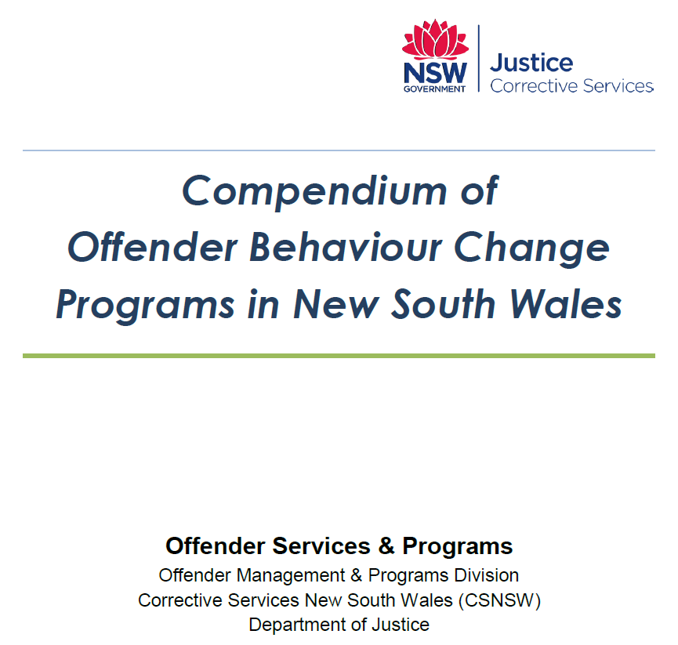

Slide 6
Consider the impact of “common sense” solutions on crime and justice practices
The “common sense” revolution has brought about several criminological abominations:
  “nothing works” in corrections
  No frills prisons
  Boot Camps
  Preventative Patrol
  Scared Straight programs
  3 Strikes and You’re Out
Notes:
How can science get in the way of a good idea!
Commonsense revolution

Slide 7
Key elements
Embrace a culture of research and evaluation
Be informed about available evidence
Have research findings inform the construction of (fluid) guidelines for practice
Embrace accountability and continuous improvement
Notes:
How can police organisations justify the use of valaubel policing respources toward unproven strategies

Slide 8
Accessing knowledge---building organisational capability

Slide 9
Washington State Institute for Public Policy
The Washington State Institute for Public Policy (WSIPP) is a nonpartisan public research group located in Olympia, the hub of Washington State government. WSIPP is a team of multidisciplinary researchers who conduct applied policy research for the state legislature in a creative and collaborative environment.
WSIPP is strongly committed to the core values of nonpartisanship, quality, and impartiality. Created in 1983, WSIPP has become nationally and internationally recognized for the design, depth, and quality of its research reports and benefit-cost analyses.

Slide 10
Mission
WSIPP’s mission is to carry out practical, non-partisan research at the direction of the legislature or the Board of Directors. WSIPP works closely with legislators, legislative and state agency staff, and experts in the field to ensure that studies answer relevant policy questions. Fiscal and administrative services for WSIPP are provided by The Evergreen State College.

Slide 11
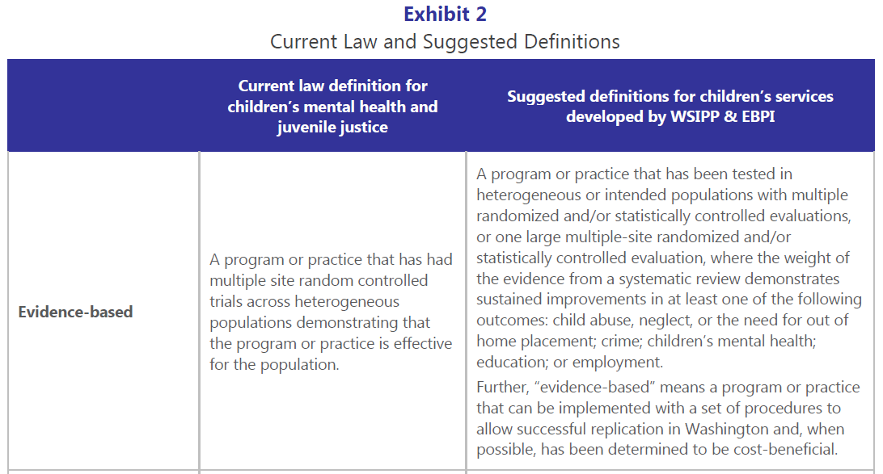

Slide 12

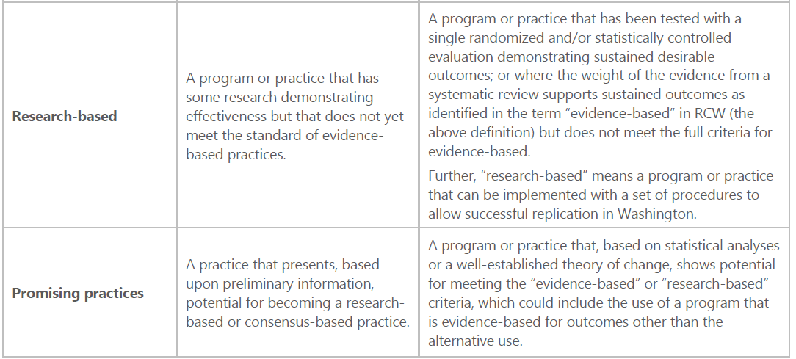

Slide 13
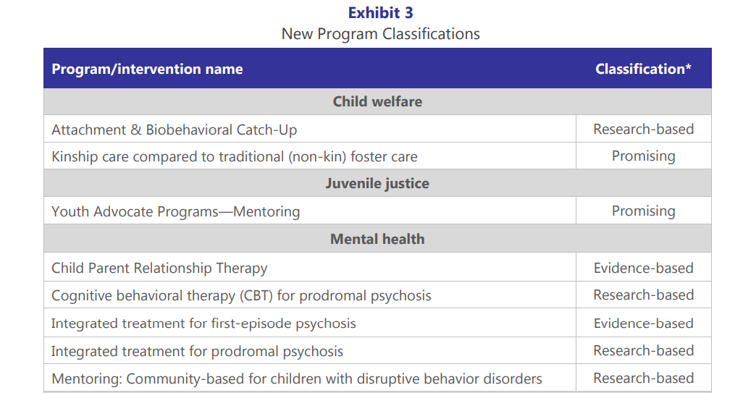

Slide 14
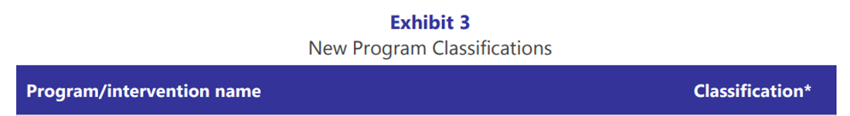
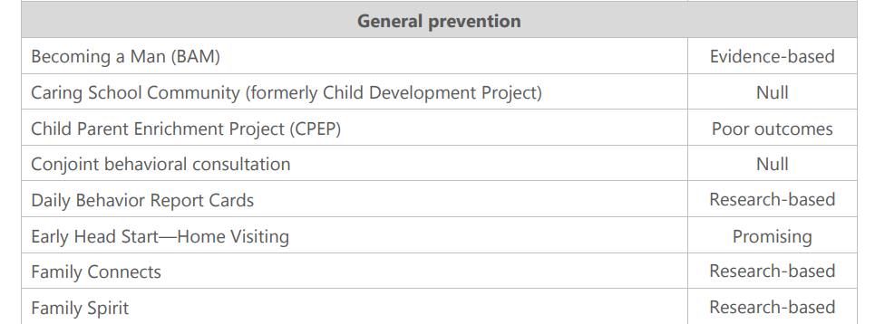

Slide 15
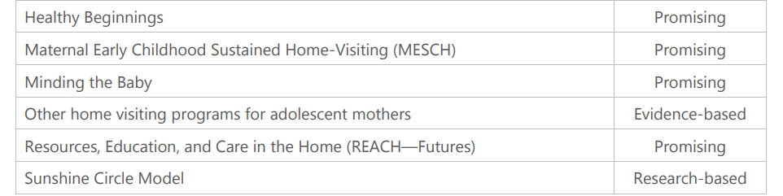

Slide 16
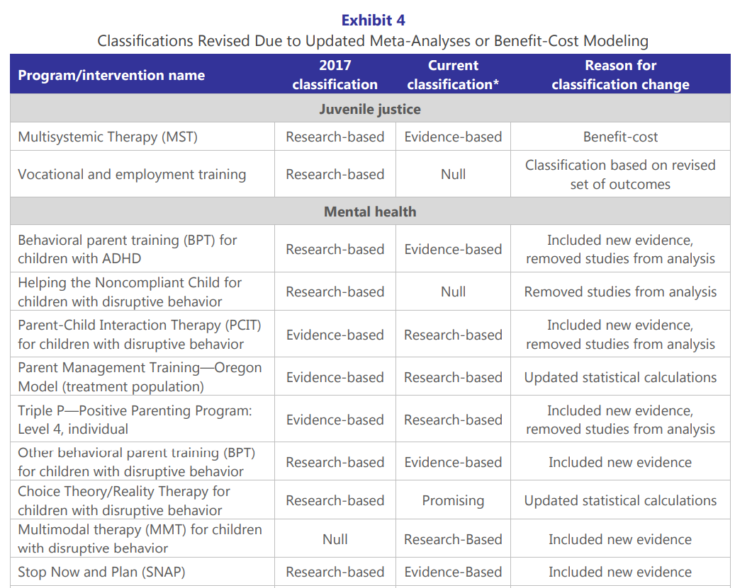

Slide 17
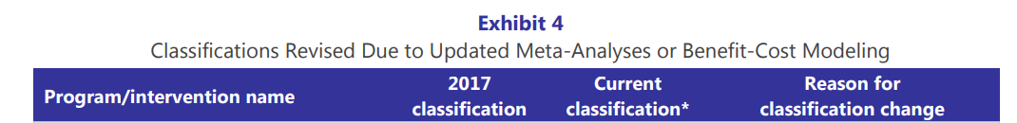
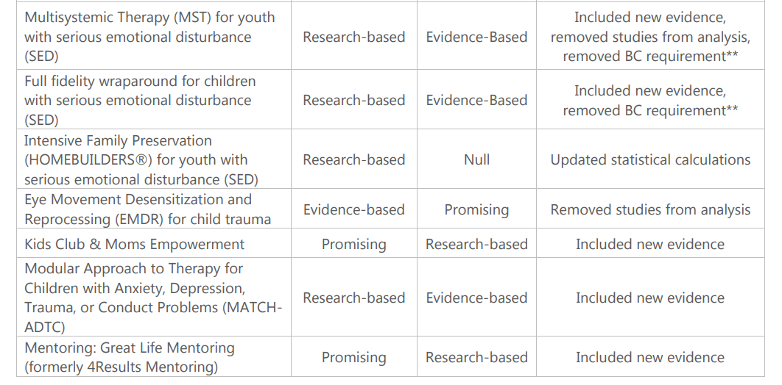

Slide 18
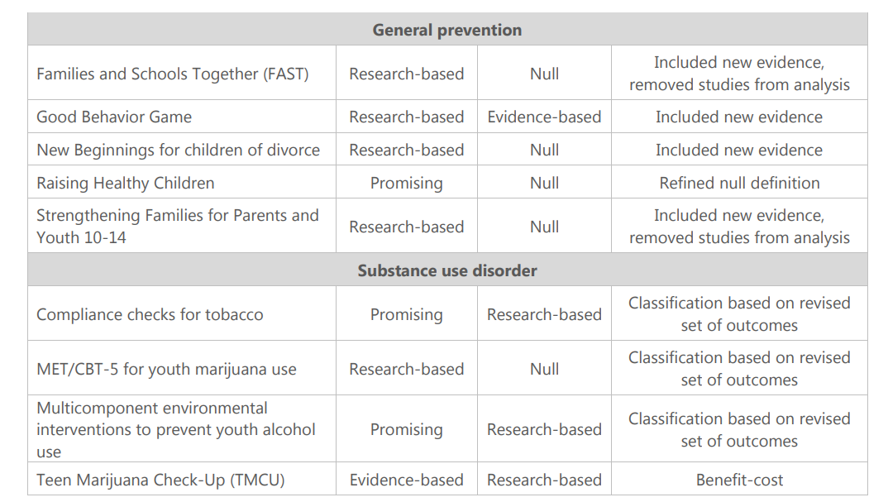

Slide 19
Blueprints for Health Youth Development
Blueprints for Healthy Youth Development provides a registry of evidence-based positive youth development programs designed to promote the health and well-being of children and teens. Blueprints programs are family, school, and community-based and target all levels of need — from broad prevention programs that promote positive behaviors while decreasing negative behaviors, to highly-targeted programs for at-risk children and troubled teens that get them back on track.
More than 1,500 programs have been reviewed, but less than 5% of them have been designated as model and promising programs. These programs will help young people reach their full potential by promoting positive youth development such as academic performance and success, emotional well-being, positive relationships, and physical health.
Blueprints prevention and intervention programs also help young people to overcome challenges associated with violence, delinquency, and substance abuse. Blueprints continues to look for programs which meet the selection criteria.

Slide 20
PROGRAM CRITERIA
Each Blueprints program has been reviewed by an independent panel of evaluation experts and determined to meet a clear set of scientific standards. Programs meeting this standard have demonstrated at least some effectiveness for changing targeted behavior and developmental outcomes.
Programs are rated as either Promising or Model. Promising programs meet the minimum standard of effectiveness. Model programs meet a higher standard and provide greater confidence in the program’s capacity to change behavior and developmental outcomes.

Slide 21
Program classification
BLUEPRINTS PROGRAMS are rated as Promising, Model, or Model Plus.
Promising programs meet the minimum standard of effectiveness. Model and Model Plus programs meet a higher standard and provide greater confidence in the program’s capacity to change behavior and developmental outcomes. Only Model and Model Plus programs are ready for scale

Slide 22
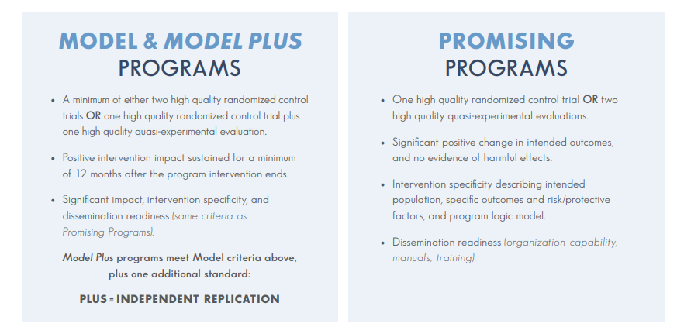

Slide 23
Building evidence embracing organizational settings
Embrace the importance of knowledge transfer
Foster a culture of biblio-therapy
Be committed to evaluation
Commit to invest in the appointment and up-skilling of agency staff in research and evaluation techniques
Embrace research partnerships
Commit to translating research findings into practical messages
Send your staff to conferences!

