Slide 1
How I would spend $100 million to reduce crime this year
BOCSAR Conference
16 February 2017, Sydney
Rick Sarre
School of Law, UniSA

Slide 2

The challenge
I am going to take $100 million and spend each dollar in ways which I believe will deliver the best outcomes for crime prevention.

Slide 3
BUT FIRST SOME BACKGROUND …
CRIMINAL JUSTICE KNOWLEDGE IS GROWING
Huge increase in academic interest
Continued funding (ARC/CRC/NHMRC) of university centres, and government and private research institutes (world-wide)
Rapidly expanding body of literature
Terrific national data (ABS/AIC/ProdCom)
Lots of ‘tool-kits’ for policy-makers …

Slide 4
University of Maryland “What Works?”
The Campbell Collaboration
The Washington State Institute for Public Policy
The Crime Reduction Toolkit
EMMIE
are all examples of vehicles by which researchers are able to inform policy-makers, in a readily digestible form, regarding preferred choices.

Slide 5
Policy-makers are listening
Because governments cannot afford the costs of crime
- and -
Because victimisation is something that no government feels comfortable with
and -
Because there’s a temptation in government to think that the current drive to imprison is having an effect on crime rates

Slide 6
Yes, crime rates are going down …
Violent crime rates have been declining significantly since the mid-1990s.
National rates for property crime have been steadily declining over the last decade for break-in, motor vehicle theft, theft from a motor vehicle, malicious property damage, and other theft.
The proportion of Australian households experiencing malicious property damage fell from roughly one in 10 in 2008-09 to one in 20 in 2015-16 (ABS, 2017).

Slide 7

Or remains stable or (in one case) rising
While face-to-face threatened assault showed a general decline, the rates of physical assault, non face-to-face threatened assault, robbery and sexual assault remained stable (ABS 2017).
Cyber-dependent and cyber-enable crime is on the rise.

Slide 8
But, no, the connection between high imprisonment rates and lower crime is flimsy:
There have been similar crime drops in jurisdictions where police numbers have not risen, and where the rate of imprisonment has remained stable or actually declined (Queensland 2005 to 2012) (Sarre 2011).
There are many reasons that have been suggested for the drop in crime that have more to do with economic factors, police strategies, demographics, enhanced social institutions, lead in petrol, and better and cheaper security, than the justice system’s effect (Farrell, 2013).
Whatever returns there are, they are diminishing returns; that is, the expenditures on the extra prison beds will eventually outweigh the savings in relation to lesser victimisation (Vollaard, 2012).

Slide 9
FACTS: How much is crime costing Australians?
Australian Institute of Criminology, 2014
$21 billion from direct losses
40% fraud
10% burglary
9% drug offending
8% arson
7% assault
(Not including organised crime / cybercrime that Australian Criminal Intelligence Commission estimates at $15 billion)

Slide 10
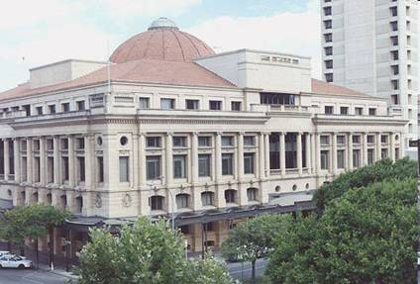
Other estimates:
Justice process costs (police, courts and corrections)
Expenditures (2015-2016): around $16.3 billion (PC 2016)

Slide 11
TOTAL
$21b direct losses
$15b estimated cybercrime losses
$16.3b machinery of criminal justice
$52.3 billion (AIC/ACIC/PC)
Productivity Commission (Jan 2017): $47.6 billion
Let’s split the difference = $50 billion p.a.

Slide 12

I propose that we spend $100 million
If justice mechanisms cost $16.3 billion p.a. then $100 million is what is being currently expended in just over 2 and a half days
If the costs of crime, all up, are $50 billion, a clever use of $100 million to reverse the upward trend is money well spent.

Slide 13
The challenge
Letter to The Australian, 13/2/17 (p 13 by Michael Doyle, Ashburton, Vic) in response to a journalist’s observation that it was now fashionable for the public to “degrade experts.”
“…If academics were less cowardly, retreated less often, and spoke up more, perhaps the community would have less propensity to ‘degrade experts.’”

Slide 14


The challenge (with deference to Bar Wars)
So, we cannot live in
So I continue with a

Slide 15
What should we spend our $100 million on?

Slide 16

Here we go …
(Warning: meta-analysis of the entire panoply of criminological research findings over the last 40 years is about to take place)

Slide 17
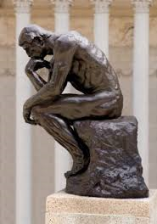
I am going to list the dilemma, some of the evidence concerning it, and then what proportion of the $100 million should go to address it, and, finally, to whom to give the money!

Slide 18

Prisoner rehabilitation
WHAT IS THE DILEMMA?
In prisons we find those who are economically marginalised and facing labour market uncertainty, and who live under the influence of drugs, poor education or mental illness.
WHAT IS THE EVIDENCE?
There is evidence of good programming (and well trained and keen program staff) in rehabilitative settings within prisons in Australia, but it remains under-funded and under-utilised (Heseltine, Day & Sarre, 2011).
WHAT SHOULD WE SPEND?
Five million dollars should be spent injecting life back into Australian prison-based rehabilitative programs.

Slide 19

Pre- and post-release programs
WHAT IS THE DILEMMA?
Inmates have high rates of mental illness and cognitive disability (e.g. Acquired Brain Injury, or “ABI”, and foetal alcohol syndrome).
WHAT IS THE EVIDENCE?
If we deal with these issues in custodial settings, then the transition to society becomes much more amenable to success (Baldry, 2014; Butler, Allnutt, Kariminia & Cain, 2007; Andrews & Baldry, 2013).
WHAT SHOULD WE SPEND?
Five million dollars should be spent implementing programs designed to ameliorate the debilitating effects that these illnesses have on the ability of ex-prisoners to re-join society.

Slide 20
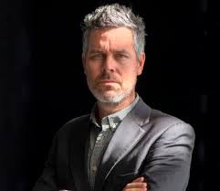
Pre- and post-release programs
WHAT IS THE DILEMMA?
More than the total of our nation’s prisoners are released each year, inmates find that many of their problems have been compounded.
WHAT IS THE EVIDENCE?
Pre- and post-release services are highly beneficial in enhancing the rate of desistance from crime (Halsey & Harris, 2011; Maruna, 2011; Goldsmith & Halsey, 2013; Cherney & Fitzgerald, 2014)
WHAT SHOULD WE SPEND?
Five million dollars should be spent on improving
accommodation support and employment opportunities
for ex-prisoners.

Slide 21

Diversionary options and therapeutic justice
WHAT IS THE DILEMMA?
The probability of an offender returning to the juvenile courts increases as the number of appearances of that offender increases (Cunneen & White, 2002). There is no stopping the flow of young offenders into the system.
WHAT IS THE EVIDENCE?
Diversionary options have been shown to reduce the likelihood of offenders – including those who are older (Thompson, et al, 2014) but especially young persons – continuing into the formal criminal justice process.
WHAT SHOULD WE SPEND?
Five million dollars for reinforcing the diversionary
programs currently being undertaken in each
Australian jurisdiction, including family conferencing.

Slide 22

Diversionary options and therapeutic justice
WHAT IS THE DILEMMA?
Therapeutic mechanisms of justice too easily become casualties of governments keen to tout their “law and order” credentials.
WHAT IS THE EVIDENCE?
Problem-solving courts such as drug courts, Indigenous courts, mental health courts and family violence courts can have a therapeutic effect upon those who appear before them (Freiberg, 2003). Even if the evidence of lower recidivism rates in these courts remains scant, they boost confidence in the system.
WHAT SHOULD WE SPEND?
Five million dollars will be spent reinforcing the therapeutic justice problem-solving courts currently in operation, and re-instating the courts that have been cancelled.

Slide 23

Programs designed to improve policing
WHAT IS THE DILEMMA?
We need to make our policing more effective in ways that do not involve simply adding to numbers.
WHAT IS THE EVIDENCE?
Faith in procedural justice exhibited by police is the strongest and most consistent predictor of a “felt obligation to obey” (Tyler, 2006; Hough, Jackson & Bradford, 2013). Moreover, procedural justice is an important predictor of a victim’s satisfaction with the criminal justice system (Murphy & Barkworth, 2014).
WHAT SHOULD WE SPEND?
Five million dollars should be set aside for curriculum development, training and implementation of legitimacy practices. This training should not be reserved only for recruits but all levels of policing.

Slide 24

Public and private security partnerships
WHAT IS THE DILEMMA?
Policing is now increasingly performed by non-governmental participants, with private security companies being the most prominent category (Prenzler & Sarre, 2014). This needs to be strengthened but can it be done without compromising quality?
WHAT IS THE EVIDENCE?
Privately-funded security directly contributes to significant reductions in criminal victimisation (Prenzler, 2011; van Dijk, 2008; Farrell, 2013). E.g. the fight against cyber fraud has been a site for global cooperation between police and the corporate sector (Gill, 2013).
WHAT SHOULD WE SPEND?
Governments should invite and reward (by making ten million dollars available) funding applications that bring together and encourage public and private initiatives that have been shown in pilot studies to have a crime reductive effect.

Slide 25

Indigenous justice initiatives
WHAT IS THE DILEMMA?
We have a reprehensible record when it comes to Indigenous over-representation, especially with young people. There are 5,600 young people (aged 10 and older) under youth justice supervision in Australia (AIHW, 2016), and 40% of them (both custodial and non-custodial) are Indigenous. 27% of Australia’s prisoners are Indigenous (50% of females).
WHAT IS THE EVIDENCE?
To combat the legacy of dispossession, we must address health care needs, ensure appropriate housing and increase employment opportunities for released Aboriginal prisoners (Kelly & Tubex, 2015).
WHAT SHOULD WE SPEND?
Seven million dollars for the specific education and mentoring of Indigenous men and women who are in contact with the justice system, in partnership with Indigenous communities, to enhance their life-skills and, in the process, their prospects of employment. This should include a specific emphasis for children of Indigenous prisoners.

Slide 26

Indigenous justice initiatives
WHAT IS THE DILEMMA?
Too many Indigenous offenders find themselves swept into the justice process by failing to meet their bail conditions.
WHAT IS THE EVIDENCE?
Aboriginal courts now make it more likely that those on bail will turn up for hearings and less likely to be ordered to serve custodial remands (Cultural and Indigenous Research Centre Australia, 2013). They instil confidence in those who appear before them that the system is dealing with underlying issues (Marchetti, 2014).
WHAT SHOULD WE SPEND?
Three million dollars will be devoted to the facilitation of Aboriginal courts, along with breathing new life into Indigenous-run justice centres, and night patrols, with a focus upon the treatment of those affected by drugs and alcohol, and who suffer from mental illnesses.

Slide 27

Protecting victims of domestic violence
WHAT IS THE DILEMMA?
In the financial year 2014-2015, 106,000 Australians sought help from specialist services after being forced to leave home as a result of family violence. Almost half were single parents, and more than three quarters were female (AIHW, 2016). They need protection to enable them to lead fulfilled lives, and to nurture their vulnerable children.
WHAT IS THE EVIDENCE?
There are a number of successful services that assist women who wish to leave violent relationships to put in place protection orders, to arrange accommodation, counselling, and legal advice. All need guaranteed foundational funding, and there needs to be better police training regarding this (Segrave, Wilson and Fitz-Gibbon, 2017).
WHAT SHOULD WE SPEND?
Five million dollars shall be allocated to shelter services, plus five million for police-run family violence units, with dedicated officers in every police station in Australia where an assessment has been made that such support is necessary, plus five million dollars for specific police training modules in order to ‘join the dots.’

Slide 28

Protective factors in young people’s lives
WHAT IS THE DILEMMA?
Juvenile crime occurs when young people feel disengaged from the social processes, and shut out of educational and employment offerings.
WHAT IS THE EVIDENCE?
Life-course studies help us understand that interceding with protective factors at crucial developmental transition points in a child’s life can have the effect of reducing law-breaking (Homel, 1999). The reinforcement of these effects is dependent upon a community’s capacity to agree on goals for a child’s well-being and its ability to mobilise efforts to meet them (Homel, Freiberg & Branch, 2015; Homel & McGee, 2012; McGee & Mazerolle, 2015).
WHAT SHOULD WE SPEND?
Ten million dollars should be set aside for the purpose of funding community-based strategies that implement programs that enhance the social and mental health of Australian children.

Slide 29

Preventing child neglect and abuse
WHAT IS THE DILEMMA?
We have an instinctive feeling that there are links between social disadvantage and crime.
WHAT IS THE EVIDENCE?
The literature details the criminality wrought by inequality and economic impediment (Weatherburn & Lind, 1997; Wilkinson & Pickett, 2009); that variations in income levels have a greater effect on crime rates than shifts in the intensity of policing or deterrent sentences (Wan, Moffatt, Jones & Weatherburn, 2012); that abuse and neglect of children will link to their later criminality (Currie, 2008; Olds, 2008).
WHAT SHOULD WE SPEND?
Eighteen million dollars on programs and practices that have been shown to be effective in reducing the levels of child abuse and neglect in Australia.

Slide 30

Preventing child neglect and abuse
WHAT IS THE DILEMMA?
How can we act to limit access to factors that precipitate abuse and neglect?
WHAT IS THE EVIDENCE?
Abuse, neglect and family violence are significantly associated with the alcohol and drug dependence of children’s caregivers (Payne & Gaffney, 2012) and its availability (Livingston, 2011; Donnelly, Menendez & Mahoney, 2015).
WHAT SHOULD WE SPEND?
Two million dollars for the implementation of further pilot programs to test the policy implications of programs designed to limit the availability of cheap packaged wine and the placing of restrictions on the number of alcohol licences permitted in selected neighbourhoods.

Slide 31

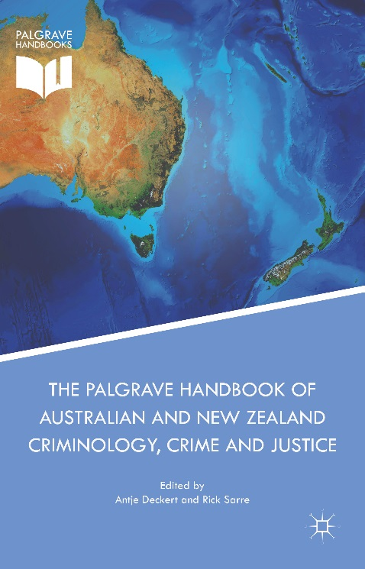
Public education
WHAT IS THE DILEMMA?
The public have very little idea about what else to focus on, other than police, courts and corrections
WHAT IS THE EVIDENCE?
Publicly-funded advertising is crucial. It can assist policy-makers who will respond if the political will is there (Head, Ferguson, Cherney & Boreham, 2014).
WHAT SHOULD BE SPENT?
Two million dollars will go into public education programs designed to convince Australians that the above priorities will keep them safer than simply injecting (or siphoning) the same amount of money into the formal justice system and its processes. ANZSOC can play a crucial role!

Slide 32




Evaluation
WHAT IS THE DILEMMA?
We need to know if these priorities are sound
WHAT SHOULD BE SPENT?
A final three million dollars will go into an evaluative exercise, designed to determine the cost-benefit effects of these expenditures, and to keep abreast of further research findings.
Who has said that they would be happy to take this $3 million?

Slide 33
Correctional projects | $ 15
Justice delivery mechanisms | $ 10
Police training | $ 5
Policing partnerships | $ 10
Indigenous mentoring & justice centres | $ 10
Networks for victims of violence | $ 15
Pathways for young people | $ 10
Strategies to address child neglect & abuse | $ 20
Public education | $ 2
Evaluation | $ 3
Total | $100

Slide 34
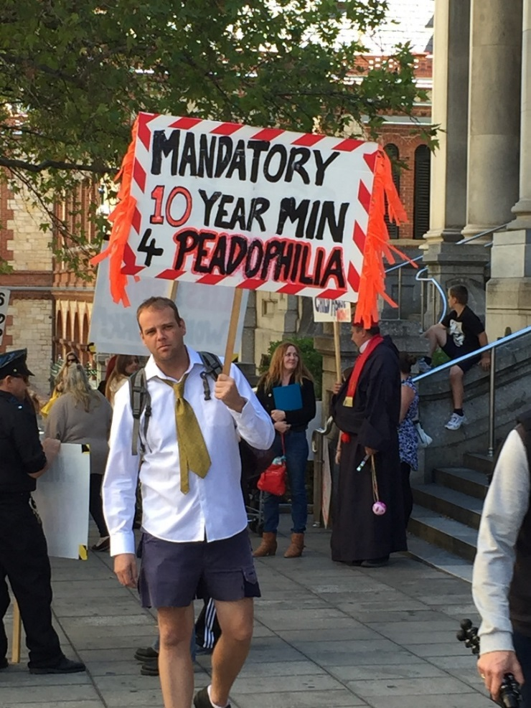
The challenge for us
There’s a disconnect between the political rhetoric and the evidence-based reality.
It needs to be tackled by academics by:
being well theorised
making findings readily available
not being cowardly, in retreat, or softly spoken!

Slide 35
Summary
Crime science specialists have a proven track record for theorising, commissioning good research, interpreting the data, suggesting preferred responses, and allocating appropriate resources.
Governments and their policy-makers should listen to them, and act accordingly, rather than going off on evidence-bereft flights of fancy.
But that will only happen if these findings are explained in easily digestible form with the media and the public in mind.

Slide 36

What are your references, Rick?

Slide 37
Selected key references
ABS (2017), Crime Victimisation 2015-2016, Australia, Cat. 4530.0, Australian Bureau of Statistics, Canberra.
AIHW (2016), Specialist Homelessness Services 2015-2016 http://www.aihw.gov.au/homelessness/specialist-homelessness-services-2015-16/
Andrews, G, and Baldry, E, (2013), ‘Mental Health Frequent Presenters’, in Chappell, D (ed), Policing and the Mentally Ill: International perspectives, CRC Press, Boca Raton, FL.
Baldry, E, (2014), 'Complex needs and the justice system', in Chamberlain, C, Johnson, G, Robinson, C (ed.), Homelessness in Australia: an introduction, UNSW Press.
Butler, T, Allnut, S, Kariminia, A & Cain, D, (2007), ‘Mental health status of Aboriginal and non-Aboriginal Australian prisoners.’ Australian and New Zealand Journal of Psychiatry, 41(5): 429-435.
Cherney, A (2000), The Adoption of ‘What Works’ Principles in Crime Prevention Policy and Practice, Current Issues in Criminal Justice, 12(1), pp. 93-97.

Slide 38
Selected key references
Cherney, A and Fitzgerald, R, (2016), ‘Finding and keeping a job: the value and meaning of employment for parolees.’ International Journal of Offender Therapy and Comparative Criminology 60(1), 21-37.
Cultural and Indigenous Research Centre Australia (2013), Evaluation of Indigenous Justice Programs, Project A: Aboriginal and Torres Strait Islander Sentencing Courts and Conferences Final report, Attorney-General’s Department, Canberra.
Cunneen, C. and R. White (2002), Juvenile Justice: Youth and Crime in Australia, Oxford University Press, South Melbourne.
Currie, E (2008), The Roots of Danger: Violent Crime in Global Perspective, Prentice Hall, Upper Saddle River, NJ.
Donnelly, N, Menendez, P, Mahoney, N, (2015), ‘The effect of liquor licence concentrations in local areas on rates of assault in New South Wales,’ NSW Bureau of Crime Statistics and Research, viewed 05 March 2015, http://apo.org.au/node/53392 .
Farrell, G (2013), Five tests for a theory of the crime drop, Crime Science, 2(5), 1-8.

Slide 39
Selected key references
Freiberg, A. (2003), Therapeutic jurisprudence in Australia: paradigm shift or pragmatic incrementalism?, Law in Context, 20(2), pp. 6-23.
Gill, M. (2013), ‘Engaging the corporate sector in policing: Realities and opportunities,’ Policing, 7 (3), 273-279
Goldsmith, A. and M. Halsey (2013), Cousins in Crime: Mobility, Place and Belonging in Indigenous Youth Co-Offending, British Journal of Criminology, 53(6), 1157-1177.
Halsey, M. and V.M.E. Harris (2011), Prisoner Futures: Sensing the Signs of Generativity, Australian and New Zealand Journal of Criminology, 44(1), 74-93.
Homel, R., K. Freiberg, and S. Branch (2015), CREATE-ing capacity to take developmental crime prevention to scale: A community-based approach within a national framework, Australian and New Zealand Journal of Criminology, 48(3), 367-385.
Homel, R. and T. McGee (2012), Community approaches to crime and violence prevention: Building prevention capacity, [in:] R. Loeber, B. Welsh (eds.), The Future of Criminology, Oxford University Press, New York, NY, 172-177.

Slide 40
Selected key references
Head, B, Ferguson, M, Cherney, A and Boreham, P, (2014), ‘Are policy-makers interested in social research? Exploring the sources and uses of valued information among public servants in Australia’, Policy and Society, 33: 89-101.
Heseltine, K, Day, A, and Sarre, R, (2011), ‘Prison-Based Correctional Offender Rehabilitation Programs: The 2009 National Picture in Australia,’ Research and Public Policy Series,112, Canberra: AIC.
Hough, M., J. Jackson, and B. Bradford (2013), Legitimacy, Trust and Compliance: An Empirical Test of Procedural Justice Theory Using the European Social Survey, [in:] J. Tankebe, A. Liebling (eds.), Legitimacy and Criminal Justice: An International Exploration, Oxford University Press, Oxford, UK, 326-352.
Kelly, M and Tubex, H (2015), ‘Stemming the Tide of Aboriginal Incarceration,’ The University of Notre Dame Australia Law Review, 17, 1-17,
http://researchonline.nd.edu.au/undalr/vol17/iss1/2
Livingston, M. (2011), A longitudinal analysis of alcohol outlet density and domestic violence, Addiction, 106(5), 919-925.

Slide 41
Selected key references
Maruna, S (2011), ‘Re-entry as a rite of passage’. Punishment & Society,13(1),3-28.
McGee, T. & Mazerolle, P. (eds), (2015), Developmental and Life-Course Theories of Crime, Ashgate, San Diego.
Marchetti, E, (2010), ‘Indigenous sentencing courts and partner violence: Perspectives of court practitioners and Elders on gender power imbalances during the sentencing hearing,’ 43(2) ANZ Journal of Criminology, 263-281.
Murphy, K and J. Barkworth (2014), Victim Willingness to Report Crime to Police: Does Procedural Justice or Outcome Matter Most?, Victims and Offenders, 9(2), 178-204.
Olds, D. (2008), Preventing Child Maltreatment and Crime with Prenatal and Infancy Support of Parents: The Nurse-Family Partnership, Journal of Scandinavian Studies in Criminology and Crime Prevention, 9(1), pp. 2-24.
Payne, J and Gaffney, A (2012), ‘How much crime is drug or alcohol related? Self-reported attributions of police detainees’ Trends & issues in crime and criminal justice , No. 439, Canberra: Australian Institute of Criminology. 1-6.
Prenzler, T, (2011), ‘Strike Force Piccadilly and ATM Security: A Follow Up Study’, Policing: A Journal of Policy and Practice, 5(3), 236-247.

Slide 42
Selected key references
Prenzler, T and R. Sarre (2014), The Role of Partnerships in Security Management, in: M. Gill, (ed.), Handbook of Security, Palgrave Macmillan, Basingstoke, Hampshire, 769-790.
Productivity Commission, (2016) Overcoming Indigenous Disadvantage, 2016 Report, http://www.pc.gov.au/research/ongoing/overcoming-indigenous-disadvantage/2016
Productivity Commission (2017), Steering Committee for the Review of Government Service Provision, Volume C: Justice Sector Overview, Canberra.
Sarre, R, (2011), ‘We get the crime we deserve: Exploring the political disconnect in crime policy’, James Cook University Law Journal, 18, 144-161.
Segrave, M., Wilson, D. and Fitz-Gibbon, K. (2017), ‘More police won’t necessarily lead to better outcomes on family violence – here’s what we need,’ The Conversation, 25 January 2017, https://theconversation.com/more-police-wont-necessarily-lead-to-better-outcomes-on-family-violence-heres-what-we-need-70755

Slide 43
Selected key references
Thompson, C, Stewart, S, Allard, T, Chrzanowski, A Luker, C, and Sveticic, J, (2014), ‘Examining adult-onset offending: A case for adult cautioning,’ Trends & issues in crime and criminal justice. No. 488, Canberra: AIC.
Van Dijk, J (2008),The World of Crime, Sage Publications, Los Angeles, CA.
Wan, W-Y., S. Moffatt, C. Jones, and D. Weatherburn (2012), The Effect of Arrest and Imprisonment on Crime, Crime and Justice Bulletin, No. 158, NSW Bureau of Crime Statistics and Research, Sydney.
Tubex, H, Brown, D, Freiberg, A, Gelb, K and Sarre, R, (2016), ‘Penal diversity within Australia’, Punishment and Society, 17(3), 345-373.
Tyler, T, (2006), Why People Obey the Law, PUP, Princeton NJ.
Vollaard, B. (2012), ‘Preventing crime through selective incapacitation’ The Economic Journal, 123 (567), 262–284.
Weatherburn, D and Lind, B, (1997), ‘Social and Economic Stress, Child Neglect and Juvenile Delinquency,’ NSW BOCSAR, Sydney.
Wilkinson, R and Pickett, K (2009), The Spirit Level: Why Greater Equality Makes Societies Stronger , Allen Lane, London.

Slide 44

“Hey, everyone. This grass is crap. Forget Genesis 2:17. Let’s go and eat from the tree of knowledge.”
rick.sarre@unisa.edu.au

