Slide 1
Using Research Evidence to
Reduce Crime in Washington State:
Trends, Taxpayer Costs, &“What Works?”
A Presentation to
The Applied Research in Crime and Justice Conference
Sydney, Australia
February 16, 2017
Elizabeth K. Drake
Senior Research Associate
Washington State Institute for Public Policy
Olympia, WA USA
Elizabeth.Drake@wsipp.wa.gov
www.wsipp.wa.gov

Slide 2
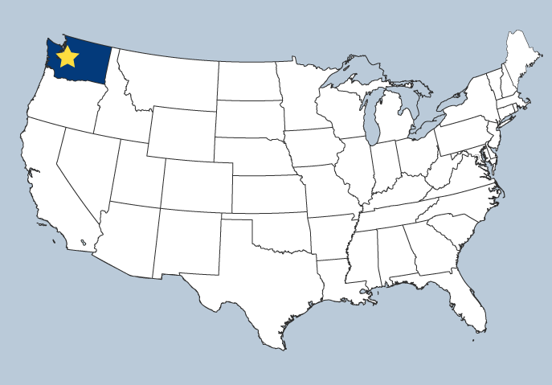


WSIPP / Trends
Approach / Results
EB Principles
Policy in WA
  Washington State Institute for Public Policy
  Created by 1983 Legislature
  Who we are:
  Non–partisan staff with bi-partisan governance.
  Projects assigned via legislative bills or Board of Directors.
Legislative Directives to Study:
Child Welfare
Crime
Developmental Disabilities
Education
Employment/Workforce
Housing
Mental Health
Public Assistance
Public Health
Prevention
Substance Abuse
Teen Births
Seattle, WA
Olympia, WA
Portland, OR
2 of 22

Slide 3
WSIPP / Trends
Approach / Results
EB Principles
Policy in WA
  Examples of Recent WSIPP Assignments
  In Criminal Justice
    Washington's Residential Drug Offender Sentencing Alternative: Recidivism & Cost Analysis
    Increased Earned Release from Prison: Impacts of a 2003 Law on Recidivism and Crime Costs
    Predicting Criminal Recidivism: A Systematic Review of Offender Risk Assessments in Washington State
    The Effectiveness of Declining Juvenile Court Jurisdiction of Youth
    Confinement for Technical Violations of Community Supervision: Is There an Effect on Felony Recidivism?
Recidivism Trends of Domestic Violence Offenders in Washington State
3 of 22

Slide 4
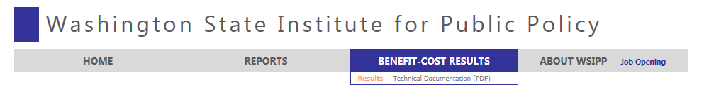
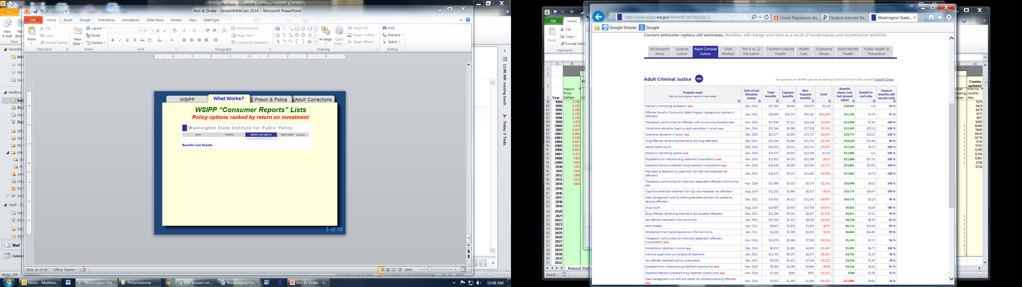
WSIPP / Trends
Approach / Results
EB Principles
Policy in WA
  The Washington State Legislature has asked,
  “What programs or policies improve outcomes at less cost?”
www.wsipp.wa.gov
4 of 22

Slide 5
Population
7.17 mil.
7.70 mil.
324 mil.
24 mil.
Square km
184,827
312,528
9.8 mil.
7.7 mil.
People per sq. km
40
25
35
3
WSIPP / Trends
Approach / Results
EB Principles
Policy in WA
  How similar (or dissimilar) are we?
Washington State (WA)
New South
Wales
United States
Australia
* Per 100,000
Incarceration rate*
(sentenced to prison)
260
211
460
208
Homicide rate*
3.0
0.9
4.9
1.0
Washington State’s criminal justice system:
  Primarily decentralized with local, state, and federal entities (police, courts, and corrections).
  Determinate sentencing:
    Superior court (felonies) => WA Department of Corrections (sentences over one year to prison).
    District court (misdemeanors) => local counties (sentences less than one year to jail).
5 of 22
Notes:
Incarceration – sentenced people in prison (not jail)
Homicide: Definition does not include attempts but does include manslaughter for US.
Australian Bureau of Statistics - 2015 rates
Vermont is lowest at 1.59.

Slide 6
WSIPP / Trends
Approach / Results
EB Principles
Policy in WA
Crime: Big Picture
Incarceration Rates in Washington and the US
6
State General Fund
Fiscal Impact
If Washington had the same incarceration rate as the average state, DOC’s budget (including debt service) would be about $675 million more per biennium.
United
States
5
4
Incarceration Rate*
3
Washington
2
1
0
1930
1940
1950
1960
1970
1980
1990
2000
2010
2020
* Per 1,000 people.
6 of 22
Notes:
4.6 vs 2.6

Slide 7
WSIPP / Trends
Approach / Results
EB Principles
Policy in WA
Crime: Big Picture
Crime Rates & Taxpayer Costs in Washington: 1980 to 2013
Percent change from 1980*
150%
In 2007, taxpayers spent 116% more on the criminal justice system than in 1980.
125%
100%
Taxpayer costs
75%
In recent years, costs have begun to decline.
50%
25%
0%
In 2015, crime rates were 45% lower than they were in 1980.
-25%
Crime
-50%
1980
1990
2000
2010
* Per capita, dollar estimates are inflation adjusted.
7 of 22

Slide 8
WSIPP / Trends
Approach / Results
EB Principles
Policy in WA
WSIPP’s Three-Step Research Approach
What works to improve outcomes?
  Outcomes → crime, education, substance abuse, etc.
  We identify programs that have already been rigorously tested (WA or elsewhere) to determine the program achieves expected outcomes.
What pays off for taxpayers (US 2015 dollars)?
We compute benefits, costs, and risk (return on investment) to the people of Washington for each policy option.
How can a “portfolio” of options affect statewide outcomes?
How much risk of failure?
8 of 22

Slide 9
WSIPP / Trends
Approach / Results
EB Principles
Policy in WA
Two Ways to Determine What Works
Do an outcome evaluation in Washington on a specific program or policy.
e.g., Does WA’s cognitive behavioral treatment reduce recidivism compared to a similar group of offenders?
Do a meta-analysis, a systematic (no cherry-picking) and empirical review of the research literature.
Not all research is of equal quality, and this greatly influences the confidence that can be placed in the results of a study.
Produces an average effect size of a program or policy (Lipsey).
We found 42 rigorous studies (tests) on cognitive behavioral therapy.
9 of 22

Slide 10
WSIPP / Trends
Approach / Results
EB Principles
Policy in WA
Cognitive Behavioral Therapy
Findings: Impact on Recidivism (crime)
42 Studies
> 33,000 CBT participants
-4.00
-3.00
-2.00
-1.00
0.00
1.00
2.00
3.00
4.00
Less Crime
More Crime
Effect Size
10 of 22
Notes:
UPDATE THIS SLIDE!!!

Slide 11
WSIPP / Trends
Approach / Results
EB Principles
Policy in WA
Cognitive Behavioral Therapy
Reduces Recidivism by 6 Percentage Points
Benefit-Cost analysis asks, “What’s the monetary savings to taxpayers & crime victims from a reduction in recidivism?”
80%
70%
60%
50%
Without CBT, an offender has a 66% chance of being reconvicted for a new felony or misdemeanor after 15 years;
Recidivism Rate
With CBT, the odds drop to 60%.
40%
30%
20%
Without Cognitive Behavioral Therapy
10%
Cognitive Behavioral Therapy
0%
1
2
3
4
5
6
7
8
9
10
11
12
13
14
15
Follow-up Years
11 of 22

Slide 12
WSIPP / Trends
Approach / Results
EB Principles
Policy in WA
Benefit-Cost Analysis of Reducing Recidivism
Once we know what works, we determine how much it costs
to buy that effect size, and what’s it worth to achieve it?
What works?
To reduce crime/recidivism relative to a non-treated population
CJS response to crime
Resources used and victimizations incurred when crime happens
Taxpayer savings (less CJS resources used) and victimizations avoided
Estimate benefit-cost results from effective program
We monetize the benefits to taxpayers and crime victims of future crimes avoided and estimate the costs of a program versus the costs of not participating.
12 of 22

Slide 13
WSIPP / Trends
Approach / Results
EB Principles
Policy in WA
Benefit-Cost Results
What works to reduce crime? (2015 US dollars)
% Point Change in Crime
(# of Studies)
Per Participant Net Benefits
(Chance WA won’t break even)
Adult Offenders
Cognitive behavioral tx -6% (42) $10,050 (<1%)
Correctional Education -11% (11) $20,601 (<1%)
Drug courts -10% (70) $8,031 (<1%)
Work release -3% (7) $5,757 (<1%)
Domestic violence tx (Duluth) +4% (6) -$9,433 (83%)
Juvenile Offenders*
Functional Family Therapy -11% (8) $28,723 (<1%)
Multisystemic Therapy -6% (11) $13,477 (25%)
Scared Straight +5% (10) -$8,802 (96%)
Prevention*
Pre-School* (low income) -10% (17) $29,044 (8%)
Mentoring* (school-based) -1% (5) $26,733 (26%)
* Programs have a number of other non-crime benefits; all benefits reported here.
13 of 22
Notes:
UPDATE ALL FINDINGS

Slide 14
WSIPP / Trends
Approach / Results
EB Principles
Policy in WA
Community Supervision
Percentage Point Change in Recidivism and
Net Benefits Per Participant
More Crime
Intensive Supervision: Surveillance Only
(14)*
Intensive Supervision:
With Treatment
(17)*
Supervision:
Focused on Risk, Need, &
Responsivity
(14)*
Supervision:
With Swift and Certain Sanctions
(11)*
Change in Recidivism
0%
-8%
-6%
-4%
-$5,000
$10,500
$7,000
$9,000
Less Crime
*The number of high-quality research studies on which this finding is based.
14 of 22

Slide 15
WSIPP / Trends
Approach / Results
EB Principles
Policy in WA
6
Core Correctional Practices: Quality Assurance
Results from Functional Family Therapy for Youth on Probation)
35%
30%
32%
Control group =
Similar youth who did not participate in FFT
25%
27%
FFT Participants =
Youth who had competent therapists
20%
18-Month Reconviction Rates
17%
15%
FFT Participants =
Youth who did not have competent therapists
10%
5%
0%
15 of 22

Slide 16
WSIPP / Trends
Approach / Results
EB Principles
Policy in WA
Core Correctional Practices: Risk Assessment
Recidivism Rates for Offenders Released From Prison (1993-2011)
70%
Among moderate risk offenders released from prison in 1993, 29 percent were reconvicted for a new felony within 36-months. For the 2011 cohort, 22 percent were reconvicted.
60%
50%
40%
36-Month Felony Reconviction
30%
20%
10%
0%
’93 ‘97 ‘03 ’07 ‘11
’93 ‘97 ‘03 ’07 ‘11
’93 ‘97 ‘03 ’07 ‘11
’93 ‘97 ‘03 ’07 ‘11
Low
Moderate
High Non-Violent
High Violent
16 of 22

Slide 17
WSIPP / Trends
Approach / Results
EB Principles
Policy in WA
Is WSIPP Evidence Used by Policymakers?
A Timeline of Major Legislative Actions in Criminal Justice
1999-01
  Funded evidence-based juvenile justice programs
  Cut prison sentences for drug offenders and diverted some fiscal savings to drug courts and treatment.
  Funded a portfolio of evidence-based programs ($43 million per biennium) in adult and juvenile corrections, and prevention. 2000 bed, $250 Million, prison avoided.
  New funding formula for the State’s 33 juvenile courts incentivizing the use of EBPs.
  Evidence-based, research-based, and promising juvenile justice, child welfare, and children’s mental health.
  Adult corrections “inventory” incentivizing EBPs and RNR model.
2002
2007…
2009
2012
2013
17 of 22

Slide 18
WSIPP / Trends
Approach / Results
EB Principles
Policy in WA
Justice Re-Investment
WSIPP’s Portfolio Analysis Tool
Some programs are effective at reducing recidivism.
Incarceration (incapacitation) is an evidence-based resource.
Empirical relationship between incapacitation on crime rates (7 studies), but relationship depends on offender’s risk level.
Police officers are evidence-based resources.
  Empirical relationship between police per capita on crime rates (9 studies).
Decrease prison ADP for:
Add one police officer
Lower risk offenders
Higher risk offenders
CBT
Per participant:
($424)
($89,158)
$5,702
$5,702
Cost of program/policy
Bottom-line (net)
$10,050
$488,375
$4,444
($4,554)
Benefit-cost ratio
$24.19
$6.52
$2.15
($0.87)
18 of 22

Slide 19
WSIPP / Trends
Approach / Results
EB Principles
Policy in WA
A Cheat Sheet on Evidence-Based Principles
      WA has adopted many policy options saving state and local taxpayers.
      Evidence & Economics
        Focus on EBP’s and compute benefits and costs because not all options have sound economics.
      Oversight & Quality Assurance
        Re-visit the EBP path periodically to ensure expected results.
  Risk, Needs & Responsivity
  Follow the risk principle and align offenders with the right EBPs.
  Punishment
  Focus on swift & certain of punishment (strong deterrence evidence for swift and certain, but not for severity of punishment).
19 of 22

Slide 20
WSIPP / Trends
Approach / Results
EB Principles
Policy in WA
Real-World Policy
Lessons Learned in Washington
  Budget Drivers Encourage interest in EBPs and monitor results. WA now ties the official state prison forecast to the expected effects of the funded portfolio.
  Research & Development State support for promising programs helps address local needs (especially if not addressed with a designated EBP).
  Policymaking is people-oriented. The EBP path is non-linear!
    Build ongoing relationships with stakeholders.
    Objectivity and/or independence is important.
    Presentation of information for non-technical audiences is important (keep it simple and clear).
    Not all policy goals are measured or achieved.
20 of 22

Slide 21
WSIPP / Trends
Approach / Results
EB Principles
Policy in WA
WA’s Investment in Evidence-Based Programs
The Cumulative Effect on The Need for Prison Beds
24,000
As of 2016, there are about 1,600 fewer people in prison as a result of Washington’s evidence-based adult, juvenile, & prevention programs. These effects are reflected in the prison bed forecast.
22,000
20,000
18,000
16,000
14,000
Average Daily Prison Population
12,000
10,000
Actual prison
Average Daily Population
Forecasted Population
8,000
6,000
4,000
2,000
1980
1985
1990
1995
2000
2005
2010
2015
2020
2025
2030
21 of 22

Slide 22
Thank you!
      Questions?
22 of 22

