Slide 1
A new paradigm for police research?
Gloria Laycock
Nick Tilley
UCL Jill Dando Institute

Slide 2
The argument:
Policing is being ‘professionalised’
Professionals use research evidence
The policing research base is thin on ‘what works’
Research funding is increasingly scarce
Co-production is essential
What are the methodological implications of this?
What are the implications for future policing?

Slide 3
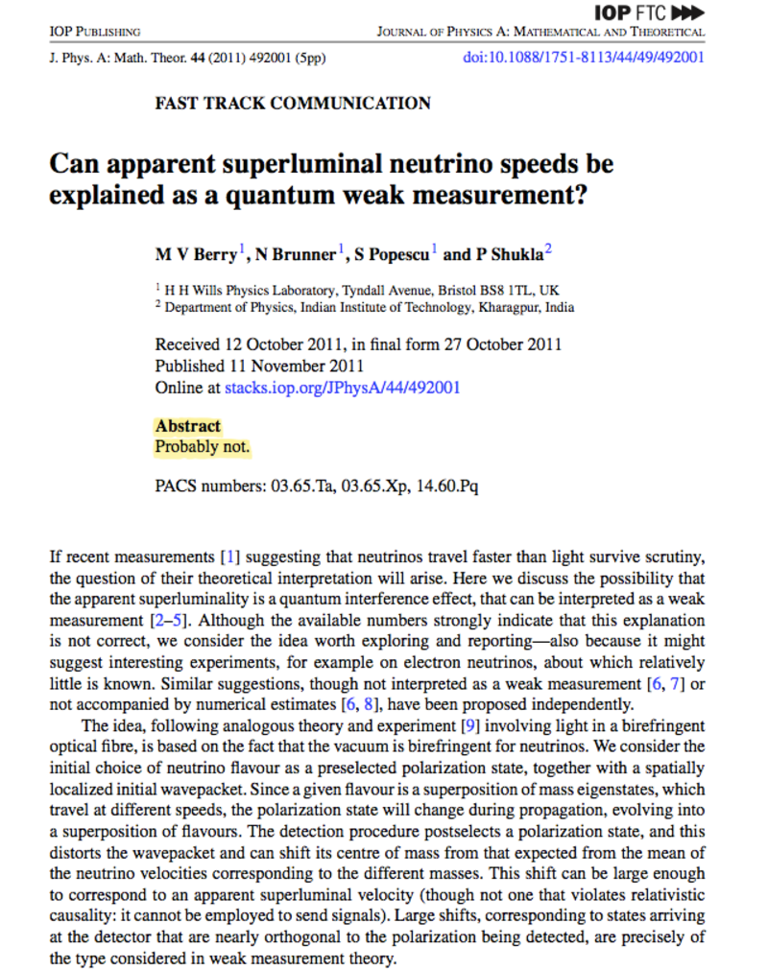
Evidence needs to be relevant and accessible
Notes:
From Aiden

Slide 4
What decision makers need to know
E = Effects (has it worked?)
M = Mechanisms (how does it work?)
M = Moderators (what conditions are needed for it to work?)
I = Implementation (what has to be in place for it to work?)
E = Economy (how much does it cost? Is it cost effective?)
Johnson, S. D., Tilley, N. and Bowers, K. J. (2015) ‘Introducing EMMIE: An evidence rating scale to encourage mixed-method crime prevention synthesis reviews’, Journal of Experimental Criminology.

Slide 5
Grading the evidence base using EMMIE
The task – “identify the best available evidence on approaches to reducing crime”
Best available evidence was taken to mean all systematic reviews with a crime reduction outcome
16,000 potentially eligible studies reduced to 82 reviews of crime prevention interventions
To what extent does the available evidence speak to the elements of EMMIE?
Bowers, K., Tompson, L. and Johnson, S.D. (2015). Implementing Information Science in Policing: Mapping the Evidence Base. Policing Journal

Slide 6
Mechanisms (EMMIE)
Notes:
0 = simple black box
1 = General statement of assumed programme theory
2 = basic tests of the assumed mechanism using variables that are at hand
3 = Full description of the theory of change with predictions
4 = Full description of the theory of change and robust testing whether this is operating as expected

Slide 7
Implementation (EMMIE)
Notes:
0 = No account of implementation or implementation challenges
1 = Ad hoc comments on implementation or implementation challenges
2 = Concerted efforts to document implementation or implementation challenges
3 = Evidence-based account of levels of fidelity to program, policy or treatment plans
4 = Analysis of structural/legal sources of departure from/fidelity to program plans

Slide 8
Economics (EMMIE)
Notes:
Considering most discussions around policing think about cost savings and austerity.
0 = No mention of costs (and/or benefits)
1 = Only direct or explicit costs (and/or benefits) estimated
2 = Direct or explicit and indirect and implicit costs (and/or benefits) estimated
3 = Marginal or total or opportunity costs (and/or benefits) estimated
4 = Marginal or total or opportunity costs (and/or benefits) by bearer (or recipient) estimated

Slide 9
The police need to know:
What works
How
Where
How do I implement it
How much might it costs
To get this kind of information from research we need to think hard about our methodologies

Slide 10
Professions learn in different ways
Styles of learning:
  Aviation
  Medicine
  Policing
Notes:
Speaking note…..

Slide 11
The Problems
Patient safety problems exist throughout the NHS
NHS staff are not to blame
Incorrect priorities do damage
Warning signals abounded and were not heeded
Responsibility is diffused and therefore not clearly
owned
Improvement requires a system of support
Fear is toxic to both safety and improvement
Taken from the report on improving the safety of patients in England by Don Berwick MD
http://www.kingsfund.org.uk/audio-video/don-berwick-improving-safety-patients-england-presentation-slides

Slide 12
The Problems
Victim safety problems exist throughout Policing
Police staff are not to blame
Incorrect priorities do damage
Warning signals abound and are not heeded
Responsibility is diffused and therefore not clearly
owned
Improvement requires a system of support
Fear is toxic to both safety and improvement

Slide 13
The Solutions
Recognise the need for wide systemic change
Abandon blame as a tool
Reassert the primacy of working with patients and carers to set and achieve health care goals
Use quantitative targets with caution
Recognise that transparency is essential
Ensure responsibility for functions is clear and simple
Give NHS staff career-long help to learn, master and apply modern methods for quality control, quality improvement and quality planning

Slide 14
The Solutions
Recognise the need for wide systemic change
Abandon blame as a tool
Reassert the primacy of working with victims and communities to set and achieve policing goals
Use quantitative targets with caution
Recognise that transparency is essential
Ensure responsibility for functions is clear and simple
Give police staff career-long help to learn, master and apply modern methods for quality control, quality improvement and quality planning

Slide 15
Additional points
Culture will trump rules, standards, and control strategies every single time
A safer NHS will depend far more on major cultural change than on a new regulatory regime
The NHS should become a learning organisation
Transparency should be complete, timely, and unequivocal

Slide 16
Styles of learning:
  Aviation
    Engineering
    Theory based
  Medicine
    Drug companies using RCTs; surgeons trying and refining methods; medical physicists build and test, etc
    Theory based
  Policing
    Research model?
    No theory

Slide 17
How do engineers do it?
They focus on solving problems
Draw on formalised and tested theory
Are creative
Adapt designs in the light of experience and build on it
Carry out experiments taking informed risks
Learn from their mistakes
Notes:
You learn from your mistakes.

Slide 18
Learning organisations
Aviation
  Private sector
  Incentives
  No political interference?
Medicine
  Public/private
  Drugs companies
  Litigation
  Political interference?
Policing (as in having the power of arrest)
  Public sector
  Blame
  Risk
  Media
  Politics
  Leadership style

Slide 19
And police/academic partnerships?
Co-production is vital – work together
  Money is tight so ‘business as usual’ won’t work
  Academics are also under pressure to demonstrate ‘impact’
  The police use tacit theory which needs to be made explicit and tested
  Academics should know how to do that
Taking a scientific approach to evidence development requires testing of hypotheses – the police are best place to develop those hypotheses working with communities

Slide 20
Implications for future policing
Training
  Theory
  Styles of evaluation
Liaison with communities
Culture
A learning organisation
  Risk
  Mistakes
Leadership – ‘ambidextrous’
Notes:
Hillsborough

Slide 21
Summary
Professionalisation means using research evidence – becoming a learning organisation
There isn’t much evidence on ‘what works’
We can work together to generate it
But we need to develop an appropriate research model for policing
Engineering offers a relevant and pragmatic option
There are cultural and training implications for researchers and police
Notes:
There are lots of ways to learn in an organisation – I have talked about two.... We need to give more thought to what working together means in practice

Slide 22



Thank you
Further reading:
Matthew Syed (2016) Black Box Thinking
Iain MacLeod (2016) Learning to solve problems available from http://info.iesis.org/papers/Eng-problem-solving.pdf

