Slide 1


Assessment of Short Term Risk of Recidivism for Intellectually Disabled Offenders
Matt Frize
(Acting) Manager
Clinical & Forensic Psychologist
Community Justice Program
Matthew.frize@facs.nsw.gov.au

Slide 2
Thanks
Prof Doug Boer – Uni of Canberra
Prof Alex Blaszczynski – Uni of Sydney
Katrina Hyland & Christian Cabrera – FaCS
Jackie Fitzgerald - BOCSAR

Slide 3
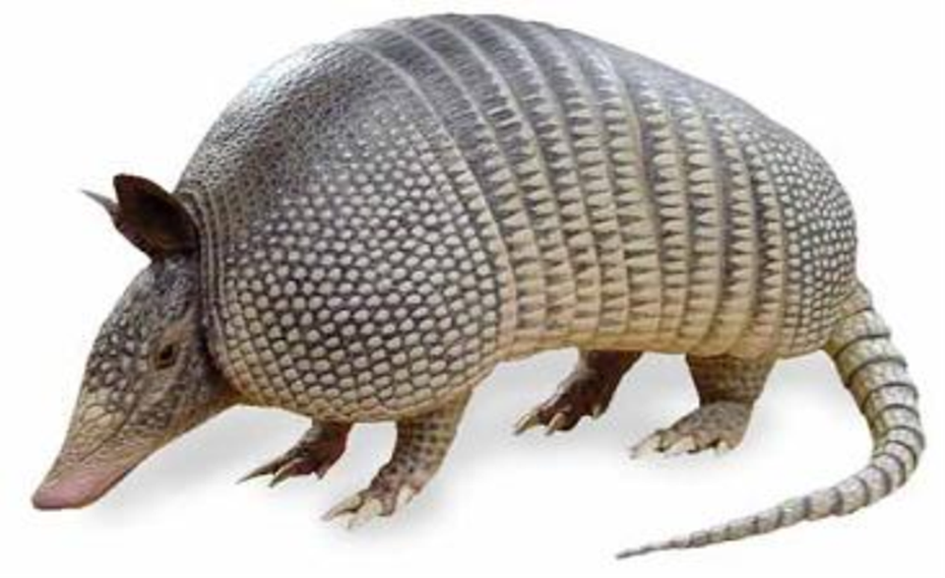


Slide 4
History of Risk Assessment
Nothing works (Martinson 1970s)
Prediction of dangerousness
  Emphasis on release decisions
  Idea of dangerousness as a static trait of the individual
Risk assessment (Steadman 1993)
  Public safety
  Risk as continuous and dynamic

Slide 5
Develop of Risk Assessments
Unstructured
Mechanical
Actuarial
Structured Professional Judgment
Researcher?
Clinician?

Slide 6
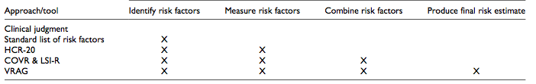
Complexities
Clinical
Actuarial

Slide 7
Purpose
Prevent?
  Many tools have treatment targets
Predict?
  Good tools only have static factors
  Treatment targets may dilute the predictive power
Depends on the post-assessment control (Heilbrun, 1997)

Slide 8
Review of Violence Risk (Singh et al 2011)
No difference between actuarial and SPJ approaches
Generally good predictive validity
Improved predictive validity for measures that were more specific (to offence or population)
Heterogeneity of offences and offenders provided significant variability

Slide 9
Intellectual Disability & Risk Assessment
In 2001, not one tool validated for ID population
Johnston (2002) concluded little direct evidence for their use in ID. Barriers included:
  Unclear relationship between offending and challenging behaviour
  Need for normalisation of risk taking for ID
  Need for focus on management than prediction of recidivism

Slide 10
Systematic Review
1900 til June 2012
30 studies (all between 2002-2012)
31 tools
Average sample size = 88.72 (5 – 422 participants)
Average age 33.29 years
90.8% male (or 73.33% in studies that incorporated women)
No reference to ethnicity in 70% (77.46% Caucasian where identified)

Slide 11
Study Location
Country: UK (23), USA (3), Canada (2), Sweden (1) and Australia (1).
Location: Community (15), medium to high forensic ID or mental health (10), multiple settings (4)
Only 2 studies identified participants were in receipt of treatment

Slide 12
Measure | Inter-Rater Reliability |  | AUC
 |  |  | General |  | Violence |  | Sexual
 | mean (n) | Range | mean (n) | range | mean (n) | range | mean (n) | range
HCR | 0.84 | .80-.95 | 0.78 (6) | .61-.94 | 0.76 (7) | .69-.83 | - | -
HCR-20 (ID) | 0.8 | - | 0.97 | - | 0.8 | - | - | -
VRAG | 0.86 (4) | .79-.92 | 0.79 (3) | .70 -.92 | 0.73 (3) | .69-.79 | 0.69 | -
PCL:SV | 0.95 | .92-.98 | 0.74 (2) | .71-.76 | 0.73 | - | - | -
PCL-R | 0.81 | .80-.81 | 0.70 | - | 0.69 (2) | .54-.83 | - | -
SAVRY | 0.82 |  | 0.86 | - | - | - | - | -
DRAMS | 0.46 (2) | .45-.46 | 0.73 | - | - | - | - | -
WARS | - | - | 0.28 | - | - | -- | - | -
NAS | - | - | 0.20 | - | - | - | - | -
QoLQ | - | .41-1 | - | - | - | - | - | -
OGRS | 0.96 | - | 0.90 | - | 0.85 | - | - | -
RM2000v | 0.91 | - | - | - | 0.62 | - | - | -
Static 99 | 0.97 (2) | - | - | - | - | - | 0.68 (2) | .64-.71
RM2000s | 0.92 | - | - | - | - | - | 0.61 (2) | .58-.63
RRASOR | - | - | - | - | - | - | 0.45 (2) | .42-.47
ARMIDILO (acute) | - | - | - | - | - | - | 0.86 | -
ARMIDILO (stable) | - | - | - | - | - | - | 0.75 | -
SVR | - | - | - | - | - | - | 0.75 | -
Method

Slide 13
ID v General Offender Risk AUC
(Sexual)
(Sexual)
(Physical)
(Physical)
(Physical)

Slide 14
Gaps
What is the imminent risk?
What strengths can we not ignore?
What environmental factors are important?
What service factors are important?
What is the ‘general’ risk?
How do we structure intervention?
Can we provide a fair assessment?

Slide 15
History of Risk Assessment
Reformulation (Monahan 1981; 1984)
  Need to consider dynamic variables
  Need for ongoing reassessment
  Consider different perspectives of risk
  Need to consider imminence of risk
  Need to consider context
  Need to not throw the baby out with the bath water

Slide 16
ARMIDILO-G
Assessment of Risk and Manageability of Individuals with Developmental and Intellectual Limitations who Offend - Generally
SJP
Adaptation of the ARMIDILO-S

Slide 17
Client |  | Environment
Risk & Protective Item | Rationale | Risk & Protective Item | Rationale
Supervision Compliance | ARMIDILO-S | Consistency of Supervision | ARMIDILO-S
Treatment Compliance | ARMIDILO-S | Attitudes Towards the Client | ARMIDILO-S
Emotional Coping | ARMIDILO-S | Staff Communication | ARMIDILO-S
Inappropriate Preoccupation | ARMIDILO-S | Client Knowledge | ARMIDILO-S
Attitudes | ARMIDILO-S | Relationships | ARMIDILO-S
Offence Management | ARMIDILO-S | Access to Victims / Means | ARMIDILO-S
Relationships | ARMIDILO-S | Access to Substances | ARMIDILO-S
Impulsivity | ARMIDILO-S | Situational Stability | ARMIDILO-S
Substance Use | ARMIDILO-S | Access to Services | ARMIDILO-S
Mental Health | ARMIDILO-S
Goals | Good Lives
Self Efficacy | Good Lives
Education | RNR
Employment | RNR
Leisure | RNR
Finance | RNR
Behaviour | RNR

Slide 18
Ecological Validity
Dynamic
  Items used as treatment targets
Short term risk
  Provides window for intervention
Individual & environment factors
  Tells clinicians what and where
Risk and protective factors
  Minimises risk of removing protection
  Attempts to reduce stigma
Considers criminogenic needs & GLM

Slide 19
Participants
Participants from Community Justice Program
  Provision of accommodation and support services
  People with an intellectual disability
  Who have exited custody.
  Targets individuals who are identified as requiring specialist support on re-entering the community in order to:
    promote a positive independent lifestyle and
    reduce the risk of harm to themselves or to others.
  Across all NSW

Slide 20
Participants
Clients must be eligible for ADHC services
Ages 10 - 65
Ongoing contact with the criminal justice system, resulting in time spent in custody
Continuing risk of re-offending
Outside regular disability service response
Court mandate is not required

Slide 21
Participants
N: 111
Age: 32.67
Male: 92.1%
IQ: Mode = Mild (50.36%)
Aboriginal: 36.7%
CALD: 5.8%
Guardianship: 45.3%
AoD History: 89.3%
Mental disorder: 64.8%

Slide 22
Participants
Service type:
  Drop in (58.3%)
  Semi independent (23.1%)
  Intensive accommodation (17%)

Slide 23
Offences
Type | Frequency | Percent Charged
General | 16.08 (17) | -
Theft | 4.84 (6) | 79%
Violence | 3.63 (4) | 80%
Public order | 2.31 (6) | 59%
Justice | 2.23 (3) | 74%
Property | 1.13 (2) | 52%
Vehicle | .66 (1) | 25%
Sexual | .60 (1) | 37.3%
Drug | .54 (1) | 27.8%
Misc. | .13 (1) | 6.3%

Slide 24
Procedure
Implemented 3-6 monthly ARMIDILO-G
Conducted by CJP clinicians
Used disability support workers to inform
Training on a 6mth basis
Conducted between 2011-2014
Trained clinicians

Slide 25
Outcome Data
Linkage of Police, Court and Corrective Services data (thanks BOCASR!)
Charge
Conviction
Custodial order
Time to reoffend
Days in custody

Slide 26
Recidivism
General 3 months16.22% (18)
General 6 months 28.28% (28)
Only juveniles more likely to reoffend & theive
Theft 6 months 15.2% (15)
Violence 6 months 10.1% (10)
Justice 6 months 5.1% (5)

Slide 27
Assessment Tools
Tool | Target | Type | ID Specific
HCR-20 | Violence | SPJ | No
CuRV | Violence | Actuarial | Yes
LSI-R | General | Adjusted Actuarial | No
GRAM | General | Actuarial | No

Slide 28
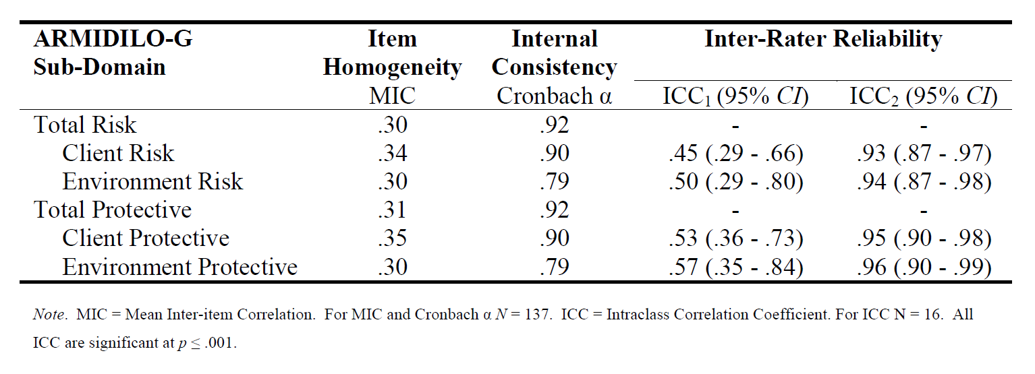
Reliability of the ARMIDILO-G

Slide 29
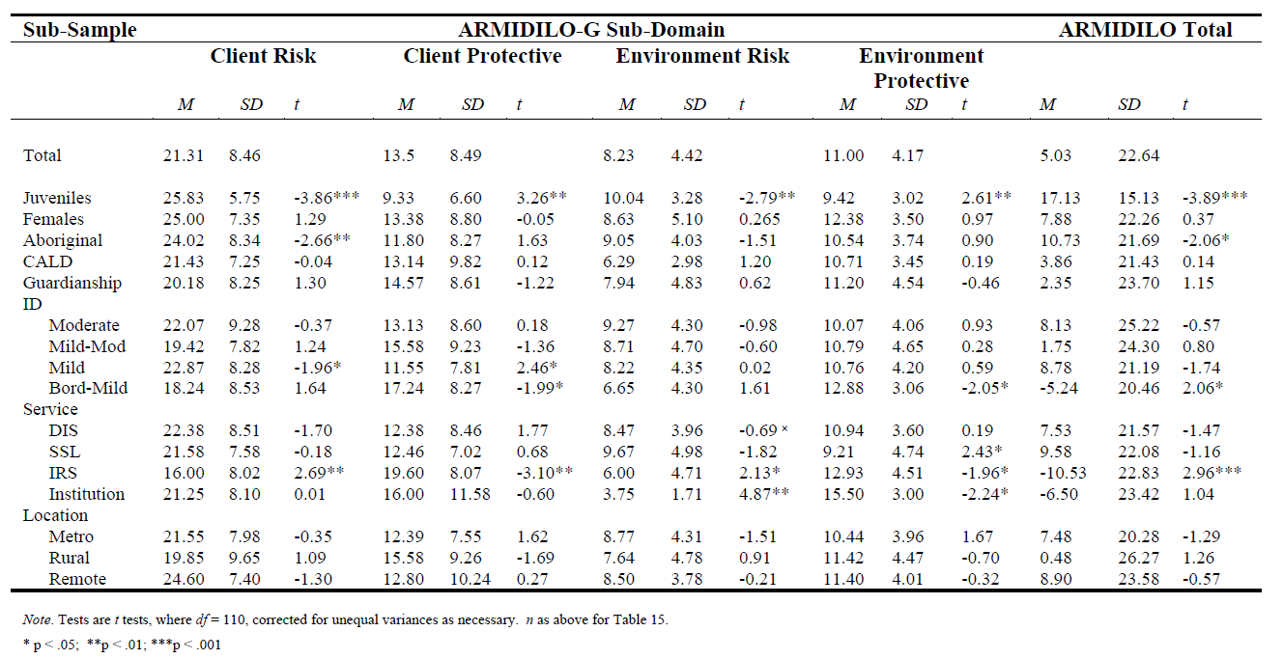
Sub-Group ARMIDILO-G Scores

Slide 30
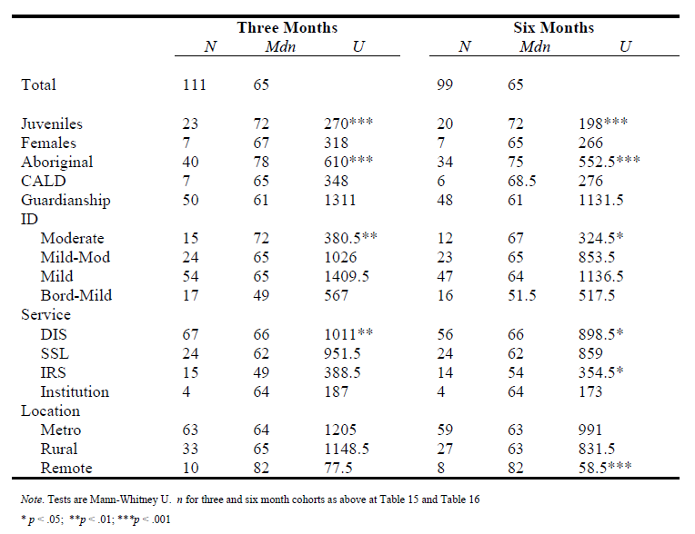
GRAM

Slide 31
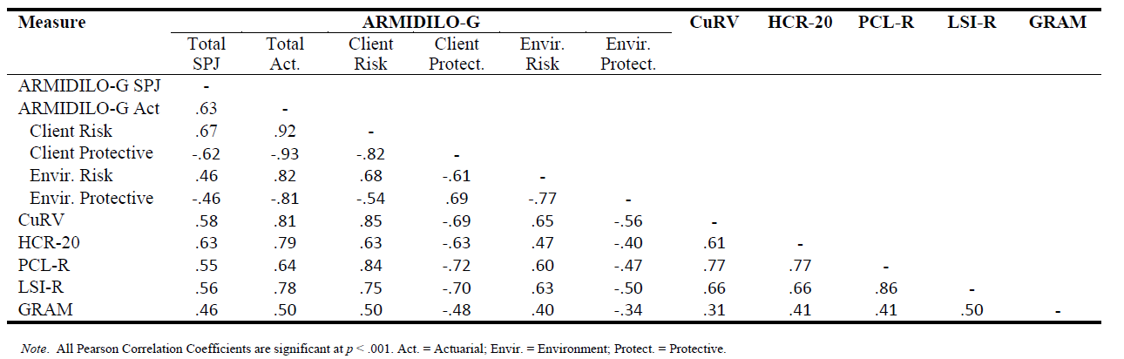
Correlations between tools

Slide 32
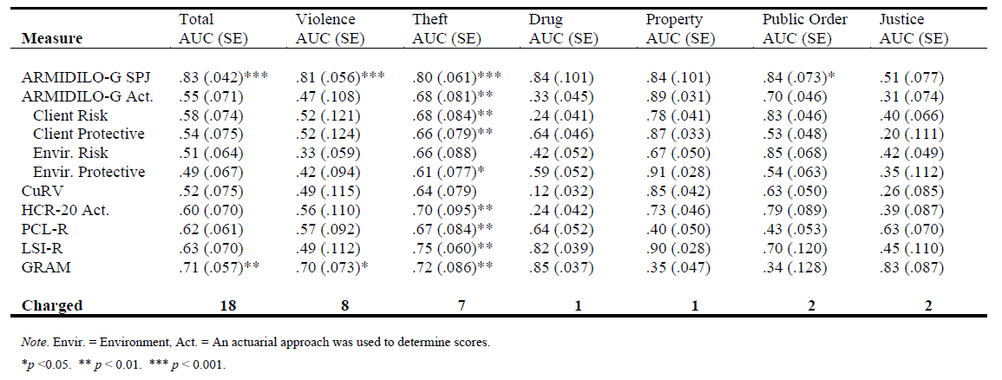
AUC for tools at 3 months

Slide 33
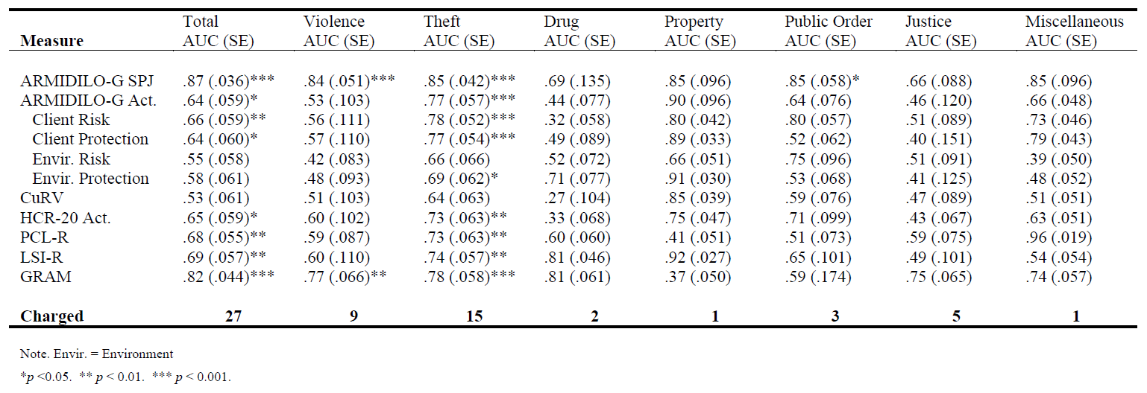
AUC for tools at 6 months

Slide 34
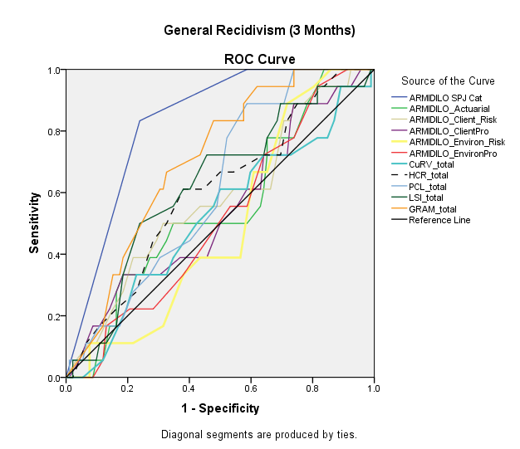

Slide 35
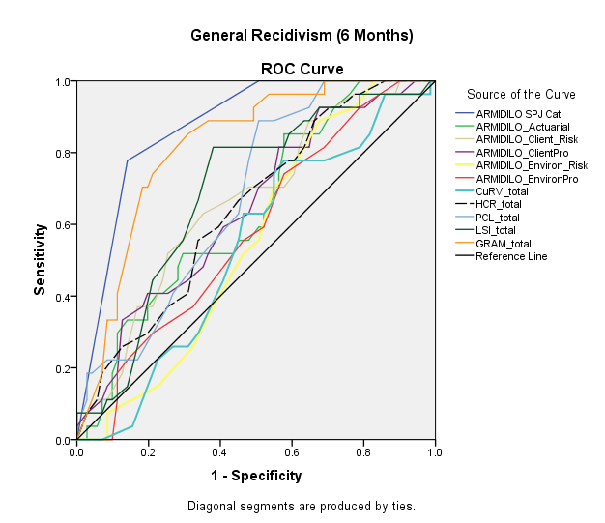

Slide 36
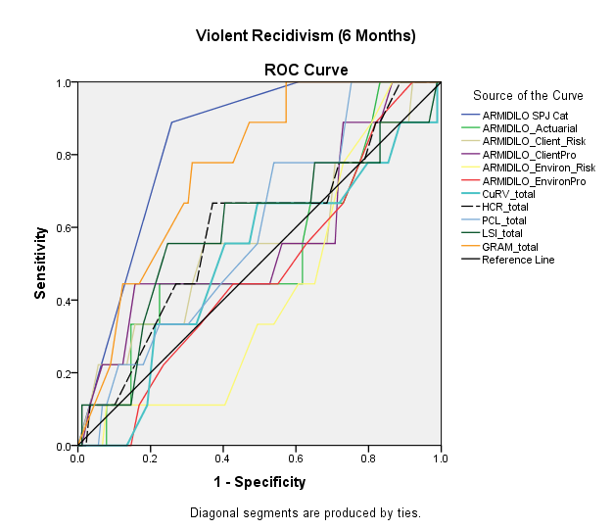
Violent Recidivism (6mth)

Slide 37
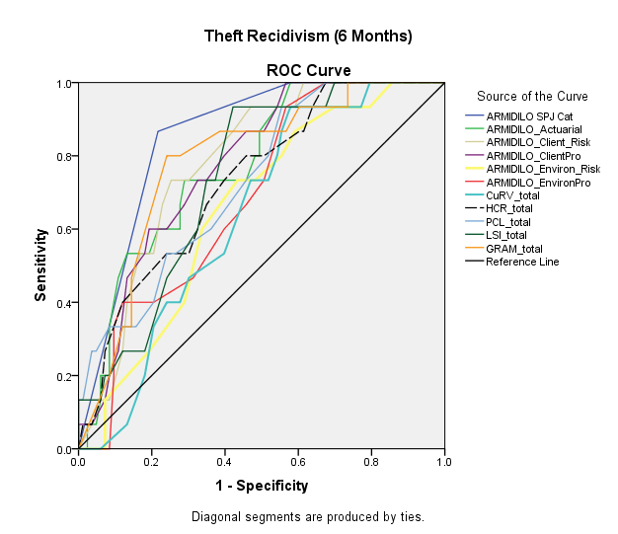
Theft Recidivism (6mth)

Slide 38
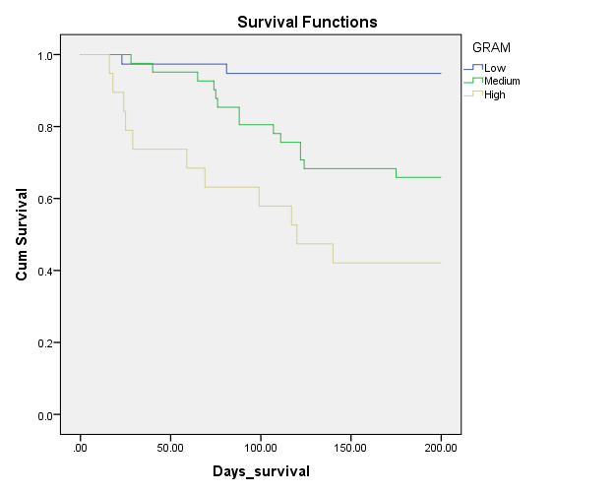
Survival -GRAM

Slide 39
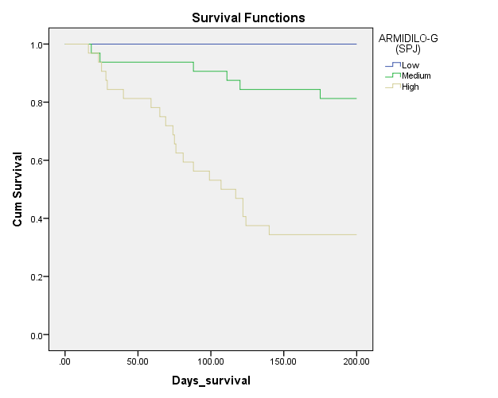
Survival – ARMIDILO-G SPJ

Slide 40
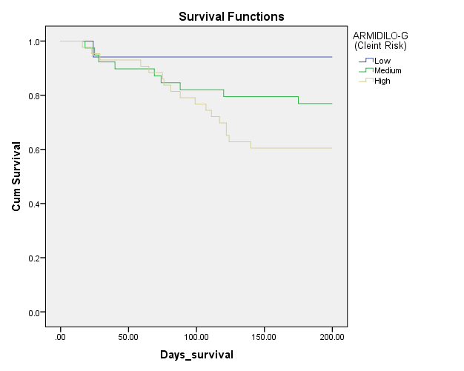
Survival – ARMIDILO-G Clinical Risk

Slide 41
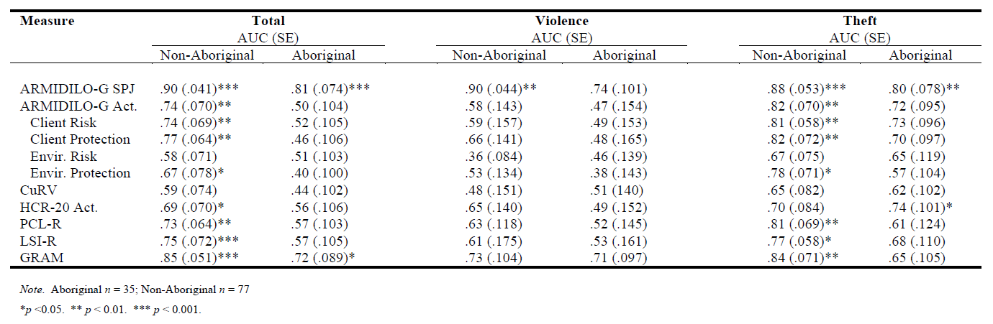
Aboriginal Participants AUC

Slide 42
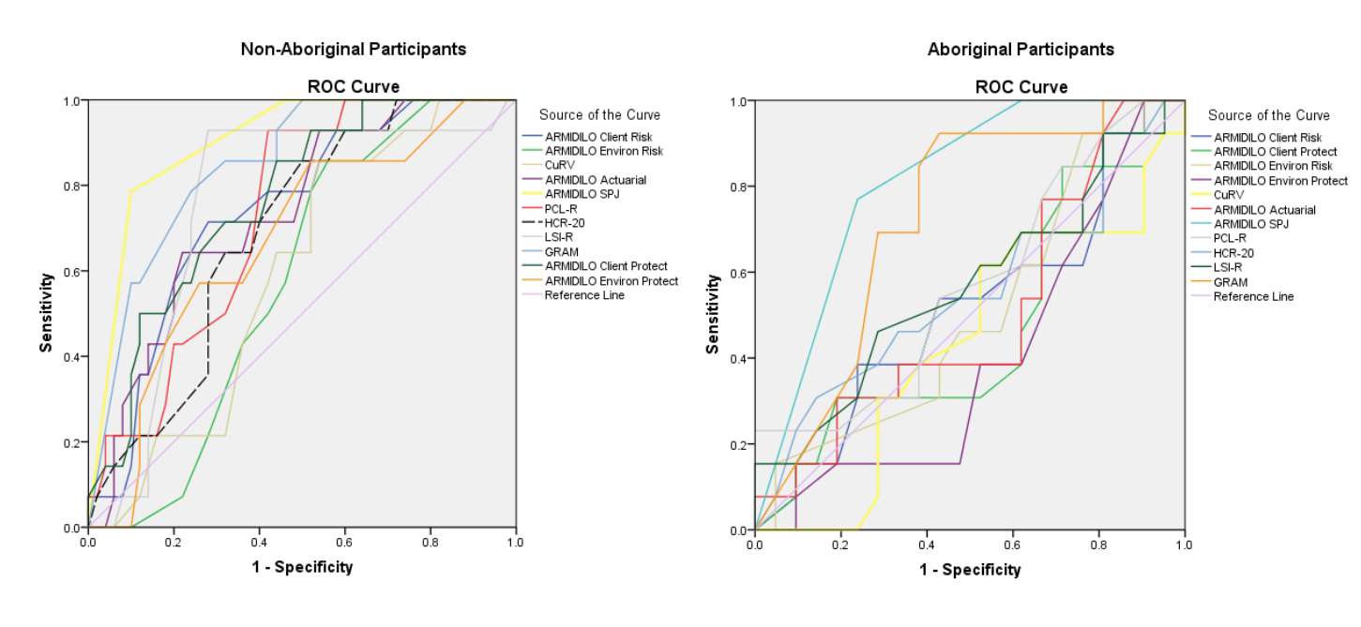
Aboriginal Participants

Slide 43
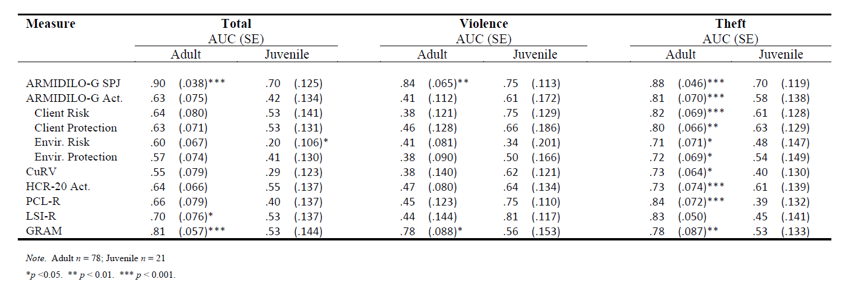
Juvenile Participants AUC

Slide 44
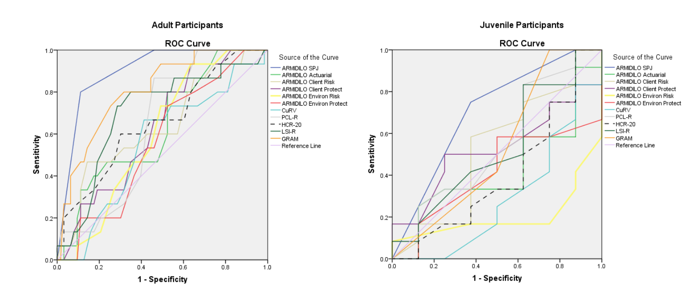
Juvenile Participants

Slide 45
Limitations
Small sample
A non-representative sample?
Affect of ARMIDILO-G assessment
Use of direct care staff
Limitation of information for comparison measures
Challenges of assessing SPJ tools

Slide 46
Conclusions
ARMIDILO-G (SPJ) and GRAM useful in prediction
Advantages of both in unique circumstances
Importance of question
  Prediction?
  Prevention?
Importance of age and aboriginality
Poor predictive ability of environmental items
Poor prediction of protective items
Concern regarding common current tools used (such as the LSI-R)

Slide 47
Future Direction
Examine influence of ARMIDILO-G as an intervention structure
Use of broader samples across jurisdictions
Examine mechanisms of SPJ approach

