Slide 1
Is a community court a program or a partnership?: Evaluation scope and design issues
Stuart Ross & Karen Gelb, University of Melbourne
BOCSAR Applied Research in Crime and Justice Conference:
February 2015

Slide 2
Presentation outline
Summary of the T&I paper
Standard governmental evaluation metrics
Methodological problems with this approach
Problem solving courts as a form of collaborative governance
Evaluating collaborative governance
Example of Primary Care Partnerships
Translate PCP program logic into justice outcomes

Slide 3
Criminal justice programs and partnerships
Program: a therapeutic or developmental or support intervention that targets one or a small number of related deficits
eg cognitive skills training, post-release housing
Partnership: collaborations in delivering or coordinating services that address a range of needs in a target population
common in health and human services sectors, not so common in justice
eg Primary Care Partnerships, Integrated Family Violence service networks

Slide 4
Community justice as a partnership
NJC offers multiple rather than single interventions
NJC as an assessment and service gateway
Important outcomes take place “outside” the NJC
Community justice is a “place-based” strategy where community engagement is a core element

Slide 5
Neighbourhood Justice Centre goals
Prevent and reduce criminal and other harmful behaviour in the City of Yarra by
Improving the community’s capacity to prevent and manage the impacts of crime/harm
providing dispute resolution and restorative justice practices
enhancing offender accountability and thereby reducing recidivism
Increase confidence in and access to the justice system for the Yarra communities through
two-way engagement between the justice sector and Yarra Communities
improving community understanding of legal and human rights
providing support services to victims of crime
Further develop the NJC justice model and facilitate the transfer of its practices to other courts and communities

Slide 6
Program evaluation outcomes for community justice
Evaluation outcomes consistent with “program” orientation & DTF evaluation guidelines
Reduced crime rates
Improved order compliance
Reduced recidivism

Slide 7
Limitations to this approach
The problem of attribution
Order compliance needs to take into account the risk profile of offenders
Recidivism measures also require the measurement of a range of covariates (risk-dependency) and relatively large group sizes (~200)

Slide 8
Order compliance outcomes by assessed risk level
Table 1: Proportion of unsuccessful orders finalised from July 2008 to June 2011.
Site | Low Risk | Moderate Risk | High Risk | Total
NJC | 25.6% | 13.6%** | 23.1%** | 22.8%*
Comparison 1 | 19.3% | 34.0% | 61.5% | 29.7%
Comparison 2 | 14.9%** | 36.5% | 62.7% | 30.9%
Comparison 3 | 18.9% | 42.6% | 72.7% | 37.0%*
Comparison 4 | 23.5%* | 40.4% | 63.9% | 37.4%*
State-wide | 18.1% | 35.3% | 59.9% | 30.1%

Slide 9
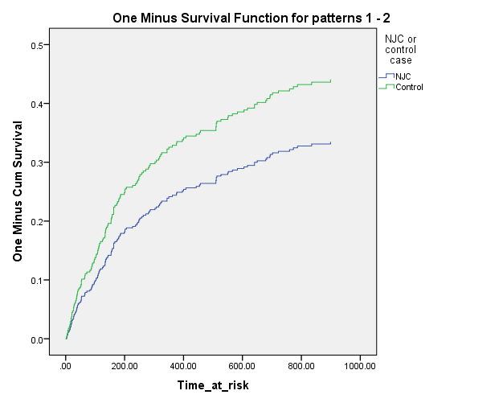
Survival functions for NJC and matched comparison group

Slide 10
Evaluating collaborative interventions at the NJC
Multiple versus single interventions
Need to be able to scale the investment in each participant and look for the relationship between this investment and the individual and social outcomes that are produced
Service gateway role
Engagement and retention rates for services delivered within and outside the NJC
Does partnership-based referral change the quality of service provider interactions with clients? (eg as a result of compliance reporting obligations)
Positive or negative interactions with other service requirements

Slide 11
Evaluating collaborative interventions at the NJC
Measuring outcomes that take place “outside” the NJC
Compliance or retention with treatment/support services
Self-directed care
Long-term (> 1 year) health, mental health, housing outcomes, financial security
Community justice is a “place-based” strategy where community engagement is a core element
Engagement with local organisations/social capital
Service integration outcomes

Slide 12
Challenges for evaluating collaborative interventions
Need for more developed theory around partnership based interventions
Eg integrated family violence services
“Hidden” and indirect costs and benefits: allocative and distributional transfer effects
How much of the outcomes from community justice represent new versus transferred outcomes?
Do CJS initiated outcomes compete with outcomes in other sectors? (eg Housing)

Slide 13
What is the counter-factual?
Measuring the costs of doing nothing
Conventional CBA analysis examines monetised benefits of outcomes against marginal costs (usually costs of avoided negative outcomes versus intervention supply costs)
But costs of “doing nothing” are not necessarily zero.
Access Economics estimate for annual cost of family violence of $4.5 billion, homelessness costs of $1M to $5.5M per person to age 21
But we lack “do nothing” estimates of the cost of many forms of social problems and disadvantage

Slide 14
Application to other justice partnership/programs
Potential application of this approach to partnership/programs that offer multiple interventions, act as a service gateway, where outcomes take place outside the program boundary:
Integrated family violence service networks
Post-release support programs
Multi-systemic therapy approaches in juvenile justice
Criminal justice / mental health programs

