Slide 1


The longitudinal relationship between alcohol availability and family violence in Victoria
Michael Livingston

Slide 2
Alcohol and family violence
Long and complex research history
Good evidence that intoxication co-occurs with incidents of partner violence (estimates vary between ~25% and 60%)
Causal mechanism is complex
Alcohol is not a necessary and sufficient cause
Concern over alcohol being used to excuse offender or stigmatise victim
Reasonable evidence that at least some instances of IPV would not have occurred without the involvement of alcohol (WHO , 2010)
Limited research assessing the effects of alcohol policies on rates of IPV

Slide 3
Alcohol policy and family violence
Recent review by Wilson et al. (2014)
Few studies, even fewer well-designed studies
Suggestive evidence on pricing/taxation (although only 1 of 3 studies found significant effects)
Reasonably strong evidence for community restrictions (although studies usually have weak designs)
E.g. Halls Creek, WA – alcohol stronger than 2.7% not sold as packaged liquor, sales not permitted before midday.
Reduction of between 25%-50% in police records of domestic violence
What about more gradual changes in availability?

Slide 4
Relationship between neighbourhood level availability and alcohol problems
A large and growing research literature
Generally based on aggregate-level measures of alcohol availability (e.g. alcohol outlet density) and problems (e.g. assault rates).
Studies use complicated statistical models to adjust for geographical nature of their data
Associations are usually tested cross-sectionally, with a wide range of controls
Increasingly longitudinal models are being developed to assess the affect of change over time

Slide 5
Research evidence
Links between outlet density and:
consumption and drinking patterns,
drink-driving and traffic accidents,
assault, homicide and other violent crimes,
child abuse and neglect,
sexually transmitted diseases,
drunkenness and neighbourhood disturbances,
property damage and vandalism, and
personal injury
Most small-area research from the late 1990s onwards

Slide 6
Research evidence
Studies mostly come from US cities
Gradually emerging from other settings
Largely based on cross-sectional designs
Increasing number of longitudinal studies that generally support the cross-sectional findings
Big picture: rates of harm seem to be associated with alcohol availability at the local level
Variety between setting to setting, outcome to outcome and across licence types
Wide range of outcomes examined

Slide 7
Alcohol availability and family violence
Limited evidence base
Studies all from the US or Australia
Mostly cross-sectional, using a mix of self-report and administrative data
Mixed findings – most studies found some association, but the relationships between particular types of outlet and IPV varied, and were sometimes entirely mediated by alcohol consumption
Two longitudinal studies from California
One found that packaged liquor outlets were associated with police-recorded IPV, the other found that bars were associated with ED presentations related to IPV

Slide 8
Alcohol availability and family violence
Potential mechanisms
Small changes in availability have small affect overall consumption, changing rates of intoxication and therefore violence (crude availability theory)
Changes in types of availability change contexts of drinking and shift the types of harms that occur
Gradual changes in availability affect drinking particularly for marginalised heavy drinkers, who may have higher rates of family violence

Slide 9
The current study
Examines the postcode level relationship between alcohol availability and police recorded family violence in Melbourne over a ten year period
Makes use of a major natural experiment in Victorian alcohol availability
Relies on administrative data from liquor licensing regulator, Victorian Police and the ABS
The first longitudinal analysis of Australian data on this topic

Slide 10
Victorian policy changes
Historically Victoria had a conservative and restrictive approach to licensing
Strong temperance movement
Government closed ~ 1,000 hotels over a decade from 1906-1916
More than 40% of the population voted for prohibition in 1918
Maintained 6pm closing longer than other states
Gradual liberalisation over the second half of the 20th century
Dramatically liberalised through the 1980s and 1990s

Slide 11
Victorian policy changes
Niewenhuysen Review
Completely overhauled the licensing system, making it much easier to get new licences, removing a wide range of restrictions and requirements
Aiming to shift Victoria to a European style drinking culture
Followed by Kennett Government changes in the 1990s
Brought on by Crown Casino and National Competition Policy
Key change: removed cap on ownership of packaged liquor outlets allowing Coles/Woolies to expand dramatically

Slide 12
Effects of regulatory changes

Slide 13
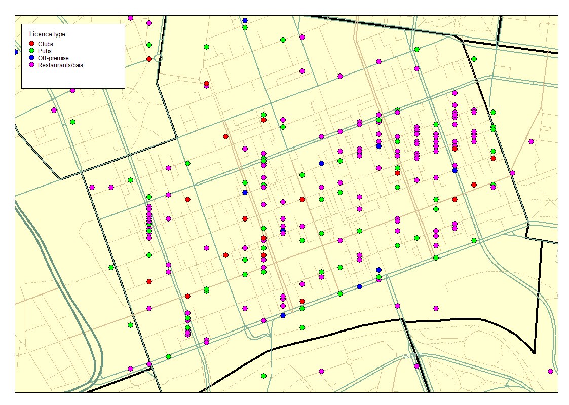

Slide 14
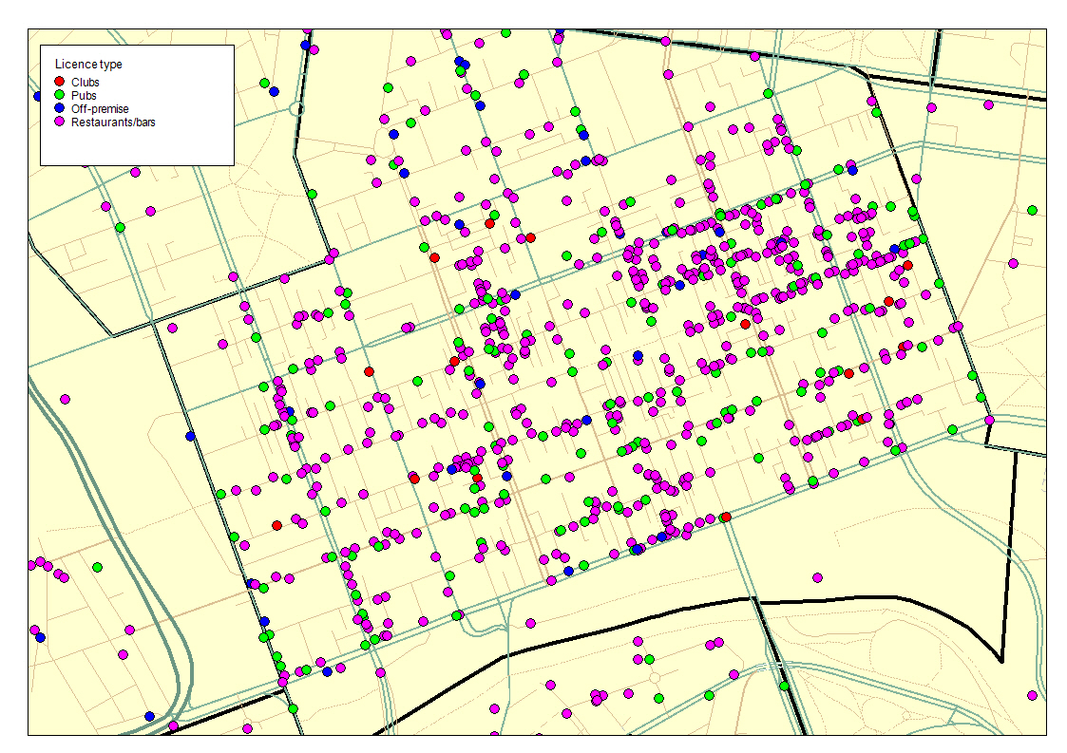

Slide 15
This study
Uses data from 186 consistently defined postcodes in Greater Melbourne, 1996-2005
Three different types of outlet:
General licences (pubs, selling alcohol for both on- and off-premise consumption)
On-premise (restaurants, bars and some nightclubs)
Packaged (bottle shops, supermarkets, etc)
Domestic violence based on police records of ‘family incidents’
Records of an offence involving family violence
Data on male-to-female, female-to-male, partner- or other family violence not available
Measures of alcohol involvement not reliably recorded, so total rates used (increasing the likelihood of null findings)

Slide 16
This study
Modelling
Trends in socio-economic status were controlled for
Using ABS SEIFA index of relative disadvantage from Censuses in 1996, 2001 and 2006
Socio-economic status has been linked to both reporting rates for family violence and alcohol outlet density, so an important potential confound
Spatially explicit fixed-effects models were developed
Modelling spatial structure is necessary as study units are not strictly independent
Fixed effects for postcode and year of study included to avoid spurious relationships due to either overarching trends or unmeasured characteristics of neighbourhoods

Slide 17
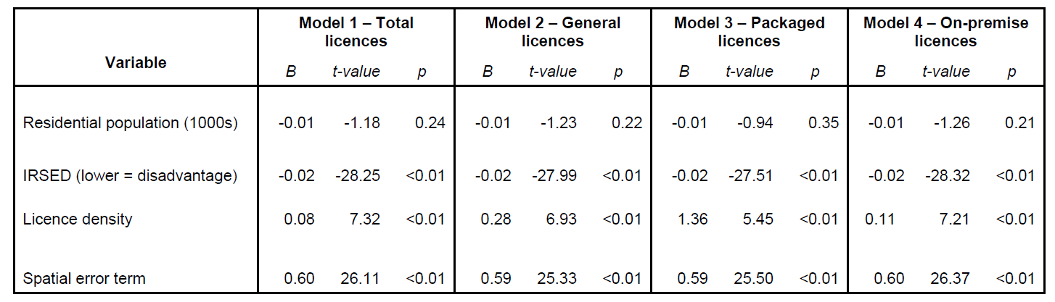
Results
Running separate models for each outlet type

Slide 18
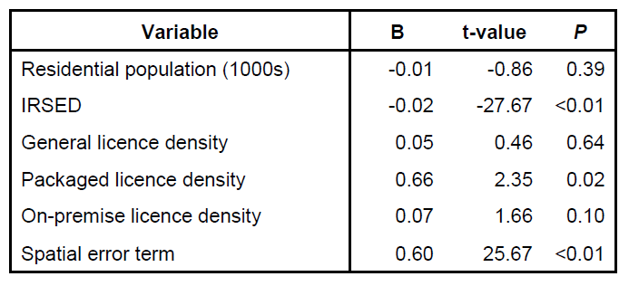
Results
Including all licence types in the same model

Slide 19
Results
Including all licence types in the same model

Slide 20
Results
Across the study area, changes in packaged liquor licence densities are significantly, positively associated with changes in rates of family violence
Effects are relatively small – a 10% increase in packaged liquor density in a neighbourhood is associated with a 3.3% increase in reported rates of domestic violence
Not hugely useful for policy
Blanket policy is not plausible (or desirable).
More important: what kinds of outlets matter in what kinds of neighbourhood?

Slide 21
Modelling differential effects across neighourhood types
Develop separate models for five clusters of neighbourhood types (derived using cluster analyses)
No detailed data available over time to compare different types of outlet within licence categories
E.g. No data on sales, floorspace, trading hours, turnover, etc

Slide 22
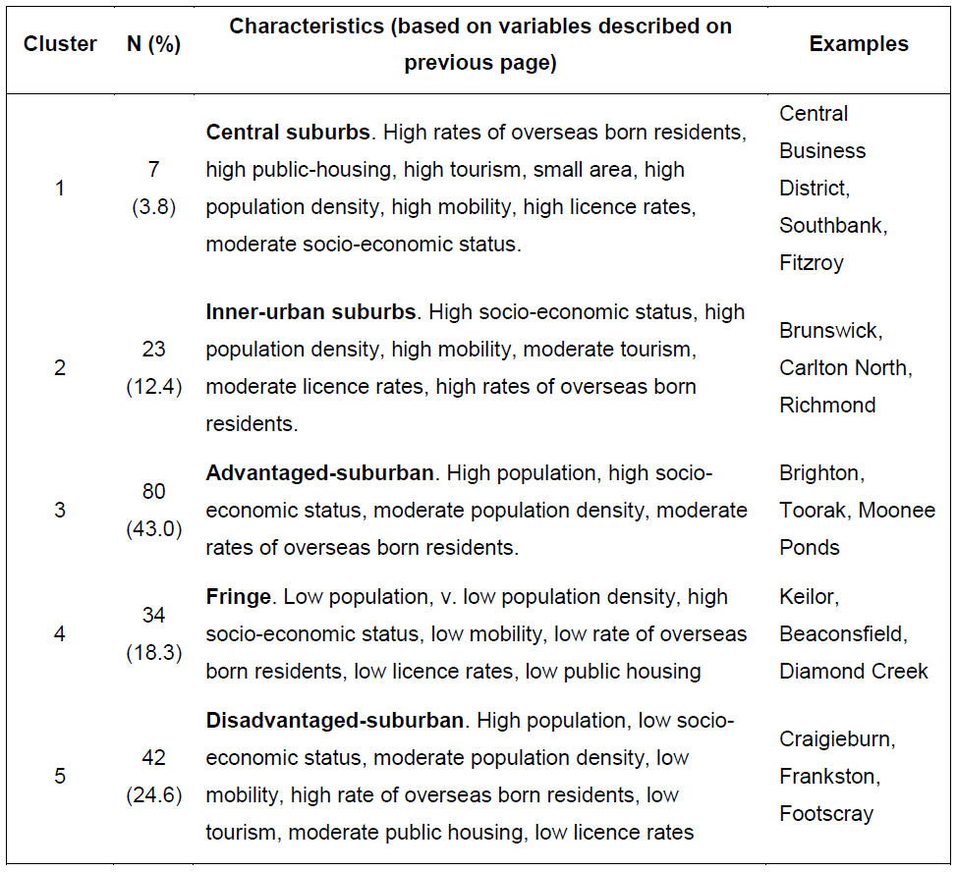
Postcode clusters

Slide 23
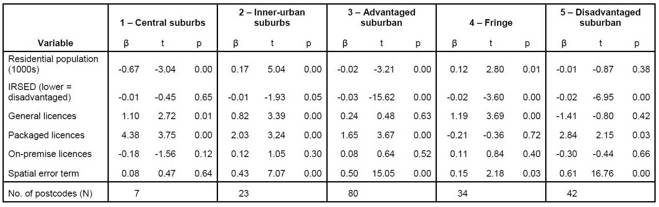
Results

Slide 24
Results
Neighourhood-specific results
Packaged liquor outlets were significant in all types of neighbourhood except the ‘fringe’ areas
Pubs were significant in three neighbourhood types, but with much smaller effects than packaged liquor in two
On-premise outlets were not significant in any neighbourhood types

Slide 25
Conclusions
Suggestive evidence that alcohol outlet density at the neighbourhood level is associated with family violence
Part of a complex causal web and unlikely to be the most important factor in determining rates of family violence (effect sizes quite small)
Packaged liquor seems particularly important
Relationships vary across neighbourhood types – largest effects in the central suburbs and in socio-economically disadvantaged neighbourhoods

Slide 26
Conclusions
Some substantial limitations
Relying on aggregate measures of alcohol outlet density which greatly simplify the actual availability
Police records of family violence highly influenced by reporting behaviours (crime victimisation survey data suggest less than 40% of offences are reported)
Limited neighbourhood-level control variables available

Slide 27
Implications for policy
The results add to the Australian evidence that increasing the availability of alcohol has potential negative effects
Previous longitudinal studies have identified relationships between outlet density and general violence as well as alcohol-specific chronic disease
Contradicts the assumptions evident in many policy reviews justifying liberalisation (i.e. that increased competition has no downside)
Suggests broader range of outcomes need to be considered in licensing and planning decisions (Victorian hearings tend to focus on ‘amenity’ issues)
Shouldn’t undermine broader policy agendas aimed at reducing domestic violence

