Slide 1
The impact of community-based drug and alcohol treatment on reoffending in Indigenous communities
Anthony Morgan, Tracy Cussen, Alex Gannoni & Jason Payne
Applied Research in Crime and Justice Conference
18 February 2015

Slide 2
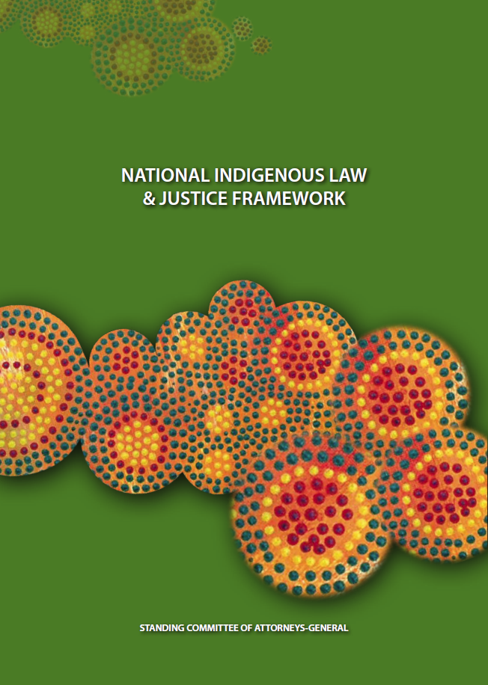
Background
  National Indigenous Law and Justice Framework
  Previously funded evaluations of sentencing courts and conferences, offender support and reintegration, diversion programs and night and community patrols
  Goal 4: Increased safety and a reduction in offending within Indigenous communities by addressing alcohol and substance misuse.

Slide 3
Importance of drug and alcohol treatment
  High rates of substance misuse within some Indigenous communities
  Significant consequences for individuals, families and communities
  Contributes to high rates of offending, victimisation and overrepresentation in the CJS
  Evidence that drug and alcohol treatment is an effective response to AOD misuse and in reducing reoffending

Slide 4
BUT…there are significant gaps in our evidence base around the effectiveness of treatment for Indigenous people

Slide 5
Evaluation methodology
  Interviews and focus groups with program staff and clients
  Analysis of client case files
  Program entry and exit assessment
  Analysis of reoffending using police and court data

Slide 6
Overview of evaluated drug and alcohol programs
 | Program A | Program B | Program C | Program D
Primary goals | Reduce harm from AOD use | Reduce alcohol misuse and related harms | Successful rehab of substance misuse, abuse and domestic violence issues | Reduce AOD abuse in a healing environment
Location | Northern Territory | Northern Territory | New South Wales | Victoria
Program duration | 12 weeks | 12-24 weeks | 8-26 weeks | 16 weeks
Capacity | 20 clients | 50 clients | 12-14 clients | 8-10 clients
Indigenous specific | No | No | Yes | Yes
Target population | Adult males and females (incl couples) | Adult males and females (incl couples) | Adult males | Young males 14-25 years
Model | Residential rehabilitation | Residential rehabilitation | Healing centre | Healing centre
Treatment approach | Harm minimisation and abstinence | Harm minimisation and abstinence | Harm minimisation and abstinence | Harm minimisation and abstinence

Slide 7
Program participants and participation (%)
 | Program A | Program B | Program C | Program D
Indigenous | 100 | 94 | 90 | 100
Male | 80 | 75 | 100 | 100
Principal drug of concern
Alcohol | 98 | 98 | 70 | 35
Used daily | 57 | 44 | 71 | 89
Referral source
Criminal justice referral | 80 | 77 | 62 | 46
Mandated to participate (CJS referrals only) | 90 | 77 | 61 | 92
Program status
Completed | 36 | 68 | 50 | 41
Terminated | 35 | 11 | 46 | 35
Absconded | 25 | 21 | 4 | 8
Mean days (completed) | 98 | 81 | 109 | 101

Slide 8
Improvements in client health and wellbeing (program completers only)
  Physical and mental health (programs A, B & C)
  Social skills and relationships (program C)
  Employment readiness and status (programs A & B)
  Living arrangements (programs A & C)

Slide 9
Residential rehabilitation provides opportunities for respite – a break from challenging circumstances, family pressures and problems with police

Slide 10
Time to first offence following treatment, by completion status, Program A (% survived)

Slide 11
Cox regression predicting reoffending (any offence) among program participants, Program A
 | hr | 95% CI (lower) | 95% CI (upper) | p
Completed program (vs did not complete) | 0.43 | 0.25 | 0.74 | 0.002
Male (vs female) | 1.22 | 0.71 | 2.08 | 0.476
26 to 30 years (vs 17 to 25 years) | 1.00 | 0.53 | 1.90 | 0.999
31 to 40 years (vs 17 to 25 years) | 0.87 | 0.51 | 1.49 | 0.611
41 years or older (vs 17 to 25 years) | 0.49 | 0.24 | 1.01 | 0.054
CJS referral (vs other referrals) | 1.51 | 0.92 | 2.48 | 0.100
Violent offence before treatment (vs any other offence) | 2.14 | 1.05 | 4.34 | 0.036
21–40 prior offences to treatment (vs 0–20 prior offences) | 1.56 | 0.85 | 2.86 | 0.156
41 or more prior offences to treatment (vs 0–20 prior offences) | 2.53 | 1.38 | 4.64 | 0.003
Model chi square | 53.58
Log likelihood | -360.49
p | 0.00
n | 132
Limited to those offenders whose had entered into treatment between June 2010 and July 2012
Source: AIC, Indigenous drug and alcohol treatment database [computer file]

Slide 12
Negative binomial regression predicting frequency of offending, Program A
 | IRR | 95% CI (lower) | 95% CI (upper) | p
Completed program (vs did not complete) | 1.50 | 0.90 | 2.51 | 0.120
Male (vs female) | 1.69 | 1.07 | 2.68 | 0.024
26 to 30 years (vs 17 to 25 years) | 0.60 | 0.35 | 1.01 | 0.056
31 to 40 years (vs 17 to 25 years) | 0.70 | 0.43 | 1.13 | 0.142
41 years or older (vs 17 to 25 years) | 0.23 | 0.12 | 0.42 | 0.000
CJS referral (vs other referrals) | 1.12 | 0.75 | 1.66 | 0.575
Violent offence before treatment (vs any other offence) | 1.90 | 1.07 | 3.40 | 0.030
21–40 prior offences to treatment (vs 0–20 prior offences) | 0.95 | 0.55 | 1.63 | 0.845
41 or more prior offences to treatment (vs 0–20 prior offences) | 2.06 | 1.26 | 3.38 | 0.004
31 to 40 years and completed program (vs all others) | 0.17 | 0.07 | 0.45 | 0.000
Model chi square | 70.02
df | 10
p | 0.000
n | 132
Limited to those offenders whose had entered into treatment between June 2010 and July 2012
Source: AIC, Indigenous drug and alcohol treatment database [computer file]

Slide 13
Time to first offence following treatment, by completion status, Program B (% survived)

Slide 14
Comparison in offending frequency among Program B participants before and after treatment episode (based on number of offences per 365 free days)
 | Pre-treatment |  |  | Post-treatment
 | n | Mean | Median | n | Mean | Median
30 days or less | 68 | 3.5 | 1.9 | 68 | 2.3 | 1.4
31–75 days | 48 | 3.8 | 1.7 | 48 | 2.4 | 1.3
More than 75 daysª | 83 | 3.6 | 2.9 | 83 | 2.7 | 1.2
a: p<0.05
Source: AIC, Indigenous drug and alcohol treatment database [computer file]

Slide 15
Time to first offence following treatment, by completion status, Program C (% survived)

Slide 16
Cox regression predicting reoffending (any offence) among program participants, Program C
 | hr | 95% CI (lower) | 95% CI (upper) | p
80 days or more in program (vs less than 80 days) | 0.64 | 0.34 | 1.20 | 0.164
26 to 30 years (vs 25 years and under) | 1.71 | 0.66 | 4.43 | 0.273
31 to 40 years (vs 25 years and under) | 1.36 | 0.59 | 3.13 | 0.465
41 years or older (vs 25 years and under) | 0.64 | 0.26 | 1.58 | 0.332
CJS referral (vs other referrals) | 1.40 | 0.73 | 2.65 | 0.310
Violent offence before treatment (vs any other offence) | 3.21 | 0.92 | 11.18 | 0.067
21–40 prior offences to treatment (vs 0–20 prior offences) | 2.76 | 1.34 | 5.68 | 0.006
41 or more prior offences to treatment (vs 0–20 prior offences) | 2.70 | 1.15 | 6.31 | 0.022
Model chi-square | 34.09
Log likelihood | -204.78
p | 0.000
n | 120
Limited to those offenders whose had entered into treatment between June 2010 and July 2012
Source: AIC, Indigenous drug and alcohol treatment database [computer file]

Slide 17
Summary of key findings
  Positive impact on health and wellbeing outcomes
  Promising evidence of impact on reoffending
  No significant difference in outcomes between CJS referrals and other referral sources
  Breadth of service delivery is important
  Program location matters
  Multiple factors contribute to the impact of treatment in the community

Slide 18
Study limitations
  Comparison group
  Accounting for free time
  Small sample sizes
  Administrative data on program participation
  Capacity to follow clients post-treatment
  Reliance on case manager assessments
  Changes to programs

Slide 19
Did the programs have an impact or was it the motivation to change?

Slide 20
Some reflections about the evaluation of programs in Indigenous communities
  Need to evaluate programs outside of the criminal justice system
  Build evaluation capacity within community-based organisations
  Establish mechanisms that encourage regular assessments of program outcomes

Slide 21
The impact of community-based drug and alcohol treatment on reoffending in Indigenous communities
Anthony Morgan, Tracy Cussen, Alex Gannoni & Jason Payne
Applied Research in Crime and Justice Conference
18 February 2015

