Slide 1
The effectiveness of suspended sentences in reducing reoffending
Professor David Tait
and
Dr Karen Gelb
Justice Research Group
University of Western Sydney
BOCSAR, Sydney, 18-19 February 2015

Slide 2
Overview
What’s happening in criminal justice policy?
What do we know about reoffending?
What are the implications for criminal justice policy?

Slide 3
Background: What’s happening in CJ policy?
Rapid change in CJ policy in recent years across Australia:
  Introduction or strengthening of mandatory sentences (WA, NT, QLD, SA, Vic)
  Laws targeting specific offenders, such as bikie gangs (QLD)
  Laws targeting specific offences, such as one-punch assaults (Vic, NSW)
  Increasing use of imprisonment, for longer terms (QLD, Vic)
  Punitive attitudes to prisoners, such as proposed pink uniforms for gang members (QLD)
  Tightening of parole (Vic)
  Abolition of suspended sentences (Vic, TAS?)

Slide 4
Background: Why is this an issue?
Impact of more punitive CJ policy on community safety:
  40% increase in Australian prison population over last decade (10% just in past year)
  Prison overcrowding reduces availability of rehabilitation programs (Vic ombudsman report)
  Impact of lack of rehab on reoffending; impact on availability of parole (see Vic)
  Increasing rates of reoffending (RoGS – return to prison rates increasing)
  If prison populations continue to increase, will we become less safe?

Slide 6
Background: Why is this an issue?
  Need to have a good understanding of reoffending following sentencing – what works to reduce reoffending – if we are to have an effective criminal justice system
  In particular, need to know what works, for whom, and under what circumstances
  For example, how does imprisonment compare with suspended sentences in reducing reoffending? Do they work better for some offenders than others?
  This is an important issue as the line between the two sentencing options can be porous, with some degree of overlap in the types of offender/offence for which the orders are used

Slide 7
What do we know about reoffending?
Methodological approaches used in research into reoffending outcomes following different sentences:
  Regression studies
  Matching studies
  Experimental/quasi-experimental studies

Slide 8
What do we know about reoffending?
Regression studies:
  This was the most common approach until a few years ago
  Studies often found a statistically significant effect of sentence type, with imprisonment leading to the highest rates of reoffending, and suspended sentences having lower rates of reoffending
  PRO – controls for multiple factors at once
  CON – unobserved attributes of offenders may influence both the type of sentence received and the probability of reoffending (e.g. defendant age) – controls for but doesn’t match ‘like’ offenders

Slide 9
What do we know about reoffending?
Matching research:
  A common approach now is propensity score matching (used by BOCSAR)
  Typically match on factors such as age, gender, prior convictions, current offence type – factors that may influence sentence outcomes
  Matching studies also often find some difference in reoffending based on sentence type, although typically smaller than in regression studies
  Prison is more likely to have a criminogenic effect, with higher rates of reoffending than suspended sentences
  PRO – allows better control of possible influencing factors than regression studies
  CON – still can only match those factors that are measurable, relies on characteristics of offender/offence only (can’t account for other influences, such as sentencer)

Slide 10
What do we know about reoffending?
Experimental/quasi-experimental studies:
  Difficulty with true gold-standard random allocation studies in this field
  But ‘natural’ experiments are sometimes possible
  Swiss program allows offenders sentenced to up to 2 weeks prison to undertake community service instead
  Study using random allocation to these groups showed people in community condition had slightly fewer police contacts in subsequent 2 years than those sent to prison

Slide 11
What do we know about reoffending?
Experimental/quasi-experimental studies:
  And indirect experiments are sometimes possible
  Such an experiment is possible in those jurisdictions where there is random assignment of judges to defendants; to the extent that randomly assigned judges have different sentencing tendencies, at least some component of the sentences that defendants receive will be a function of chance, depending on judge assignment (e.g. ‘high-imprisonment’ judges vs ‘low-imprisonment’ judges)

Slide 12
What do we know about reoffending?
Experimental/quasi-experimental studies:
  Overall, experimental/quasi-experimental studies have shown little to no impact of imprisonment on reoffending
  PRO – allows random assignment in at least some respect
  CON – a true experimental study is virtually impossible so even this approach will always be limited

Slide 13
The current study
Studies have shown that suspended sentences may be able to reduce reoffending, although they also have the potential to increase imprisonment (via breaches)
But for whom do they work? Do we need to be more nuanced in our understanding of their impact?
Impact of suspended sentences on reoffending:
  Differential impact by Indigenous status?
  Differential impact by metro/rural location?

Slide 14
The current study
Data from NSW:
  Local courts
  2001-2008 reference period
  Initial offence committed 2001-02, followed up to 5 years
PSM – matched on:
  Bail status
  Age (log)
  Current offence severity
  Number of prior offences (log)

Slide 15
The current study
Compared outcomes following suspended sentences with those following imprisonment
Outcome measures:
  Any reoffending recorded in local court (incidence)
  Days to first reoffending (date of reoffending, not date of sentence) (time)
  Number of subsequent offences (frequency)
  Measured from date of sentence, not date of release for prisoners (therefore any incapacitative effect will be apparent; given that these are offenders sentenced in local courts, prison terms will be short)

Slide 16
Key findings
Focus on ‘strong’ matches: those with no more than one quartile separating the two matched cases on one or more of the matching variables
Overall:
  No difference in whether people reoffended at year 2,3,4 and 5 (incidence)
  But those on suspended sentences reoffended more quickly (time)
  Those sentenced to prison had more appearances resulting in sentence (frequency)
  (In year 1 those given a prison sentence were less likely to reoffend – likely due to incapacitation)

Slide 17
Key findings
Impact of offence type on these findings?
  Had to use ‘weak’ match (up to two quartiles separating two cases on one or more variables) to ensure adequate sample size
  Burglary (perhaps part of a criminal career) vs assault (perhaps more likely to be one-off offences) vs driving while disqualified (more common driving offences)
Small difference was found:
  Those sentenced to prison were more likely to reoffend
  This difference was virtually identical for each of the three offence types

Slide 18
Key findings
Impact of Indigenous status on these findings?
  Compared imprisonment vs suspended sentences for Indigenous offenders
  Compared imprisonment vs suspended sentences for non-Indigenous offenders

Slide 19
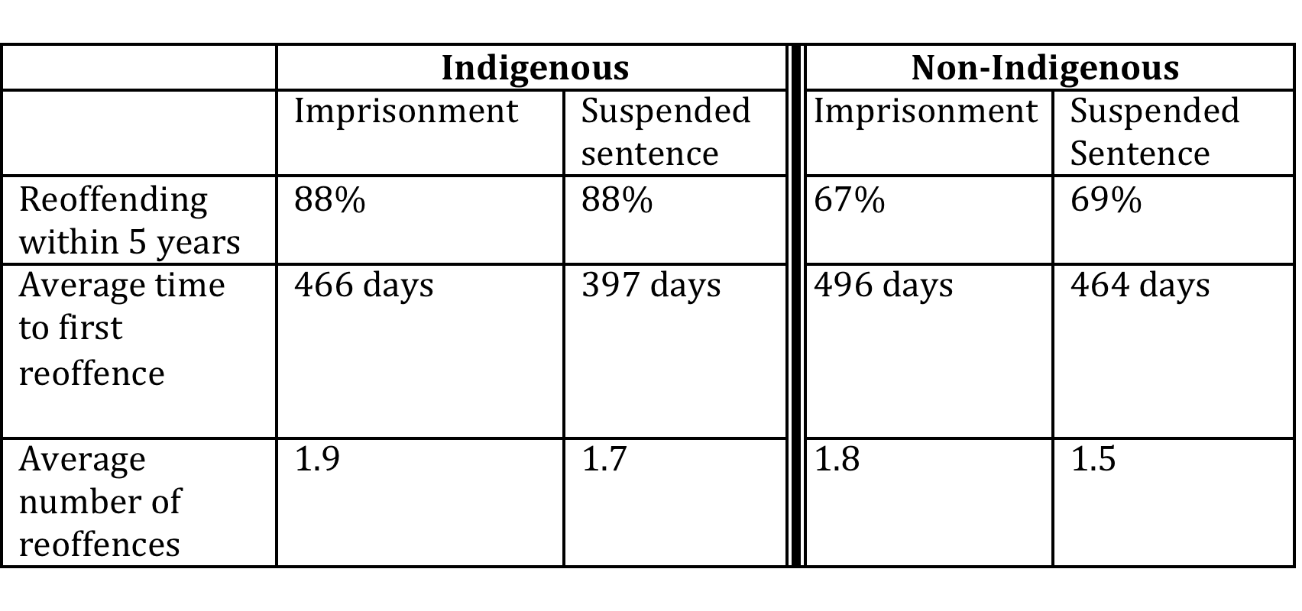
None of these differences is statistically significant (although patterns are the same)

Slide 20
Key findings
Impact of region on these findings?
  Compared imprisonment vs suspended sentences for Sydney metro offenders
  Compared imprisonment vs suspended sentences for non-metro offenders

Slide 21
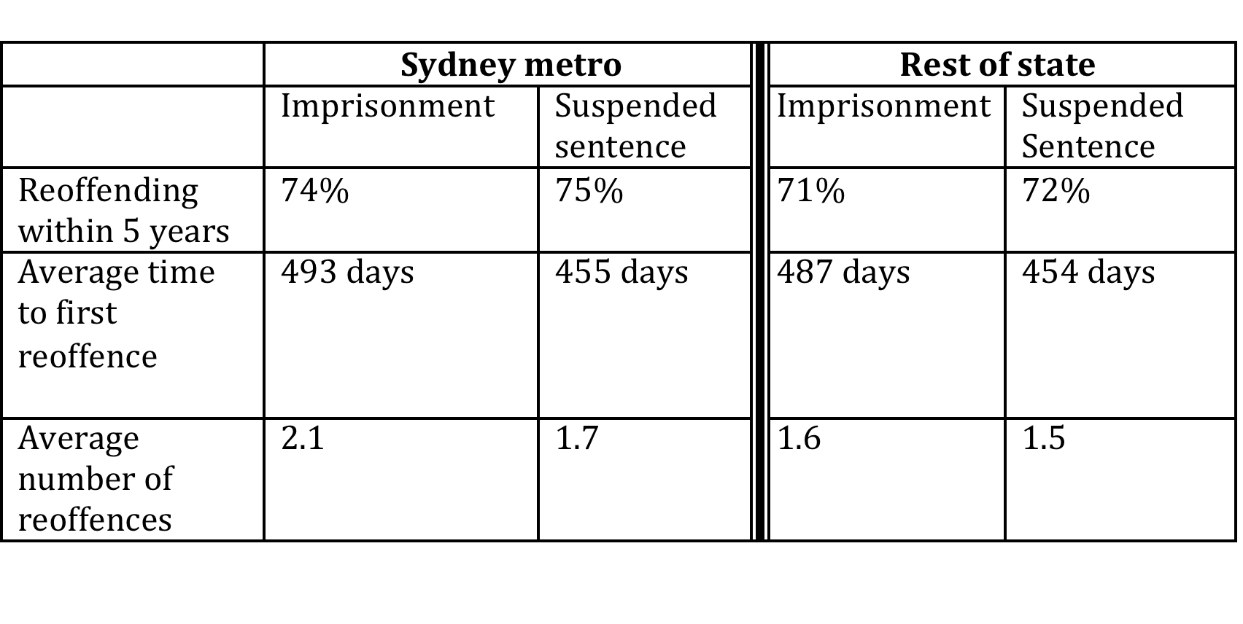
None of these differences is statistically significant (again, patterns are the same)

Slide 22
What are the implications for CJ policy?
Implications for reducing reoffending:
  The only pattern is the similarity between the reoffending patterns of those receiving the two sentences, but the differences are not statistically significant
  There is no evidence that suspended sentences are more or less effective for particular offence types or offenders: either there is no evidence that prison is criminogenic, or there is no evidence that suspended sentences are more effective than prison in reducing recidivism, or both
  If there is no difference in recidivism, then suspended sentences are a good option for avoiding the social and financial costs associated with imprisonment
  If one accepts this, then the abolition of suspended sentences in Victoria, and the proposed abolition in Tasmania, are cause for concern

Slide 23
Questions?

